Slide 1
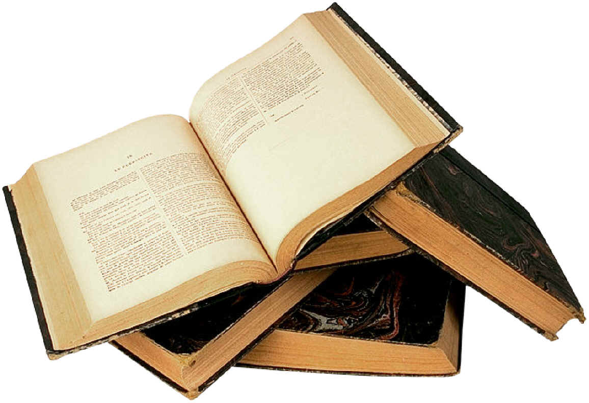
The Exam and Genre
Assessment Objectives.
Notes:
Aims and objectives. Introduction: overview of the Aos; tackling the question of the way in which this text adheres to or subverts the comic or tragic genre, applying our findings to the text, and completing a piece of work responding to either pp 6-7 or p 17. 5 mins

Slide 2
AO1 Apply concepts and methods from integrated linguistic and literary study as appropriate, using associated terminology and coherent written expression. 9%
AO2 Analyse ways in which meanings are shaped in texts. 12%
AO3 Demonstrate understanding of the significance and influence of the contexts in which texts are produced and received. 8.5%
Notes:
Students to summarise each AO to one word. Note the weightings. 5 mins The language of poetry and plays (02) Closed text 64 marks Written paper: 2 hours 32% of total A level

Slide 3
Plays: dramatic and stylistic analysis
• Use linguistic and stylistic approaches and an understanding of dramatic techniques to develop an analysis of the text
• analyse aspects of the text foregrounded through the use of repetition, pattern-making, pattern breaking and deviation
• explore dramatic techniques such as on-stage and off-stage action, paralinguistic features (gesture/ manner of speech/facial expressions), soliloquy, asides and dramatic irony
• Apply relevant methods for text analysis, drawing on linguistic and literary fields.
• Explore contexts and connections between the scene and the play as a whole, as well as literary and generic contexts.
consider the significance of relevant dramatic or other contexts
• make accurate references to texts.
• identify and describe how meanings and effects are created and conveyed through language
• use English and terminology appropriately and coherently
Notes:
In pairs: to decide which of these fits into which AO – these are taken from the specification (Content and Learners should be able to). Compare to following slides. 10 mins

Slide 4
AO1
Use linguistic and stylistic approaches and an understanding of dramatic techniques to develop an analysis of the text
use English and terminology appropriately and coherently
explore dramatic techniques such as on-stage and off-stage action, paralinguistic features (gesture/ manner of speech/facial expressions), soliloquy, asides and dramatic irony
Apply relevant methods for text analysis, drawing on linguistic and literary fields.

Slide 5
A02
analyse aspects of the text foregrounded through the use of repetition, pattern-making, pattern breaking and deviation
make accurate references to texts.
• identify and describe how meanings and effects are created and conveyed through language

Slide 6
AO3
Explore contexts and connections between the scene and the play as a whole, as well as literary and generic contexts.
consider the significance of relevant dramatic or other contexts

Slide 7
Some Ingredients of a Shakespearean comedy
A celebration
An argument or misunderstanding
A new arrival
Legal order or decree from someone in authority
Character (villainous) is punished or expelled
A journey to another space
A muddle/disguise adopted/malicious trick exacted
Thwarted love
Muddle/misunderstanding sorted/disguise thrown off
Journey back
Reconciliation of characters
Festival, carnival, party, marriage
Notes:
Hand out Shakespearean comedy structure cards. They need to find their pair: a match for the ingredient from Jerusalem. 10 mins

Slide 8
Serving Notice F-17003 in contravention of the Public Health Act of 1878 (p 7)
A man, PARSONS, in a suit with a reflective jacket and case enters the copse. (p 6)
You now have just over two hours to submit to the enforcement notice and quit this site or you will be forcibly evicted. (P 94)
Kids come here. Half of them are safer here than they are at home. You got nowhere else to go, come on over […] What do you […] think an English forest is for? (P 98)
And, you know what they done? They undone their flies and they pissed on you too. (P 82)
It’s Lee and Davey. We’ve come … we’ve come to say sorry. (P85)
There will be free booze, bangers, draw, whizz and whatnot, for all the minions of my kingdom. P50
I’m only the May Queen till six o’clock. After six that’s that. I’m just Phaedra Cox again. P 105
The trailer door opens. PHAEDRA, still dressed as a fairy, comes out. P 84
We’re not friends. I’m not your friend. I’m Johnny Byron. I’m nobody’s friend. Is that clear? You and all these rats. Just leave me alone. P 106
Tanya, I’ve listened to the offer. I respect the offer. I do not want to eat your peaches. P72
I ain’t going up the fair today. p46
Notes:
Other students are given various events from Jerusalem. The pairs should attempt to find each other. Discuss the connections. Discuss whether anyone is missing a pair, and why that might be. If they have found a pair find the two connections between them, and find one more example. If they haven’t found a pair, try and find an example from the text, or a reason why there might not be one. 20 mins

Slide 9
Order… what has happened in Jerusalem?
Reconciliation of characters
Festival, carnival, party, marriage
Notes:
Discussion about what has happened in terms of the comedic structure. Where does the festival come in the play? Where does the reconciliation appear? What has Butterworth done? 5 mins Lead to the idea that perhaps it is a tragedy?

Slide 10
Aristotle (384-322 BC) provided a structure for the genre of tragedy
For each stage, work in a pair to find a quote to illustrate it. Include the page reference.
From the start, there are clues that all will not be well
The hero starts at a high position of happiness, prosperity and success
The hero, due to some tragic flaw in his nature, begins to fall and reaches a moment of extreme suffering (“pathos”)
This results in “anagnorisis”, where the hero begins to understand and realise his mistakes
There is a cleansing of the old order; the hero dies and another one prepares to take over
Through the hero’s suffering and death, the audience experiences “catharsis” – a kind of purification.
Notes:
In pairs to repeat with tragedy – plotting an event against each stage of the Greek tragedy. Does it fit more neatly? Could you repeat this with any structural overview? Discuss. 20 mins

Slide 11
Comedy or tragedy?
Decide in pairs whether this text sits more neatly in comedy or tragedy
Select the single event that proves that Jerusalem is adhering to either the comic sub-genre.
Select one event/quote to prove that it is adhering to the tragic sub-genre.
Notes:
What do we deduce about the employment of the Shakespearean comedic structure? What do we deduce about the relevance of the Greek tragedy stages? On a continuum: where does Jerusalem sit?
If time, run a debate. 20 mins. Read on to p 30. 20 mins

Slide 12
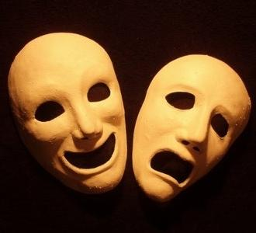
Comedy or tragedy?
Comedy is not the opposite of tragedy but the same, viewed from a different perspective.
Notes:
What do we deduce about the employment of the Shakespearean comedic structure? What do we deduce about the relevance of the Greek tragedy stages? On a continuum: where does Jerusalem sit?

Slide 13
Return to pp6-7 OR to pp 16-17 (from Just a tick mate, to the bottom of p 17)
Explore how Butterworth presents power in this extract.
You should consider Butterworth’s use of dramatic and stylistic techniques and the relationship of the extract to the rest of the play.
Remember: writing – meaning – context.
Notes:
Given 10 minutes to respond. Pulling together dramatic, stylistic, discourse, context….

