Slide 1
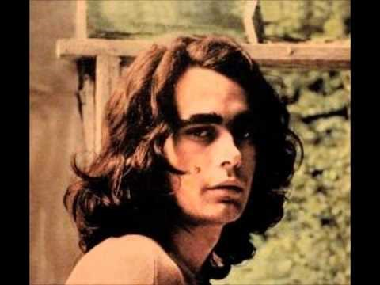
Jerusalem
Week 6: comedic language revised, essay structure
Notes:
Introduction. Aims and objectives. Revise comedic language features; finish presentations on the end of Act 1; to look at possible essay structures, and at what the examiners expect from an essay

Slide 2
Comedic Language snap
You each have a feature of comedic language
Call “SNAP” if you hear an example of your feature.

Slide 3
Comedic language….
Language turned on its head.
Used subversively to disorientate us: we laugh at Johnny’s adultery, we laugh at the villagers’ anger.
“Giddy language” according to Keirnan Ryan: “the dialogue is free to dance, however dark and painful the realities that lie beneath it.”
Notes:
Overview – flag up the quote from the critic here – useful in an essay for context.

Slide 4
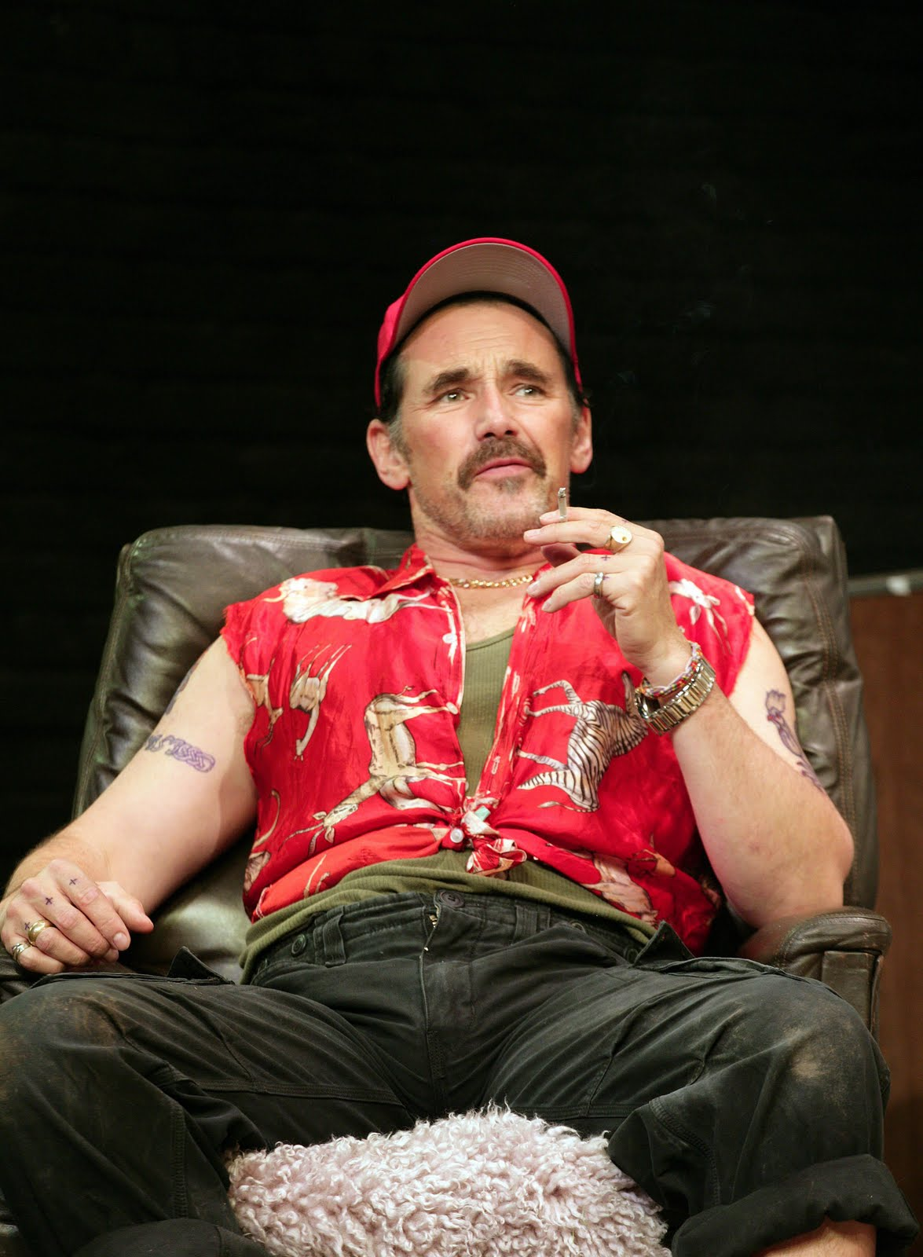
Your Presentations

Slide 5
Muddled essay
Read the paragraphs.
Allocate one of these labels to each paragraph: (ie. What is the focus of each paragraph?)
discourse
dramatic features
stylistic analysis: repetition, deviation, lexical, syntactical, grammatical analysis
Figurative language: symbol, motif etc
context (position of the extract in the play; context of the play in the genre; production and critical reception)
development and structure of the passage
Notes:
Each student is handed a muddled essay, and their task is to decide what each paragraph is about: which are dedicated to dramatic, which to stylistic, and which to context?

Slide 6
Can you now re-order it?
Notes:
In pairs: decide which one might come first, and which last, and why? Can they go further than this?

Slide 7
Skeleton Structure of this essay
Context: placing the extract in the play, explaining its function
Context: demonstrating knowledge of the whole play, what goes before and after the extract; explaining the structure of the essay
Context: focus on the extract with reference to the rest of the play
Discourse analysis: turn taking, imperatives, taboo language
Dramatic features: stage directions (use of “beat”)

Slide 8
Skeleton structure continued
Stylistic analysis: repetition, deviation
Context: reference to comedic conventions
Stylistic analysis: analysis of lexis and syntax
Discourse analysis: sociolect – and stylistic: lexical repetition
Context: overview- critical reception, demonstrating knowledge of whole text (re-visiting quote, for example)
Notes:
Before this slide, hand out the essay in the correct order – with comments added. What observations can they make about the structure of this essay? What will they apply to their own work?

Slide 9

Finishing Act 1
Notes:
After half term: character, and then critical reception and production.

