Slide 1
stylistics
Theory and practice
Notes:
Introduction. Aims and objectives: to revise some terms introduced in last week’s lesson; to explore the theory of stylistics; to apply dramatic and stylistic analysis to the text; to begin to think about the themes within the text. 5 mins

Slide 2
A couple of terms
technique in drama where sequences of single or half or two-line speeches are spoken by alternating characters. It typically features repetition and antithesis. Derivation: Greek stikhos ("row, line of verse") + muthos ("speech, talk").
Notes:
As a class: to identify this term.

Slide 3
stichomythia

Slide 4
The analysis of the physical space between characters on the stage: how close they stand to one another, the contact between them etc.
Notes:
Repeat with first hand up – no conferring.

Slide 5
proxemics
Notes:
Remind them about the meaning of “soliloquy” – ask for meaning and spelling….

Slide 6
stylistics
Look at the information you have in front of you.
Your task is to paraphrase it so that a 10 year old could understand it.
You may use up to five sentences to do so.
Notes:
Hand out sheets of paper – each group can have either one or two. They need to read and agree on a definition that they feed back to the board. 20 mins

Slide 7
Stylistics – a simplified version in three sentences.
An method used to help understand literature, where you identify the patterns made and the patterns broken. You look for patterns of words (lexis), or patterns of sentences (“parallelism”), or patterns of sound (“phonetic parallelism”). You can look for unusual use of words (“lexical deviation”) or grammar (“syntactical deviation”), or even unusual ways of presenting the words (“graphological deviation”).
Notes:
Compare to this version: what has been lost and what gained? 5 mins

Slide 8
Lexical repetition of noun “beard” (x2), foregrounding the focus of the text
syntactical repetition of “Two… and a”: building the sense of the number of resident birds
There was an old man with a beard
Who said, “It is just as I feared
Two owls and a wren
Two larks and a hen
Have all made their nests in my beard.”
Lexical deviation in the shift from indefinite article in line 1 to the first person possessive in the final line, to emphasise the focalisation on the old man here, in the use of direct speech
Notes:
Tongue in cheek illustration of stylistics in its diluted form 5 mins

Slide 9
Your transformed lines
Look at the original and at the transformed text.
Decide what has been lost and what gained in the transformation.
You may choose to look at:
use of adverbs
use of tense
use of narrative perspective
use of analeptic references
Notes:
In order to remind the students of the role and techniques used by drama…. 15 mins

Slide 10
Commentary
The use of adverbs increase the sense of the descriptive nature of the prose version
The inclusion of analeptic references (back stories)
The explicit recognition of the power balance between the two characters
The use of the third person narrative, with one character as the focaliser of the action
The distance from the characters in the prose version
The work that the writer does in the prose version, compared to that of the actor/director etc

Slide 11
Analysing the text
Your task is to analyse the text (pp6-8).
With the focus on either:
Dramatic or
Stylistic features.
Notes:
The students should prepare to present on pp 6-8 with the focus on either dramatic or stylistic features. 20 mins

Slide 12
The themes…
What do you see as the themes of Jerusalem?
Notes:
Snowballing discussion, prompted by images. Asked to find links between the images in terms of theme - ideas being written up at the front of the class. 10 mins

Slide 13
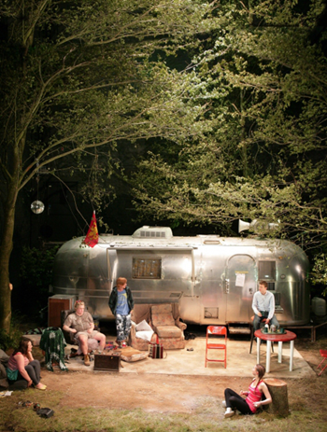

Slide 14
To start you off…
“Englishness”
Role of myth in contemporary England
Anarchic v civilised world
Creation of stories
Truth/reality
Official and the anarchic
Society v the outsider
Urban v rural
Ancient v the modern
Love
Friendship
Loyalty etc etc

Slide 15
Identifying the themes
Your task is to look at one of the allocated pages from the text, and to find three themes illustrated in your page.

