Slide 1
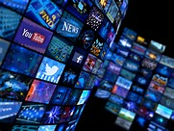
Language In the media
Linked to gender, power and technology

Slide 2
Analysing Language in the media
Using Fairclough’s features, and any others you notice, annotate three texts on the same story from different perspectives.
Then complete the table, in small groups, explaining features in context.
Then add any knowledge of power which applies here.
Once your table is complete, you are ready to write model points, combining features, context and knowledge, on Spiral.

Slide 4
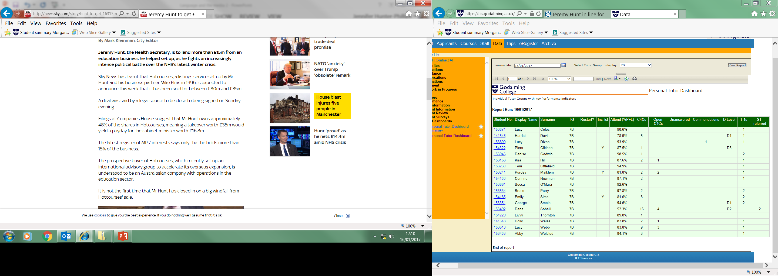

Slide 6
Some Features to consider when analysing representation in the media
Lexis and Semantics:
Euphemisms
Markedly formal or informal words
Metaphors or other figurative language
Grammar:
Noun phrases
Verbs
Adverbials
Subject and object positions (voice)
Pronouns
Conjunctions
Modals and imperatives.

Slide 7
The ‘marketization of discourse’
What is the language of advertising? Note some features.
What do you notice about the ‘Innocent Smoothie’ advert?

Slide 8
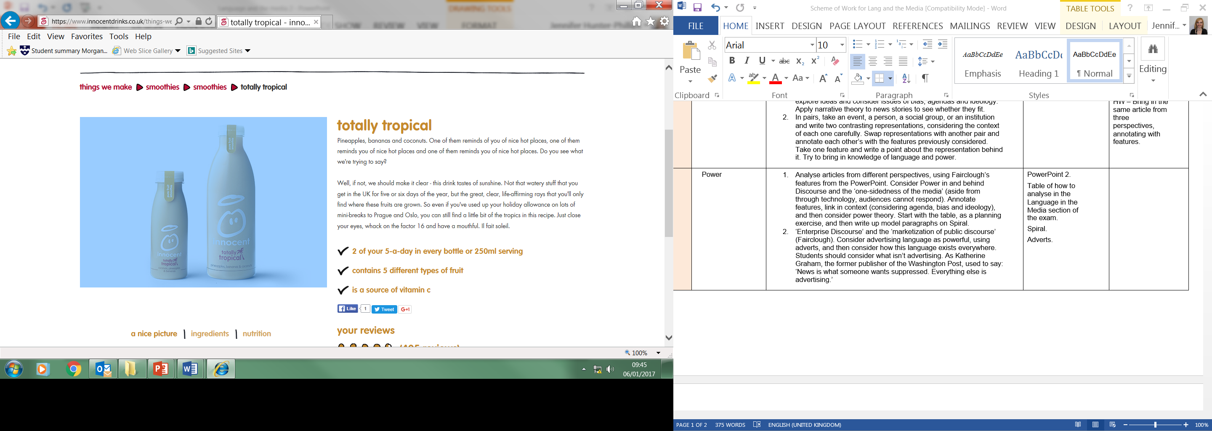

Slide 9
Agenda
Adverts have an obvious agenda but can you spot advertising language elsewhere?
Find some examples online…
Katherine Graham, the former publisher of the Washington Post, said ‘News is what someone wants suppressed. Everything else is advertising.’ Is this true?

