Slide 1
Language and the media
Linked to gender, power and technology

Slide 2
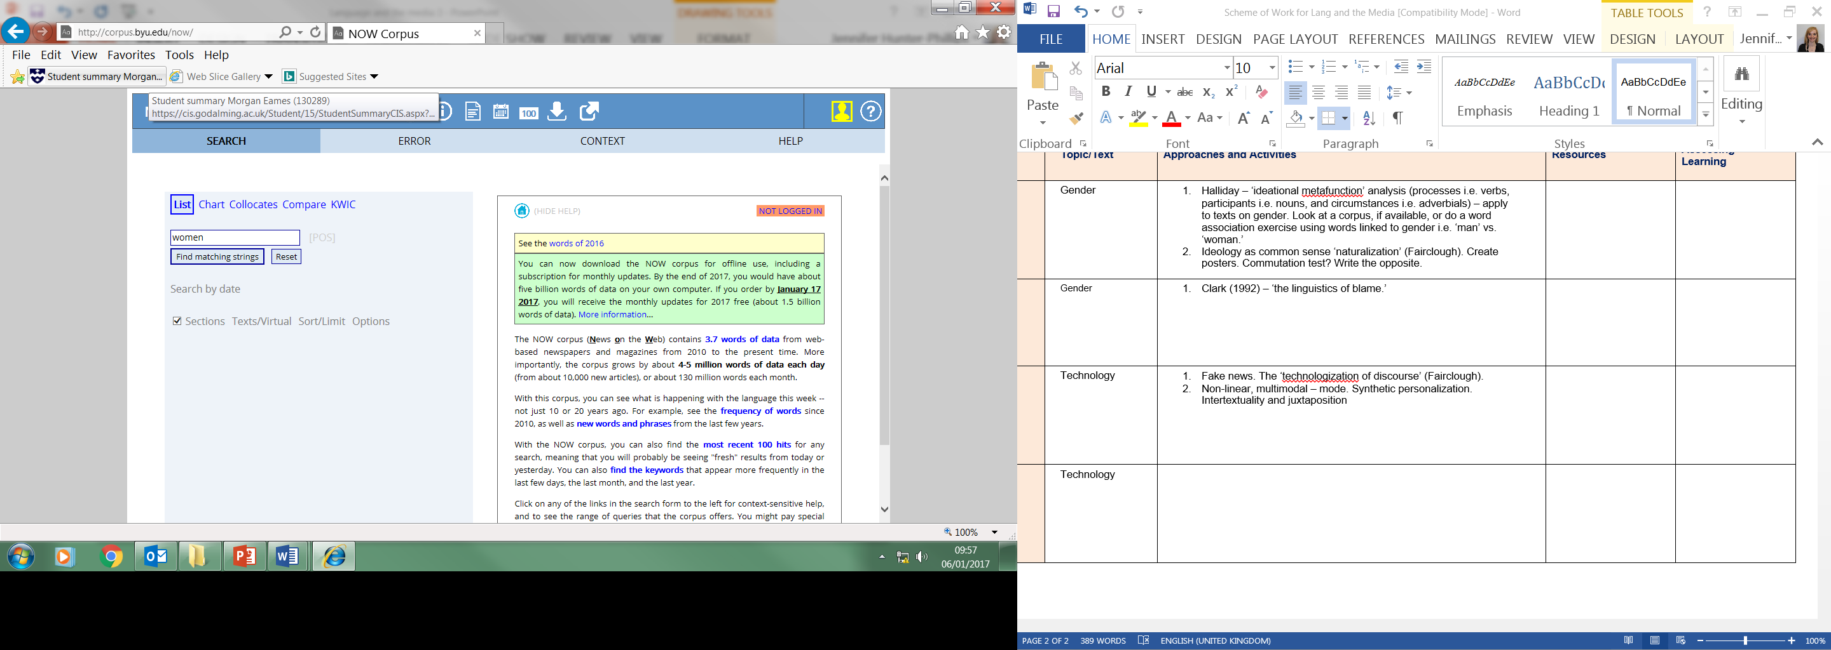
Language and the Media and gender
Create Spiral Team Up posters on the stereotypical representation of men and women.
What are their stereotypes?
Use the following corpus to search gendered terms i.e. ‘man’ vs. ‘woman’
http://corpus.byu.edu/now/
What did you find?
Are men and women that different, is it a
‘performance’ (Butler), or is it just stereotyping
(Mills)? Is an ideology being promoted as common
sense (‘naturalization’ – Fairclough)?

Slide 3
Commutation Test
https://www.millsandboon.co.uk/FreeReads/NewAndPopular
A commutation test involves changing a ‘sign’ to consider the usage of the original form. Start with Mills and Boon. Read the above extracts of stories and change the male and female pronouns to see whether there’s a difference.
Write an alternative romance story which avoids stereotypes.

Slide 4
Halliday’s ‘Ideational Metafunction’
Halliday (1994) coined ‘Ideational Metafunction’ which can be used to assess representations. This works across Language in the Media but is particularly useful in terms of gender. It involves considering the following:
Processes i.e. verbs
Participants i.e. nouns
Circumstances i.e. adverbials
Take a text which involves both men and women and have a go at an analysis, using the above.

Slide 5
Clark (1992) – ‘The Linguistics of Blame’
https://lillian90.wordpress.com/2009/05/15/kate-clark-linguistics-of-blame/
‘Referring to numerous reports of sexual assault as reported by The Sun, Clark shows how, by giving attackers and victims particular names, the newspaper influences the meaning and opinion of the report, giving the piece a certain bias. For example, when referring to the attacker The Sun either gave them ‘fiendish’ names (monster, beast, fiend etc) or ‘non-fiendish’ names (simply referring to them by their real name, occupation or even sympathetically). Also, the victims were always labelled rather than individualised. That is, they were given roles with varying degrees of culpability. Amongst other names the victims were called ‘wife’, ‘mother’, ‘daughter’, ‘schoolgirl’; and less sympathetically ‘call-girl’, ‘Lolita’ and ‘blonde divorcee’. Thus, by naming the victims The Sun was able to attach a certain amount of responsibility to the victim – a ‘vivacious blonde divorcee’ would appear to be more culpable, more responsible for the crime than a ‘housewife’ especially when the attacker was referred to in sympathetic terms.’
This links to Julia Stanley’s 1977 study on terms for promiscuous men and women.

Slide 6
Is the language itself sexist?
Saussure divided language into ‘langue’ (the language) and ‘parole’ (the use of the language).
There is clear evidence that parole can be sexist but is the language itself? Consider the following:
Markedness
The generic pronoun and use of ‘man’
Titles
Semantic derogation.
Now apply your knowledge of gender and ideational metafunction, as well as Fairclough’s list of features, to a text. Start with the table and then create model paragraphs.

Slide 7
Some Features to consider when analysing representation in the media
Lexis and Semantics:
Euphemisms
Markedly formal or informal words
Metaphors or other figurative language
Grammar:
Noun phrases
Verbs
Adverbials
Subject and object positions (voice)
Pronouns
Conjunctions
Modals and imperatives.

