Slide 1
Representation
Powerful Discourses: Advertising & Marketing

Slide 2
What’s the difference between marketing and advertising?
Marketing: the action or business of promoting and selling products or services, including market research and advertising
Advertising: the activity or profession of producing advertisements for commercial products or services

Slide 3
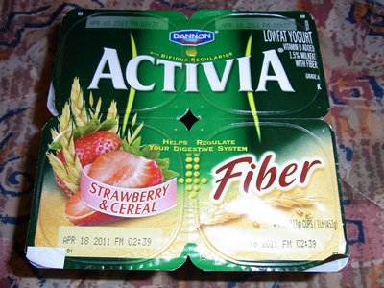
The power of language: Dannon case study
Dannon's popular Activia brand yogurt lured consumers into paying more for its purported nutritional benefits when it was actually pretty much the same as every other kind of yogurt
A class action settlement in 2015 forced Dannon to pay up to
$45 million in damages
Source: ABC News

Slide 4
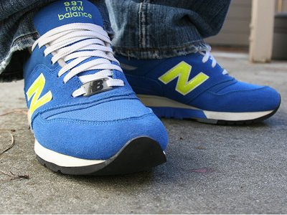
The power of language: New Balance case study
A New Balance trainer that reportedly helped users burn calories were found out when studies did not find any boosted health benefits from wearing the shoe.
Plaintiffs are seeking $5million in compensation.
Company claims included hidden technology and calorie burning activators. Source: Reuters

Slide 5
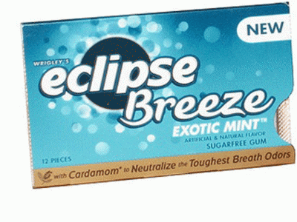
The power of language: Wrigley’s case study
Eclipse gum claimed that its new ingredient, magnolia bark extract, had germ-killing properties.
Consumers sued Wrigley’s in 2009 when it was proved ads were misleading.
As part of the settlement, Wrigley changed how it markets and labels its gum. It agreed to pay $6-7 million compensation. Source: Business Week

Slide 6
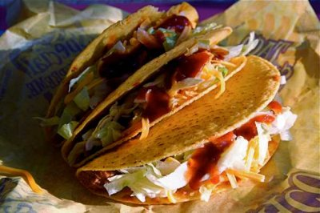
The power of language: Taco Bell’s case study The one that got away!
When consumers asked what was seasoning Taco Bell's seasoned beef, the company didn't know how to respond.
It was simply using oat filler!
The franchise had been tricking its consumers into thinking its products were of a higher grade than they actually were.

Slide 7
Research task:
In groups, try to find an example of a company who has been prosecuted against for misselling a product through the language that they’ve used. They can either have been found guilty or (perhaps more interestingly) got away with marketing the product in that way.

Slide 8
How does the language of marketing contain power?
Persuasive language: adjectives (delicious), noun phrases (This magnificent, detached Georgian family home located on the prestigious St George’s Hill estate), personal pronouns (you), interrogatives (questions that will engage)
Jargon: marketing jargon can be as exclusive as legal language. The use of abbreviations/acronyms (QR code, SWOT), buzz words (storyscaping, native advertising), collocation (call to action)

Slide 9
Connected theories of Power:
Influential power – persuasive power where the consumer has choice
Power within discourse – language features in a text that convey power (Norman Fairclough)
Power behind discourse – the status/power of the author of the text (Norman Fairclough)
Synthetic personalisation - gives an audience, who are treated en masse, the impression of being considered as individuals. This is created through the use of ‘you’ as a second person pronoun. (Norman Fairclough)
Task: Draw a picture symbolising one of the concepts above on your mini-whiteboards for your partner to work out.

Slide 10
How is the language of marketing creative?
Neologisms (new words) are coined by marketors and companies in order to label or categorise a brand or product to stand out from the rest (e.g. the compounding ‘colourfast’ – a range of cosmetics which had a long-lasting effect without the need to reapply). Some neologisms have become proprietary names e.g. Hoover which we now use to refer to all vacuum cleaners i.e. you can put a complete financial value on a word
Unique selling point (USP) – in order to place your company/product/service as different to others and as unique, the language you use to describe it has to be creative as well as persuasive

Slide 11
Task: You have 2 minutes to come up with a 30 second pitch to market the room.
In your pitch, you need to address:
The function(s) of the space
Outline the target market
What your unique selling point of the space is
How you can relate to your audience’s needs
NB. Try to make sure that your language is creative, persuasive and powerful.

Slide 12
Distinctions of genre:
Advertisement - a notice or announcement in a public medium promoting a product, service, or event or publicizing a job vacancy
Advertorial - a newspaper or magazine advertisement giving information about a product in the style of an editorial or objective journalistic article

Slide 13
Writing task:
Individually, create a new product for a particular industry. Consider its unique selling point (USP), the product’s function and your target audience.
In groups, vote on your favourite new product.
Write an advertorial for a particular magazine.

