Slide 1
Representation
Powerful Discourses: Speeches & Rhetoric

Slide 2
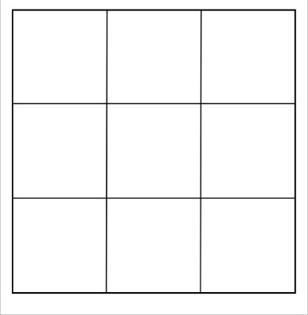
Starter: Write down 9 features of a speech on your whiteboards in 9 squares
Bingo!

Slide 3
Persuasion:
“A symbolic process in which communicators try to convince other people to change their attitudes or behaviours regarding an issue through the transmission of a message in an atmosphere of free choice.” (Perloff, 2003).

Slide 4
3 Elements of Aristotelian Rhetoric:
1. Logos: rational argument
2. Ethos: appeals to character/status
3. Pathos: appeals to emotions

Slide 5
Properties of Rhetorical Discourse:
Persuasion – the speaker/writer must engage with the recipient in such a way that they influence the outcome of these ‘decision-makers’
Narrative – narrator selects, slants and styles past actions to meet present rhetorical goals; construction of a subjective storyworld while appearing to merely reconstruct the truth; construction of own measure of truth (verisimilitude) arrived at through narrative plausibility rather than scientific truth
Conflict – presents a version of events which is in conflict with the opposing party
Evidence – this permits the recipient to not only judge what they hear/read but how the text is spoken/written; consider contextual evidence of author
Regulation – evidence needs to conform to rules/social norms so that the ‘game is played fairly’

Slide 6
Rhetorical Strategies: Targeting
Ascribing negative identities; a deliberately face-threatening act.
Rhetors can target people’s identities as individuals (e.g. liar), and identities as members of social groups (e.g. criminal).
Depersonalisation through address terms (e.g. the mother) and deixis (e.g. that thing).
Distancing through address terms (e.g. Miss Wood) and irony (e.g. was that not the case?)

Slide 7
Rhetorical Strategies: Framing
Shapes the interpretation of discourse by providing a contextual scheme for understanding that can guide both the speaker and the hearer:
Loaded questions through presupposition e.g. Did you see the broken glass? and vocabulary choice e.g. How fast were the cars going when they smashed into each other?
Reformulation through rhetorical schemes (manipulation of syntax to reinforce a point)
Antagonistic narration through the use of tag questions, modal adverbs (e.g. presumably), second person pronouns, etc.
Repetition highlighting certain features over others

Slide 8
Rhetorical Strategies: Voicing
Inflecting ‘source voices’ in various ways giving them particular identity traits and qualities:
Reported speech – linking the historical text with the contemporary communicational context projecting one’s own identity and targeting others

Slide 9
Rhetorical Strategies:
Targeting: ascribing negative identities, a deliberately face-threatening act. Rhetors can target people’s identities as individuals

Slide 10
Chocolate Biscuit speech
Listen to the ‘chocolate biscuit’ speech and note down the language features that you hear being used.
https://www.youtube.com/watch?v=iAusakvsFLQ

Slide 11
Speech comparison:
Now compare the chocolate biscuit speech with the Emmeline Pankhurst speech to identify which key language features are used.

Slide 12
Rhetorical Schemes: (syntax)
Anaphora – repetition of words at the beginning of phrases/sentences e.g. I have a dream
Antistrophe – repetition of words at the end of phrases/sentences e.g. Selfishness is not living as one wishes to live. It is asking others to live as one wishes to live.
Antimetabole – repetition in reverse order e.g. Terrorism is the war of the poor; war is the terrorism of the rich.
Antithesis – parallel phrases; one positive, one negative e.g. To err is human; to forgive divine
Asyndeton (asyndetic listing) – avoidance of a conjunction when listing e.g. I came, I saw, I conquered
Parallelism – a repeated structure of phrases/clauses e.g. Like father, like son
Polysyndeton (syndetic listing) – excessive use of conjunctions when listing e.g. Let the whitefolks have their money and power and segregation and sarcasm and big houses and schools and lawns like carpets
Quaestitio – a run of questions in succession e.g. When will they learn? When will they change?

Slide 13
Rhetorical Tropes: (semantics)
Antiphrasis – using a word with an opposite meaning e.g. The Chihuahua was named Goliath
Antithesis – two opposing ideas but with a connection e.g. That’s one small step for a man, one giant leap for mankind’
Hyperbole – an exaggeration e.g. I have done this a thousand times
Litotes – an understatement e.g. The terms are not disagreeable to me
Oxymoron – a two-word paradox e.g. beautiful nightmare

Slide 14
How and in what way are the author’s ideas conveyed in the text?

