Slide 1
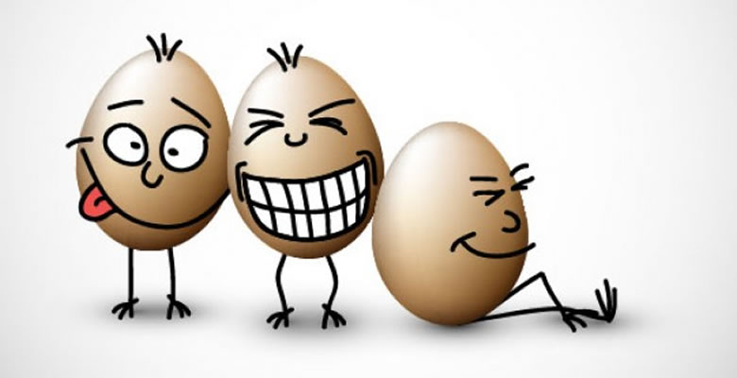
Representation
Powerful Discourses: Humour, Satire & Parody

Slide 2
Try to define the following terms:
Humour:
the quality of being amusing or comic, especially as expressed in literature or speech
Satire:
the use of humour, irony, exaggeration, or ridicule to expose and criticize people's stupidity or vices, particularly in the context of contemporary politics and other topical issues
Parody:
an imitation of the style of a particular writer, artist, or genre with deliberate exaggeration for comic effect

Slide 3
Speech comparison:
Now compare the chocolate biscuit speech with the Emmeline Pankhurst speech to identify which key language features are used.

Slide 4
How is humour represented differently in spoken and written texts?

Slide 5
How humour is represented through phonology:
Many jokes are based on the fact that there can be two possible interpretations of the same group of sounds e.g. What’s black and white and re(a)d all over? A newspaper. This is because red/read is a homophone.
Ambiguities can be caused by the way that words are stressed and by their intonation e.g. It’s not my hand you should kiss can have multiple meanings. Equally, Q: How do you make a cat drink? A: Easy, you put it in the liquidiser. (How you interpret this is how you interpret the word classes of the final two words).
Inappropriate words that sound appropriate because of the number of syllables/vowels they have and connotations of certain etymologies. Mrs Malaprop, a character from The Rivals, doesn’t use words with quite the right meaning. This is called a malapropism. Delboy also uses inappropriate French words in Only Fools and Horses.
Spoonerisms (named after Rev. William Archibald Spooner) is where the initial sounds of words are mixed up. Such a device can be deliberately used for humour which suggests but does not articulate a taboo word e.g. He is a shining wit. This could also be suggested for the brand name FCUK.

Slide 6
How humour is represented through semantics:
Polysemy – refers to the phenomenon of words having various, related meanings. Unintentional humour can occur in translations e.g. a notice in the toilet of an Italian train gave instructions for its use: Deeply depress the stud. English speakers rarely use the literal meaning of ‘depress’ (to press down) so the metaphorical sense is the first to be understood, particularly as it occurs before ‘stud’, which can mean both a ‘knob’ or ‘a young man noted for his sexual prowess’.
Idioms – a group of words that should be regarded as a single unit as their meaning cannot be worked out from the constituent parts e.g. go bananas. There is ambiguity if the group of words can be interpreted both as an idiom and as individual words e.g. When down in the mouth, remember Jonah. (meanings of miserable and in the mouth of a whale).
Connotations/collocations – words can be grouped as belonging to a field of meaning but have different connotations. E.g. ‘snow’ is similar to ‘slush’ but the former has connotations of purity and the latter has connotations of unpleasantness and dirt: ‘I’m as pure as the driven slush.’ (Tallulah Bankhead)

Slide 7
How humour is represented through grammar: (morphology)
People’s instinctive knowledge of the ways that morphemes are used to form meanings can be exploited in jokes which point out the possible ambiguities. The word –ish as a suffix has been used to indicate the sense of ‘slightly’ e.g. hungryish
Certain suffixes when applied to other words don’t work in quite the same way causing confusion and therefore humour:
‘What’s a baby pig called?’
‘A piglet.’
‘So what’s a baby toy called?’
‘A toilet.’
Compound words – formed from 2 free morphemes, the order is significant and they can’t be reversed without altering the meaning e.g. an overpass is very different to Passover. Equally, with the following example, ‘Have you heard the one about the main who bought a paper shop? It blew away.’ – paper shop can either mean ‘shop made out of papers’ or ‘shop that sells papers’.

Slide 8
How humour is represented through grammar: (word class)
Prepositions – often occur as part of fixed phrases or idioms which cannot be understood by the meaning of the individual parts e.g. in an episode of the sitcom, Friends, there was an exchange between Ross and Rachel on the brink of a relationship and Rachel leaves a message on Rachel’s answerphone saying ‘You said you were over me. When were you ever under me?’
Phrasal verbs – some verbs in English are not single words but include a following preposition (or particle) as the unit of sense e.g. Note the difference between I ran up a hill vs. I ran up a bill. These can be manipulated to form ambiguities in jokes: When is a car not a car? When it turns into a garage.

Slide 9
How humour is represented through grammar (syntax):
Modification – ambiguities can often occur in headlines because they are abbreviated and occur before the context. Although such puns are often deliberately used to catch attention, they are sometimes unintentional. E.g. Squad Helps Dog Bite Victim. Such examples are not simply a case of individual words having double meanings (polysemy) but the fact that there are two possible ways to group the words in relation to each other. Often, there can be multiple interpretations based on which modifier goes with which head noun e.g. For sale: Mixing bowl set designed to please a cook with round bottom for efficient beating.
Phrasal verbs – some verbs in English are not single words but include a following preposition (or particle) as the unit of sense e.g. Note the difference between I ran up a hill vs. I ran up a bill. These can be manipulated to form ambiguities in jokes: When is a car not a car? When it turns into a garage.

Slide 10
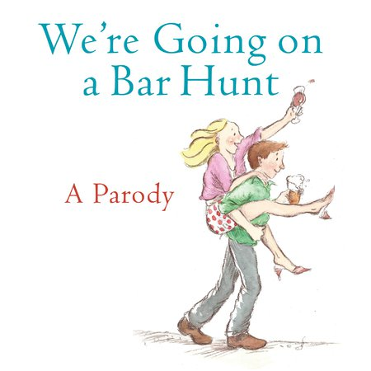
Write your own parody of a children’s book: think about the features you will need

