Slide 1
Representation
Agendas in the Media

Slide 2
Who are the participants involved in the production and reception of a source?
Choose an article and list as many different participants that have been involved as actors in the source, as creators of the source and recipients of the source. Each participant will have their own agenda.
Agenda can be defined as: the intentions of a particular person or group.
Think about how agendas can be competing.

Slide 3
Grammar Schools:
Think about the actors, creators and recipients of the Daily Mail’s article on grammar schools:
What are their agendas?
Are they largely in agreement or are they competing?
How are the tensions between participants managed by the newspaper?
Which participant(s) have the most power? Which agenda is prioritised?
Take a look at the following differences:
Discourse & layout
Language (lexis, semantics, grammar)

Slide 5
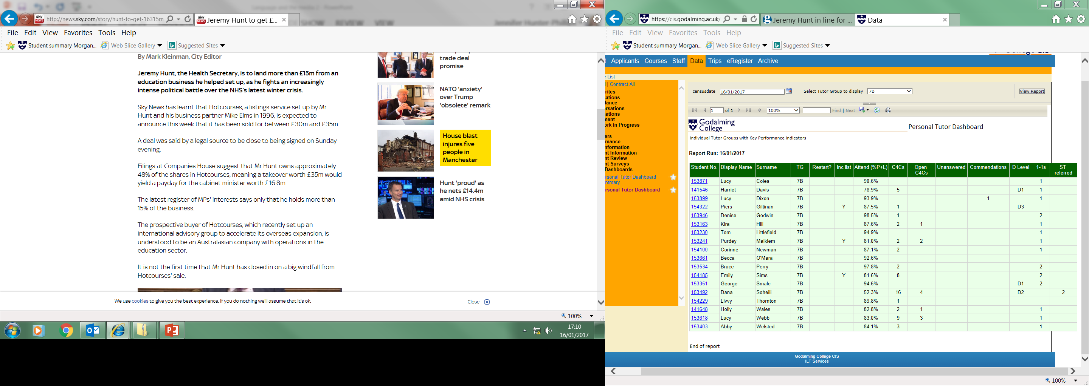

Slide 7
Review the 3 Jeremy Hunt texts:
Think about the different agendas that each text has. How are their agendas expressed through bias?

Slide 8
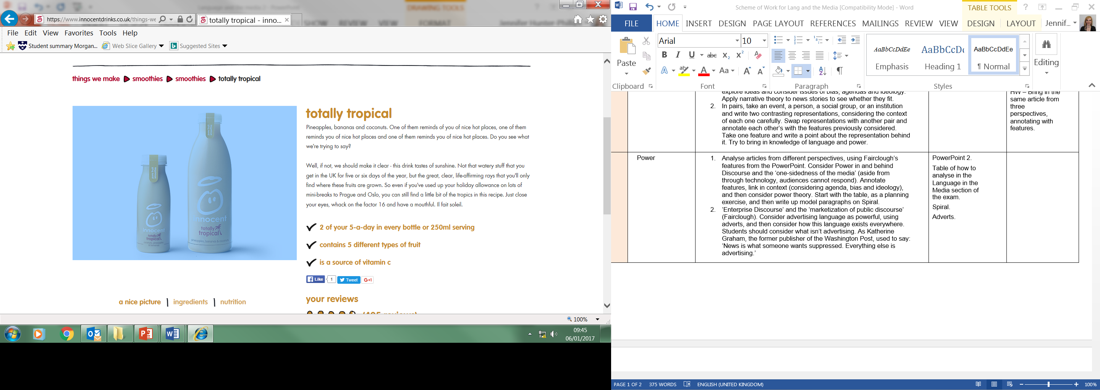

Slide 9
Think about the language of advertising:
What agendas does the Innocent Smoothie advert have?
Try to find an advert for a particular product and identify the agenda of the company/the marketing department within that company.

