Slide 1
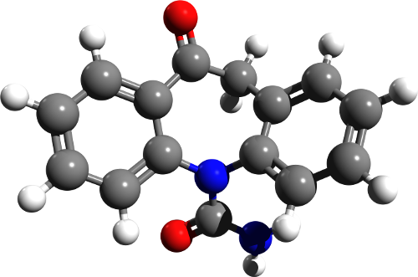
Representation
Power through Discourse

Slide 2
Representation
What is this?

Slide 3
The Arbitrary Nature of the sign (Saussure)
Everything is a representation.

Slide 4
Fairclough – Discourse as text, Interaction and Context
The language of the media must be viewed in terms of context.
You should always consider bias, agenda and ideology.
This process is known as Critical Discourse Analysis.

Slide 5
Structure of a News Story: Labov’s Narrative (1972)
Abstract: summarises what the narrative will be about
Orientation: gives information about the time, place, characters, setting of a narrative
Complicating Action: central part of the story – describes a series of events, usually in the order in which they happened
Evaluation: indicates the point of a story
Resolution: the end of a series of events
Coda: signals the end of a narrative and returns to the present
In pairs, divide up the structure of a news story. What is unique about the beginning, middle and end of a news article. Can you break it down further?
Now try and identify Labov’s Oral Narrative in your newspaper article.

Slide 6
How is Labov’s narrative structure powerful?
Why do we find narratives so influential as humans?

Slide 7
Find 2 texts with contrasting discourse structures:
How does each text represent power through the discourse structure it uses?
How does it influence the reader?
Could an alternative discourse structure be more effective?

