Slide 1
Representation
Gender in the Media

Slide 2
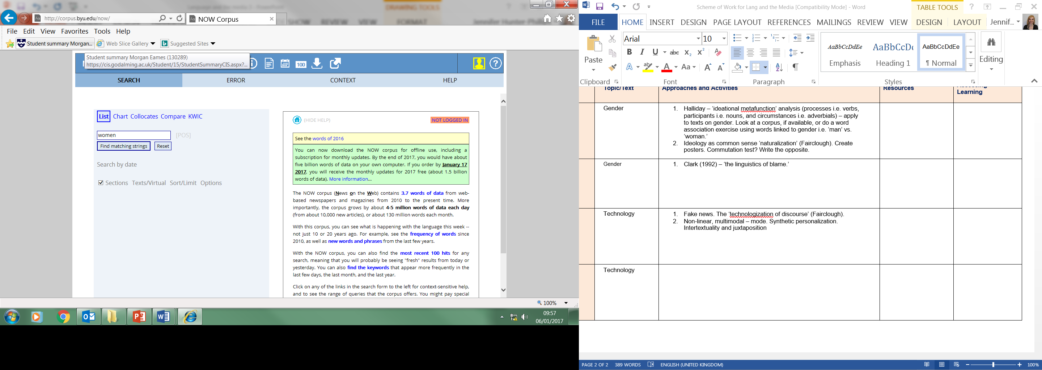
Corpus Linguistics Research:
Create Spiral Team Up posters on the stereotypical representation of men and women.
What are their stereotypes?
Use the following corpus to search gendered terms i.e. ‘man’ vs. ‘woman’
http://corpus.byu.edu/now/
What did you find?
Are men and women that different, is it a
‘performance’ (Butler), or is it just stereotyping
(Mills)? Is an ideology being promoted as common
sense (‘naturalization’ – Fairclough)?

Slide 3
Commutation Test:
https://www.millsandboon.co.uk/FreeReads/NewAndPopular
A commutation test involves changing a ‘sign’ to consider the usage of the original form. Start with Mills and Boon. Read the above extracts of stories and change the male and female pronouns to see whether there’s a difference.
Write an alternative romance story which avoids stereotypes.

Slide 4
Gender Representation in Non-Fiction:
Halliday: maintains the Ideational Metafunction which deconstructs how gender has been constructed through language. When you analyse the metafunction of a text, you can see who does what to whom, when, where and how:
Who and whom = participants, actors who do things or have things done to them (nouns/pronouns)
Is doing what = processes (verbs of actions/states)
When, where and how = circumstances (adverbs, prepositional and adverbial phrases)
Kate Clark (1992): covered violent crimes against women in The Sun newspaper in the 1980s illustrating the ways in which lexical and syntactical patterning removed blame from the perpetrator to the victim.

Slide 5
Address terms: Connotations
Monster, beast, fiend
Andrew Bates, 39, a carpenter from Leeds
Wife, daughter, mother, schoolgirl
Call-girl, Lolita, blond divorcee

Slide 6
Clark (1992) – ‘The Linguistics of Blame’
https://lillian90.wordpress.com/2009/05/15/kate-clark-linguistics-of-blame/
‘Referring to numerous reports of sexual assault as reported by The Sun, Clark shows how, by giving attackers and victims particular names, the newspaper influences the meaning and opinion of the report, giving the piece a certain bias. For example, when referring to the attacker The Sun either gave them ‘fiendish’ names (monster, beast, fiend etc) or ‘non-fiendish’ names (simply referring to them by their real name, occupation or even sympathetically). Also, the victims were always labelled rather than individualised. That is, they were given roles with varying degrees of culpability. Amongst other names the victims were called ‘wife’, ‘mother’, ‘daughter’, ‘schoolgirl’; and less sympathetically ‘call-girl’, ‘Lolita’ and ‘blonde divorcee’. Thus, by naming the victims The Sun was able to attach a certain amount of responsibility to the victim – a ‘vivacious blonde divorcee’ would appear to be more culpable, more responsible for the crime than a ‘housewife’ especially when the attacker was referred to in sympathetic terms.’
The links to Julia Stanley’s 1977 study on terms for promiscuous men and women?

Slide 7
Gender Representation in Non-Fiction: Verb Processes
Verb processes provide a way of highlighting how actions in a text are represented and identifying those responsible and those affected by the actions. A character whose behaviour is mostly represented through material processes as an actor might be said to have more control over their actions and ability to make decisions than one who is represented largely through relational or mental processes. Equally those characters who are affected by the verb processes, that is who act as objects rather than subjects, can be said to be less powerful in their ability to make decisions and therefore remain less powerful actors or participants in the narrative.

Slide 8
Is the language itself sexist?
Saussure divided language into ‘langue’ (the language) and ‘parole’ (the use of the language).
There is clear evidence that parole can be sexist but is the language itself? Consider the following:
Markedness
The generic pronoun and use of ‘man’
Titles
Semantic derogation.
Now apply your knowledge of gender and ideational metafunction, as well as Fairclough’s list of features, to a text. Start with the table and then create model paragraphs.

