Slide 1
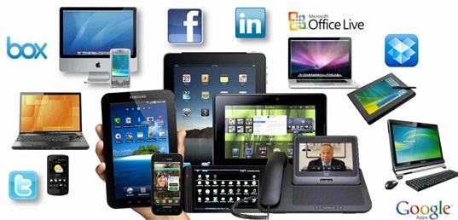
Representation
Technology in the Media

Slide 2
Language in the media and technology
How has technology changed the media?
Which media that we today would not have existed 20 years ago?
What impact has this had? Consider ‘Fake News.’
Find an online article from a mainstream newspaper. Which features would not be present in a print version? Has the language changed?
Fairclough considers the ‘technologization of discourse.’

Slide 3
Fairclough – Discourse as Text, Interaction and Context
Using this model, note features of technology in the middle and explain these in context:
Why are technological texts produced this way? How are they interpreted?
What are the social conditions behind this?

Slide 4
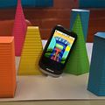
Technology in context
Texts are often non-linear.
They are multi-modal.
They often involve intertextuality.
Juxtaposition is key.
Synthetic personalization is more frequent.
Take a technological text and find evidence of this as well as features of technological discourse. Be ready to explain these in context.

Slide 5
Attitudes to Technology
John Humphreys refers to ‘SMS vandals […] destroying [our language]: pillaging our punctuation, savaging our sentences; raping our vocabulary.’
What is your response to this?
Consider prescriptivism and descriptivism.
How could you argue against this if you were writing about a topical language issue? Have a go…

