Slide 1
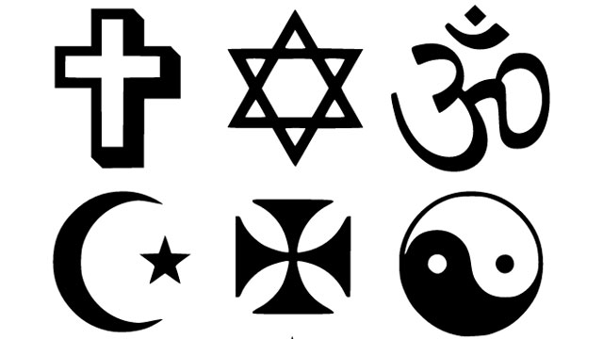
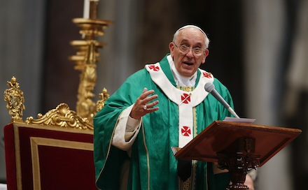
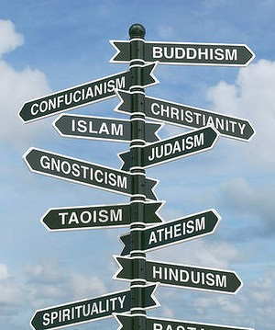
Language and Religion

Slide 2
Functions of Religious Language
Upholding spiritual belief
Persuade people to believe and to act in a certain way
Expressive
Prescribe a specific attitude to life

Slide 3
Features of Religious Language
Doctrine sustains and promotes its particular spiritual wisdom
Prayers are a special form of polite command/request addressed to God
Liturgies – chants, thanksgivings, hymns, psalms
Sermons are moral statements which aim to dictate a certain kind of behaviour through stories/examples
Theological texts are discursive documents with a moral purpose including justifications, guidelines or explanations of religious teachings

Slide 4
Lexis
Subject specific:
  Nouns – disciples, parables
  Verbs – pray, forgive
Vocabulary is often archaic
Formal phrases/idioms e.g. In the beginning
Formulaic e.g. Amen to mark end of prayer
Antithesis is common e.g. heaven and hell
Naming of the godhead e.g. Lord/God/Allah
Modifiers e.g. Almighty
Determiners are often possessive e.g. God’s love
Abstract nouns e.g. heaven, salvation

Slide 5
Grammar
Third person singular verbs inflected with suffixes e.g. –(e)th, -(e)st (creepeth, mayest)
Some verbs still have older strong forms e.g. sware for swore, spake for spoke
Do-periphrasis (emphasis) e.g. I did eat
Present tense is often used to be advisory
Verb mood is often declarative and imperative (instructional) e.g. Give heed unto this reading
Modal auxiliary verbs e.g. We may eat of the fruit
Initial position conjunction e.g. And the Lord said…

Slide 6
Metaphorical Language
Metaphor adds an extra layer of meaning to stories that provide spiritual philosophy
Personification e.g. the voice of the Lord God walking in the garden
Symbolism is central to interpretation e.g. Adam and Eve = humanity; serpent = evil; apple = temptation
Rhetoric (persuasion) through techniques such as antithesis
Phonological patterning e.g. division of texts into verses (sonorous/resonant tone)

Slide 7
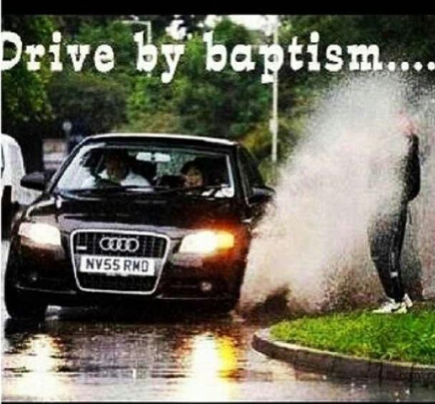
To what extent is religion viewed as a joke or as entirely fictitious?

Slide 8
10 Commandments:
King James Bible
You shall have no other gods before Me.
You shall not make for yourself a carved image—any likeness of anything that is in heaven above, or that is in the earth beneath, or that is in the water under the earth; ⁵ you shall not bow down to them nor serve them. For I, the Lord your God, am a jealous God, visiting the iniquity of the fathers upon the children to the third and fourth generations of those who hate Me, ⁶ but showing mercy to thousands, to those who love Me and keep My commandments.
You shall not take the name of the Lord your God in vain, for the Lord will not hold him guiltless who takes His name in vain.
Remember the Sabbath day, to keep it holy. ⁹ Six days you shall labour and do all your work, ¹⁰ but the seventh day is the Sabbath of the Lord your God. In it you shall do no work: you, nor your son, nor your daughter, nor your male servant, nor your female servant, nor your cattle, nor your stranger who is within your gates. ¹¹ For in six days the Lord made the heavens and the earth, the sea, and all that is in them, and rested the seventh day. Therefore the Lord blessed the Sabbath day and hallowed it.
Honour your father and your mother, that your days may be long upon the land which the Lord your God is giving you.
You shall not murder.
You shall not commit adultery.
You shall not steal.
You shall not bear false witness against your neighbour.
You shall not covet your neighbour’s house; you shall not covet your neighbour’s wife, nor his male servant, nor his female servant, nor his ox, nor his donkey, nor anything that is your neighbour’s.

