Slide 1
Language and Power
The Theory
Notes:
https://www.youtube.com/watch?v=y1IerAbfRJ0 (4:35)

Slide 2
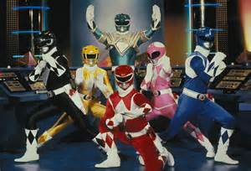
Wareing
Political = Legal e.g. Police, Judge, Barrister
Personal = Occupational e.g. Doctor, Teacher
Social Group = Friends and family, class

Slide 3
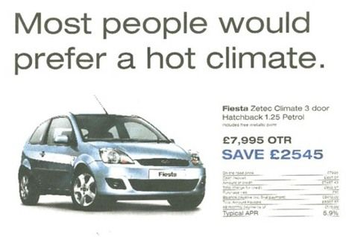
Instrumental vs. Influential
Instrumental = enforces authority imposed by the law, schools, exam boards…
Influential = persuasive power.

Slide 4
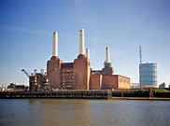
Power in and Behind Discourse
Power within discourse = features used to convey power
Power behind discourse = who? what? why?

Slide 5
Holmes
Managers favour mitigated imperatives.
E.g. Please could you hand in the work tomorrow afternoon rather than Hand in the work tomorrow!

Slide 6
Fairclough
Synthetic Personalisation = gives an audience, who are treated en masse, the impression of being considered as individuals. This is created through the use of you as a second person pronoun.

Slide 7
Morreal
Humour can be used as a powerful strategy. There are 3 humour theories:
1) Relief theory – laughter is when psychological tension is reduced; relieving the tension caused by one’s fears
2) Superiority theory – when people laugh at the misfortunes of others because these misfortunes assert the person’s superiority
3) Incongruity theory – humour results from the unexpected, sudden clash of 2 different ideas e.g. laughing at an upbeat song about murder
Notes:
https://www.youtube.com/watch?v=CDMSJig_SHs

Slide 8
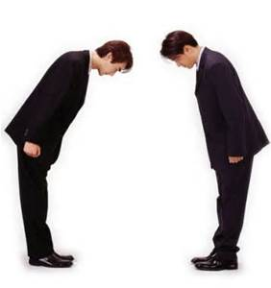
Politeness Theory: Brown and Levinson

Slide 9
Loftus and Palmer (1974)
The significance of word choice and the impact it has on people.
Watch the video below and write down an answer for the following question assigned to your group:
https://www.youtube.com/watch?v=tnknzIWY2ZY
At what speed did the vehicles hit each other?
At what speed did the vehicles collide into each other?
At what speed did the vehicles crash into each other?

Slide 10
Carmichael, Hogan and Walter (1932)
Look at the stimulus figures in the middle for 30 seconds.
Each person in the pair will have a set of words linked to that image which you have to draw.

Slide 11
Sapir-Whorf
Linguistic Determinism – language determines our thoughts.
Notes:
https://www.youtube.com/watch?v=Df25r8pcuI8 Can we only see colours that we can name?

Slide 12
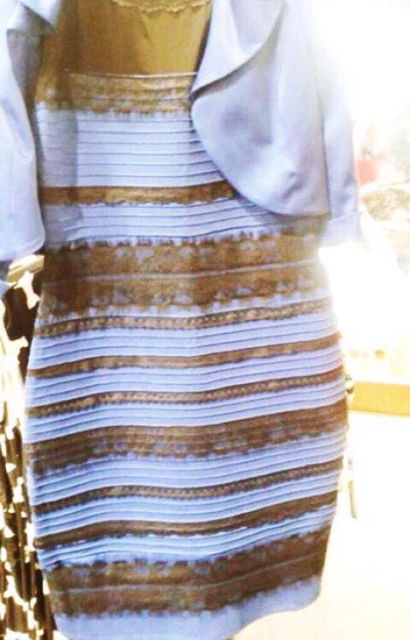
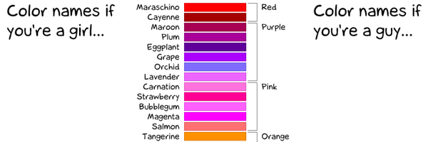
Linguistic Determinism: Colour Perspective
Do we all see the same colours?

Slide 13
Linguistic Relativity

