Slide 1
Gender
Do men and women speak differently?

Slide 2
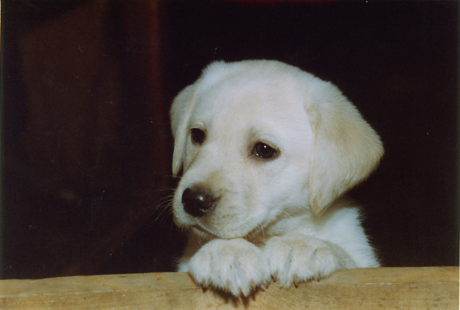
Write down the first word you think of when you look at the picture. Then write down the colour of the text.

Slide 3
The four approaches
Deficit – Women’s language is inferior
Dominance – Men dominate women in conversation
Difference – Men and women speak differently owing to socialisation
Dynamic – Men and women both alter their language based on context.

