Slide 1
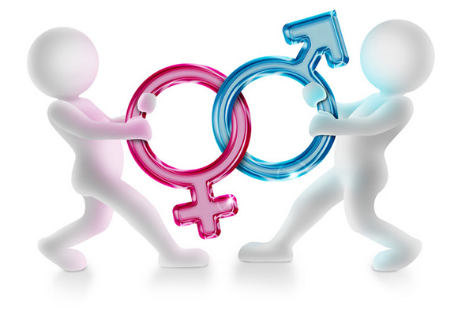
Introduction to Gender

Slide 2
Learning Objectives
To define what ‘gender’ is and how we might express it
To identify how gender is represented in men’s and women’s magazines
To consider the effect of women and men’s representations on society

Slide 3
What is gender?
Gender: the state of being male or female (typically used with reference to social and cultural differences rather than biological ones).
Gender

Slide 4
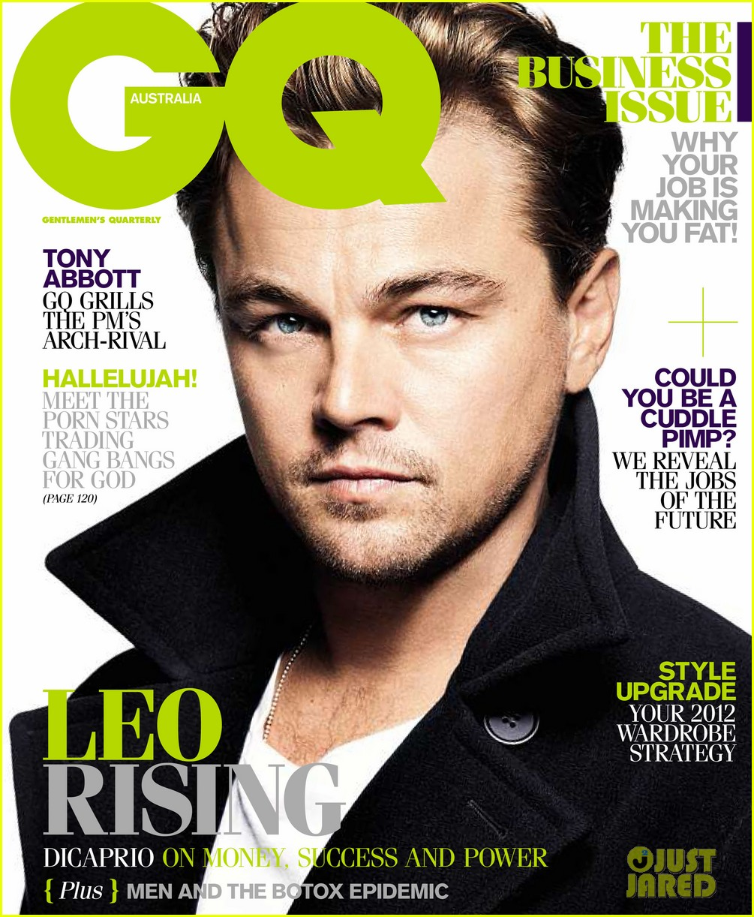
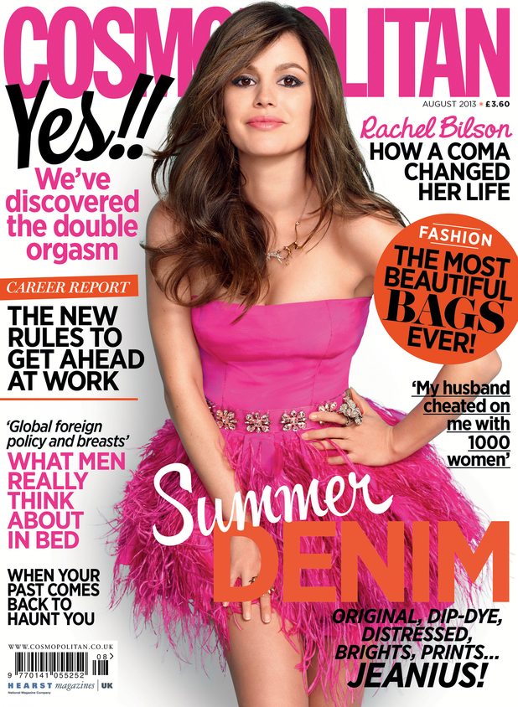
Men’s & Women’s Magazines

Slide 5
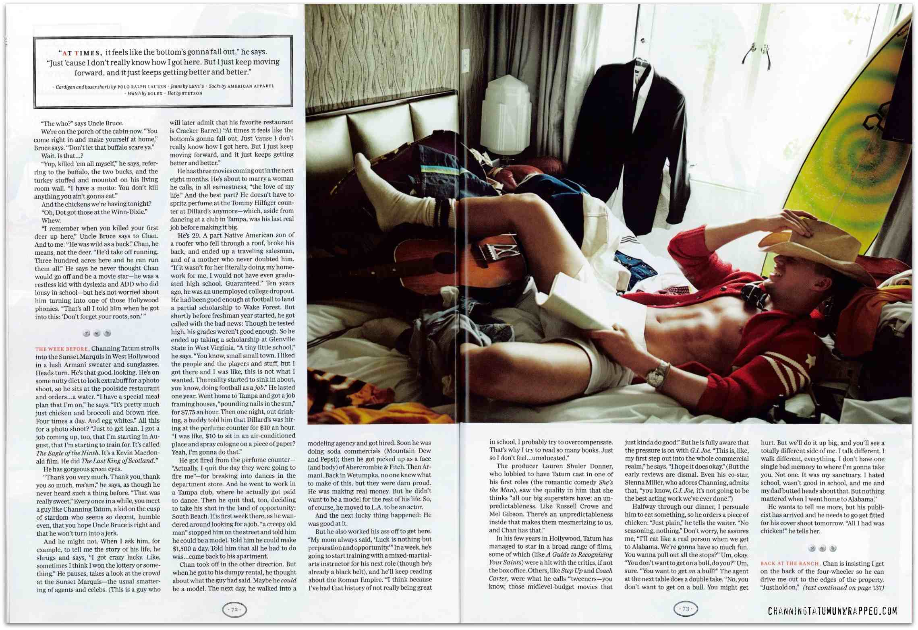
GQ: Representation of Men

Slide 6
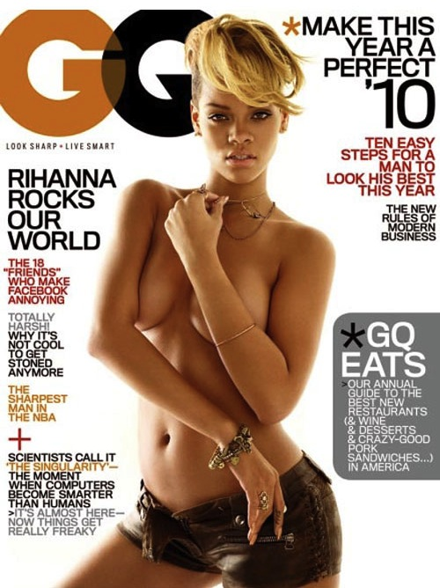
GQ: Representation of Women

Slide 7
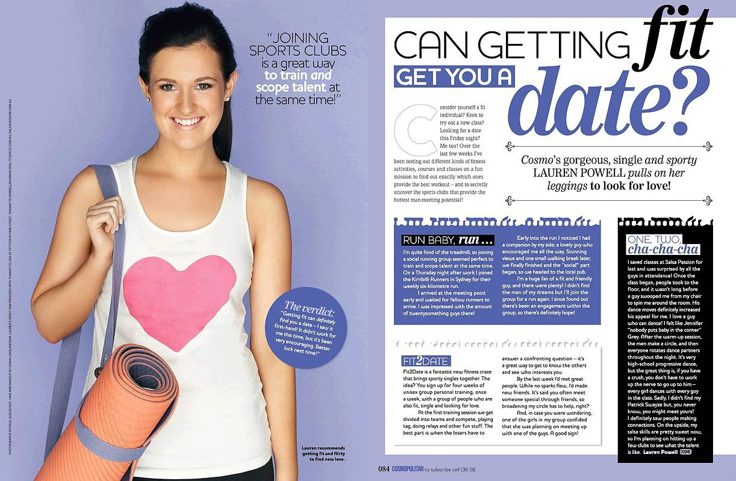
Cosmopolitan: Representation of Women

Slide 8
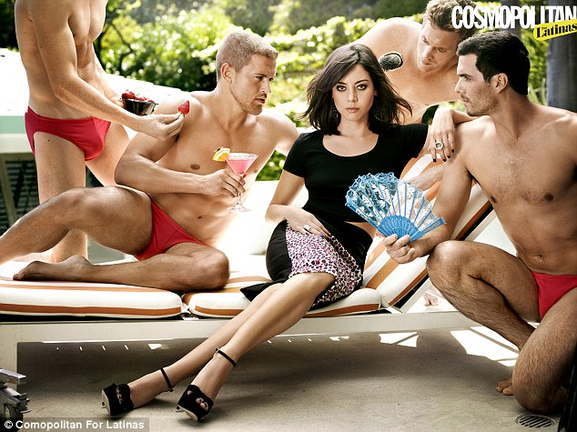
Cosmopolitan: Representation of Men

