Slide 1
Gender and Power

Slide 2
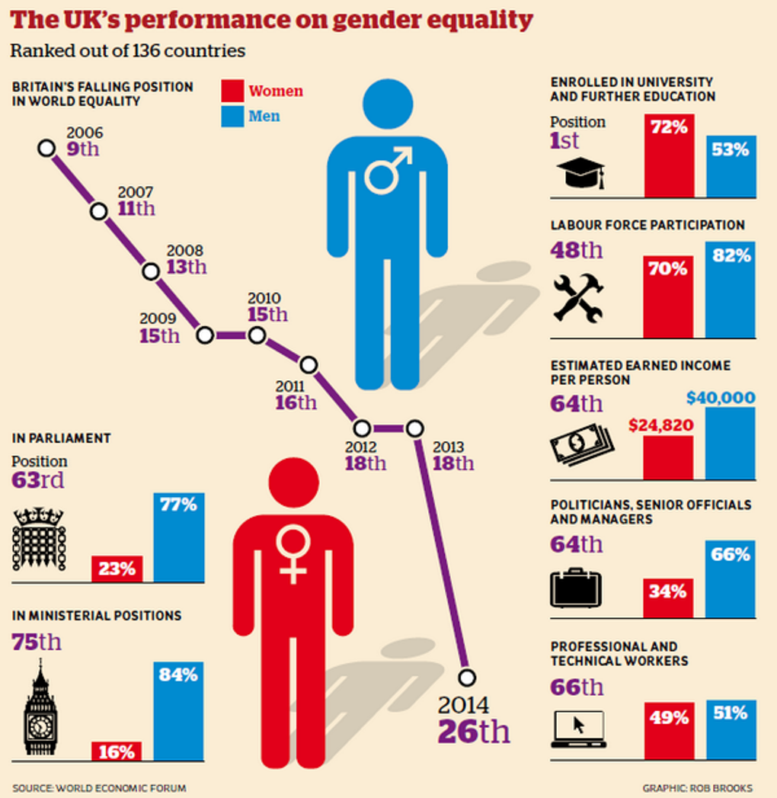
A few facts on gender inequality…
https://www.youtube.com/watch?v=IG5LyMYsvTs

Slide 3
Learning Objectives
To identify how gender is represented in your chosen text
To analyse language in terms of unmarked and marked forms
To examine how language use has suppressed women

Slide 4
How is gender represented in your text?
Is language in your text sexist?

Slide 5
Marked Expressions
Unmarked form (norm) = male
Examples:
In legal documents: ‘His possessions must be kept locked away at all times.’
In media: ‘Mrs Edgbaston of 43 Clove Crescent…’
Marked form (different to the norm) = female
In feminist books: ‘If you meet somebody and she says to you…’

Slide 6
Write a short blog article on…
…how women have been suppressed in society through language use

