Slide 1
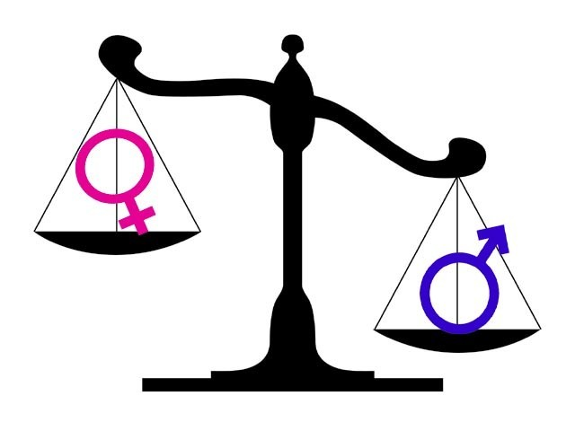
Gender and Power

Slide 2
Learning Objectives
To illustrate knowledge of semantic derogation
To evaluate the impact of semantic derogation in society
To critique the concept of semantic derogation

Slide 3
What is semantic derogation?
Definition: Negative connotations associated with overt marking of the female form (different to the male norm)
Examples of Semantic Derogation

Slide 4
Key Theorists:
Schulz (1975)
Cameron (1990)
Mills (1995)

Slide 5

Is this concept still relevant in today’s society?
FOR:
AGAINST:

Slide 6
Covert Prestige
Definition: Describes high social status through use of non-standard forms
Standard English is a social dialect used for academic and work success.
Studies:
Trudgill (1974) – found that men in Norwich used more non-standard forms than women regardless of class e.g. walking > walkin’
Eisikovits (1998) – studied 2 groups of males and 2 groups of females from working-class backgrounds aged 14 and 16. Younger adolescents of both groups used non-standard forms widely > rebellion! Covert prestige of rebellion appeared to underpin the older adolescent males’ choices, while the older females accepted the prestige of conformity.

Slide 7
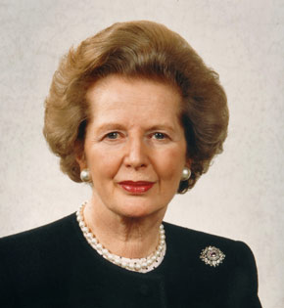
Case Study: Margaret Thatcher
Prime Minister: 1979 – 1990
Thatcher had to undergo a significant amount of speech training in order to be taken seriously as Leader of the Conservative Party and Prime Minister in a very male-dominated, upper class environment.
https://www.youtube.com/watch?v=28_0gXLKLbk

Slide 8

Gender Expression on a Continuum
Dependent on Context

Slide 9
Homework
Take a critical eye to yourself:
In 5 or more different contexts, self-monitor how you would position yourself on the gender spectrum. Comment on the following:
Standard vs. non-standard language
Body language
Hand gestures
Rising/falling intonation
Loudness or softness
Due: Next Lesson

