Slide 1
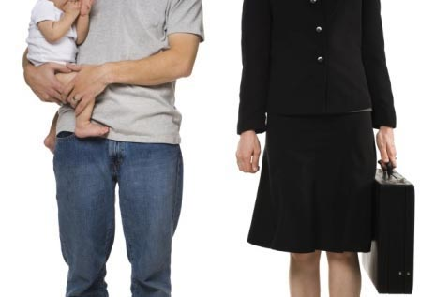
Critiquing Gender Stereotypes & Deficit Model

Slide 2
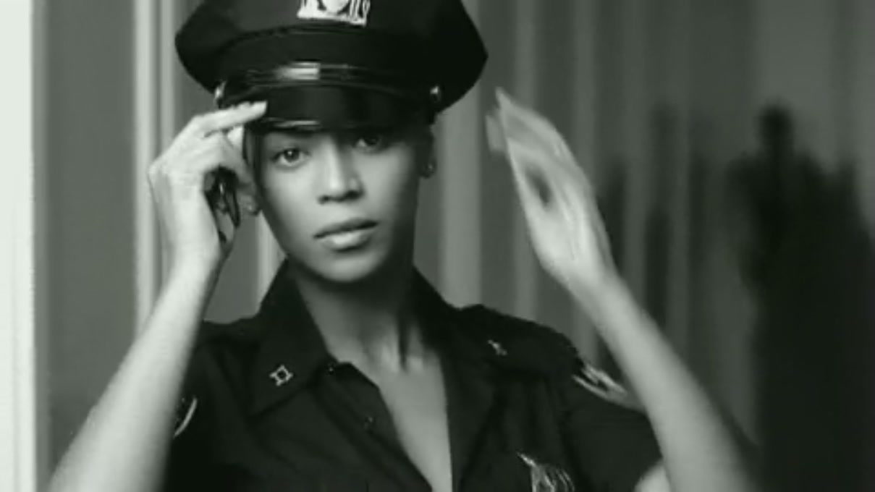
If I were a boy…
How accurately do you feel Beyonce illustrates the male gender?
https://www.youtube.com/watch?v=AWpsOqh8q0M

Slide 3
Learning Objectives
1) Consider
3) Identify
2) Debate
4) Create

Slide 4
Alternative Explanations of Lakoff’s Findings:
Dubois and Crouch (1975): found that in their data men used more tag questions than women although it was not suggested that they were less confident speakers as a consequence of these findings
O’Barr and Atkins (1980): discovered through their analysis of language in the courtroom that many of Lakoff’s suggested features did actually occur in women’s speech but also in men’s from lower class backgrounds. The term powerless language was more useful than women’s language.

Slide 5
Alternative Explanations of Lakoff’s Findings:
Holmes (1992): suggests that tag questions, rather than being simply a sign of uncertainty in a speaker, may also function as a device to help maintain discussion or to be polite. Tag questions are multi-functional. To suggest that hedges and fillers are simply markers of indecision is grossly misleading.
Which theorist(s) do you most align yourself with?

Slide 6
How is masculinity challenged through speech?
Cameron (1997): investigated the lexical choices of a group of male heterosexual friends with some interesting findings
In groups, read through your particular section of the journal article and summarise information to relay back to your peers

Slide 7
Create an Academic Poster on the Deficit Model & Critics’ Views

Slide 8
In small groups…
Listen to your data that you have collected involving single sex and mixed sex groups. Are there examples of Female Talk Features? Where would you position people along the Gender Continuum?
Please don’t delete your recordings.

Slide 9
Homework
Record a mixed sex group conversation subject to the same procedures as completed for the single sex group recordings.
Due: Next Lesson

