Slide 1
Language and Technology
What are the features?

Slide 2
SMS

Slide 3
AO2
Affordances - abbreviations are used to get information across more quickly.
Constraints – have to turn take, so not like a real argument when people speak over and overlap
Tones can’t be shown, use punctuation instead.

Slide 4
AO3
Text language/abbreviations
FYI – for your information
Plz - please
U - you
W - with
Y – you
Language that represents the semantic field of a heated discussion
‘I understand u picked up the kids?’
‘Next time tell me when you leave the country for 5 days’
‘If you were normal we would not have issues’
‘…’ used as sarcasm ‘ ya okay…’
Full stops shows anger as if she is sending short burst ‘read my email.’ ‘doesn’t matter.’
Multiple use of question marks showing anger/agitation/annoyance ‘do I need to cancel Maddie?????’

Slide 5
E.g.
Danny Smith and Rosie Parlier TEXT MESSAGE
RP – R U going tonpuck up the cat & take her 2 the cattery for me???? Plzz let me know cuz I cant
DS – why do I have to do it???? It lives W U its your responsibility I offered to look after it 4 U. I did pay 4 the thing
RP – stop messing about plzzz!!!!! FYI y would I want U to have her when u call her an it!!!!!!!!

Slide 6
Email

Slide 7
AO2
Affordances
Quick
Immediate reply
Can send to more than one person
Constraints
Tone is difficult to convey and interpret

Slide 8
AO3
The opening is very traditional.
Use of Standard English
Pre closing signal – “with best regards”
Formal lexis – “convenient”
Emails allows a subject before the e-mail.
It also allows a signature at the end which provides contact details.

Slide 9
E.g.
Dear Mr Smith,
With regard to our previous email, I am contacting you to confirm our meeting at Manor Hall on the 22nd of March, at 2:45pm.
I understand Mary King has stated her interest in attending, and after having discussed this with Mr Matthews, I have made arrangements for her to attend too.
If convenient please pass the message on to Mrs King.
Best regards,
William Stent
CEO
Monsters INC
215 Bullway St.

Slide 10
Social Networking

Slide 11
AO2
It uses links and hyperlinks which are a feature that would be expected on many websites, especially social networks as they are used to access other sites.
There are also lots of headings on each side of the page such as “events” and “requests”.
Werry said there was ‘an almost manic tendency to produce auditory and visual effects in writing to imitate speech’ which can be seen in Steve’s overuse of exclamation marks. This also links to his idea that it is more emotional/aggressive.

Slide 12
AO3
“lmao” – Dia uses initialisms in the comment on her status which are an example of text talk.
“A girl gotta save…” – she also talks about herself in third person and says “gotta” which is a representation of how people speak.
“Can I get an Amen!” – she uses Americanisms and doesn’t use a question mark as she is attempting to add enthusiasm to her status.
“Poke Back” – imperatives
“Who’s on Facebook?” and “What’s on your mind?” – interrogatives
Excessive use of exclamation marks- “im good just stressed major!!!” and “nursing school sucks!!!”

Slide 13
Jacob: Hey B, how r u?
Bella: Gd gd ty, wbu? Jacob: Yh, im good. So wuu2? Bella: Nm just chillin ☺
Jacob: Cool ☺ Bella: Wbu? Jacob: Just thinkin ;) Bella: What about? :3 Jacob: Stuffz ;) U goin to Dannys party tomoz? Bella: Nah, the she rent won’t let me out!!! :,( Jacob: Aww, sucks. Why not? Bella: I failed my mock yesterday, she’s makin me revise all day D: Jacob: Aww, well that sucks. Anyway, g2g. Food time ^.^ Byeeeeeee xxxxx <3
Bella: Haha, bye x

Slide 14
The Web

Slide 15
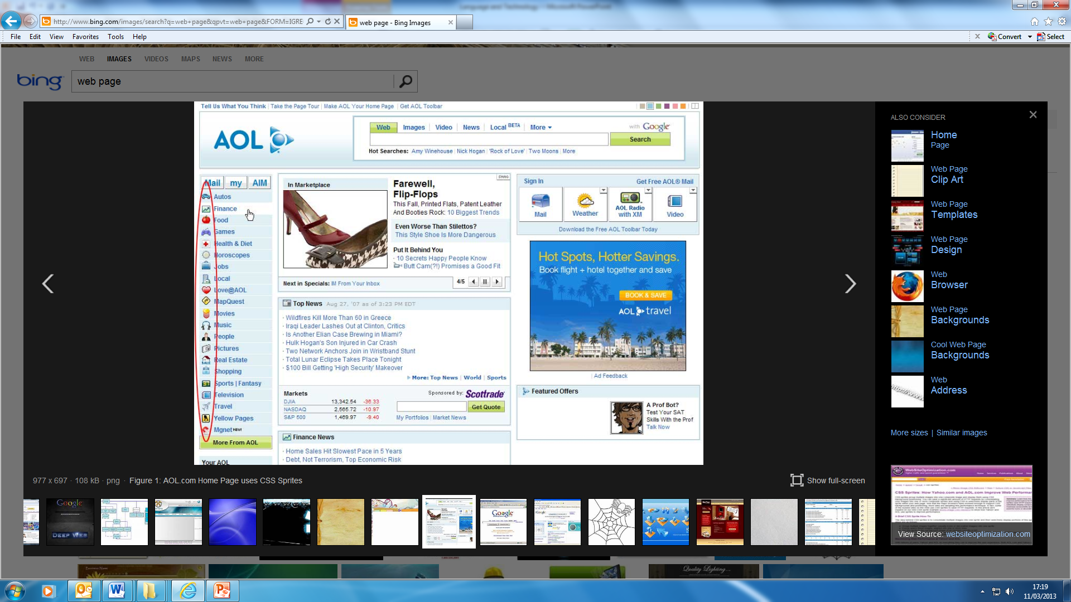

Slide 16
AO2
Affordances:
Hyperlinks and imperatives allow it to be interactive
Simple layout which is free to customise for individuals
News is always up to date
Constraints:
Not portable
Genre is newspaper, it has evolved to be online however content is still the same.

Slide 17
AO3
Hyperlinks
Imperatives “Search” “Track”
Headings
Dynamic weather news
Hyphenisation “Self-harming”

Slide 18
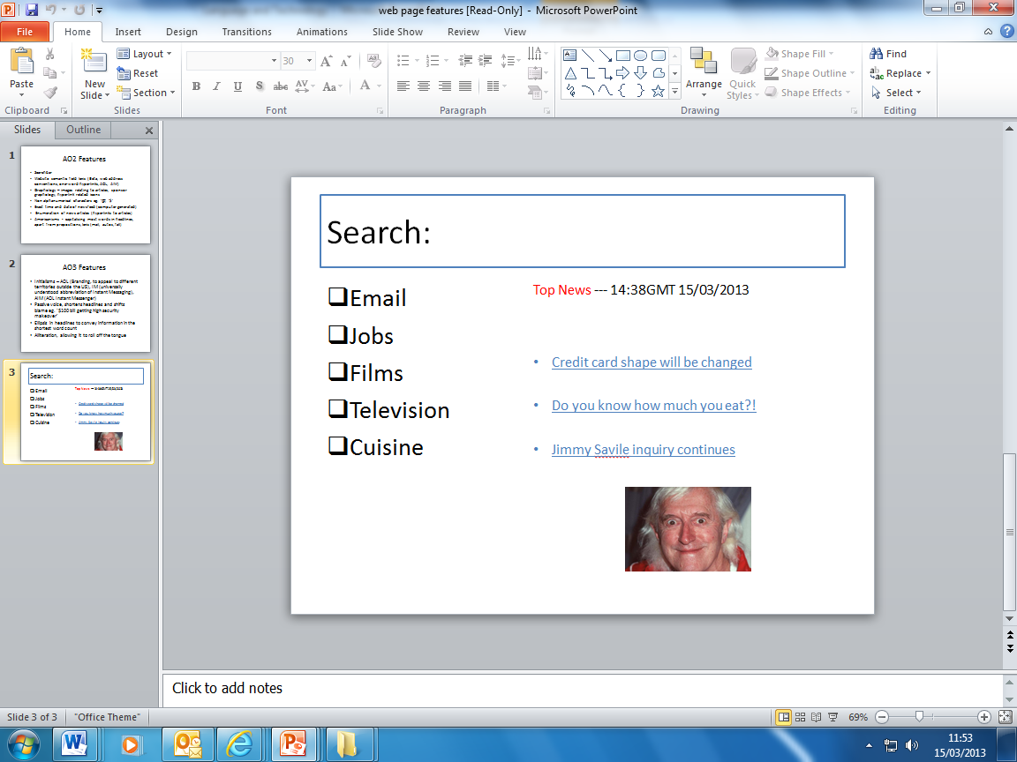
E.g.

