Slide 1
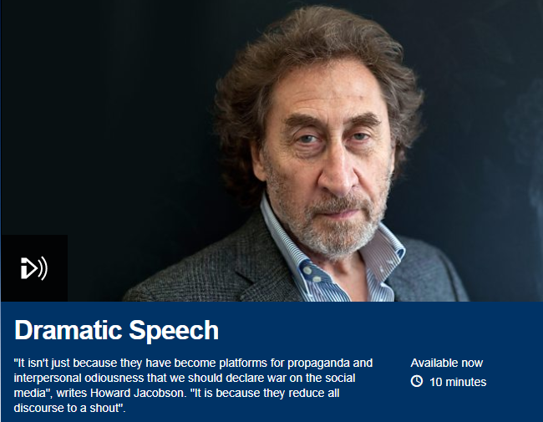
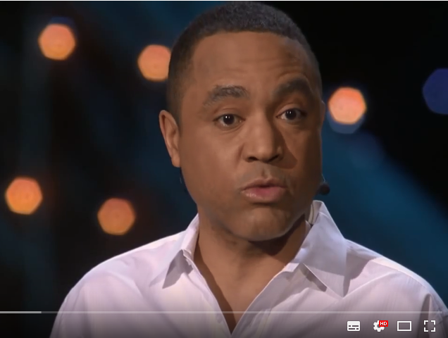
Debate: listen to these two points of view and then prepare your arguments…
Technology is having a detrimental effect on the English Language.
Also downloaded H:\Teaching\English Language\Language and Technology

Slide 2
expressive punctuation
homophonic representation
acronyms and initialisms
variant/phonetic spelling
vernacular writing
non-standard English
affordances and constraints
synchronous and asynchronous discourse
neologisms
compounds and blends

