Slide 1
Spot the pattern made or broken in this data…

Slide 2
A student’s email to a teacher
Secondly, today’s exam i found sooo hard and i am really panicking about getting my grade A… so i was wondering whether I could do a unseen practice paper for you?

Slide 3
Text conversation between friends
a-you going to sebs tonight
b-yeah man! are you?
a-Yeah deffo! meet at milford station at 7?x
b-Yeah mate, see you there

Slide 4
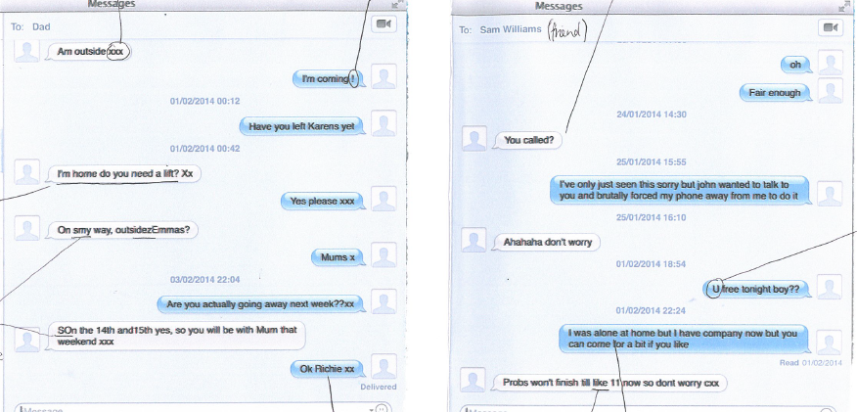
Female student to father and friend

Slide 5
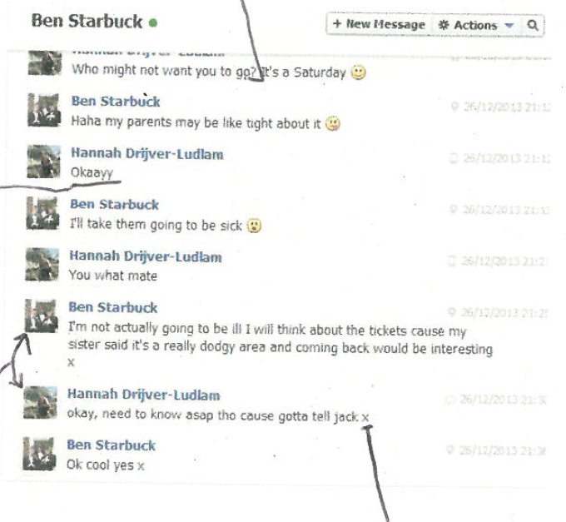
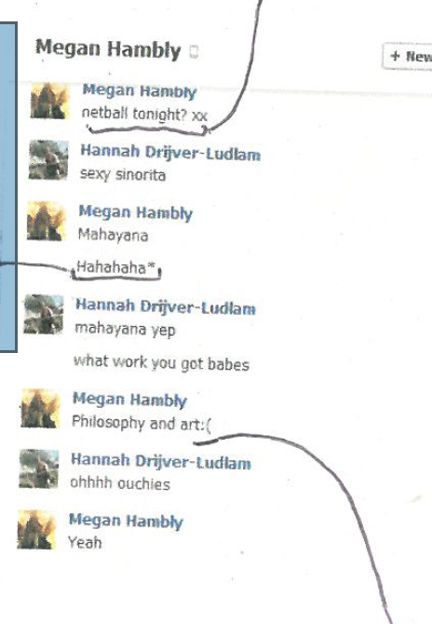
Female to female and to male

