Slide 1
A level English Language Assessment Structure
OCR (H470)

Slide 2
How the A level is examined:
Coursework (20%): Language Investigation (2,500 words) + Academic Poster (750 – 1,000 words)
Paper 1: Exploring language (40%): 2 hours, 30 minutes
Paper 2: Dimensions of linguistic variation (40%): 2 hours, 30 minutes

Slide 3
Coursework: Language Investigation (15%)
Language Investigation: 2,500 words on a topic of your choice
Introduction & Research Focus (with Aim & Hypotheses)
Methodology
Findings & Analysis
Conclusion
Evaluation
Bibliography
Appendix of Data

Slide 4
Coursework: Academic Poster (5%)
Academic Poster: 750 – 1,000 words representing investigation
Literature Review
Methodology
Findings & Analysis
Conclusion
Future Directions/Developments
Sources

Slide 5
Paper 1: Section A – Language under the microscope (20 marks)
You will be given 1 text and asked the following question:
Giving careful consideration to the context of the text:
a) identify and analyse uses of [lexis/semantics] in this text
b) identify and analyse the way [sentences] are constructed in this text
The board recommends spending 40 minutes on this section.
Lexis/semantics seems to be a popular choice for a) and sentences a particular focus for b) but these might change. No CGAP introduction is required; 10 marks are awarded per bullet point.

Slide 6
Levels

Slide 7
Paper 1: Section B – Writing on a topical language issue (24 marks)
You will be given a language statement such as ‘The English language is biased against women’ and asked the following question:
Taking the above statement into account, write a [genre] expressing your views. It should be no more than 500 words long.
The board recommends spending 45 minutes on this section.
The genre can change per paper. You must make sure to critique the statement at some point within your response even if it is to outline an alternative view in your introduction. Your audience is a non-specialist, reasonably well-educated one (imagine your A level peers not studying English Language); therefore, do not use any linguistic terminology. The statement could be on power, gender, technology, child language acquisition, language in the media or language change.

Slide 8
Paper 1: Section C – Comparing and contrasting texts (36 marks)
You will be given 2 texts (one ‘spoken’) and asked the following question:
Using appropriate linguistic concepts and methods, analyse the ways in which language is used in these two texts. In your answer you should:
Explore connections and variations between the texts
Consider how contextual factors contribute to the construction of meaning
The board recommends spending 1 hour and 5 minutes on this section.
We recommend structuring your answer with a brief comparative CGAP introduction and then according to language levels. It would be useful to include spoken language concepts/theories e.g. Accommodation Theory

Slide 9
Spoken Methods

Slide 10
Spoken Concepts

Slide 11
Paper 2: Section A – Child language acquisition (20 marks)
You will be given a transcript of a conversation between a caregiver and a child and asked the following question:
Using the appropriate terminology to explain your findings, examine the language development stage of both participants as evidenced in the transcript. You should identify and analyse the phonology, grammar and meaning of their utterances. Use your knowledge of theories and concepts of child language acquisition to support your answer.
The board recommends spending 40 minutes on this section.
‘Meaning’ includes lexis, semantics and pragmatics. No CGAP introduction required. Focus on the children and not the adults.

Slide 12
CLA Methods

Slide 13
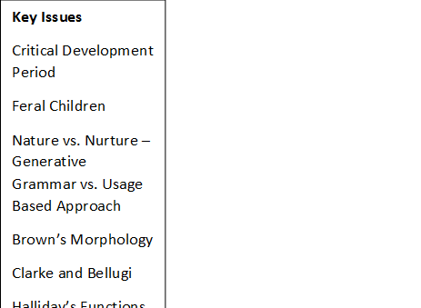
CLA Theory

Slide 14
Paper 2: Section B – Language in the media (24 marks)
You will be given 1 text to analyse and asked the following question:
Using your understanding of relevant ideas and concepts, investigate how language features and contextual factors construct meanings in this text.
The board recommends spending 45 minutes on this section.
This question is designed to synoptically assess your knowledge on power, gender and technology; however, this won’t be specified in the question. It is your decision to apply appropriate concepts. Focus on representation and context. We advise beginning with a short CGAP introduction and then structuring your answer systematically according to language levels.

Slide 15
Media Methods

Slide 16
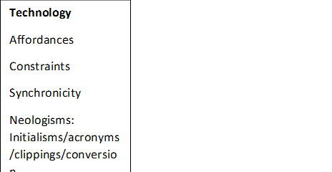
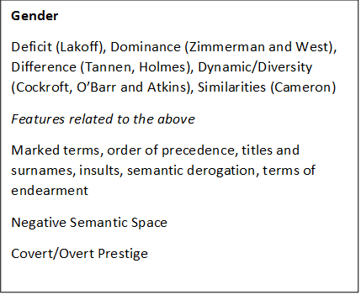
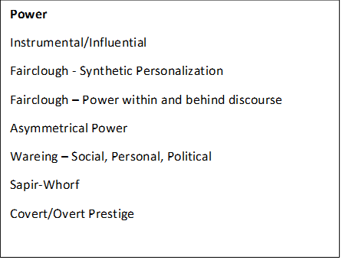
The Media

Slide 17
Paper 2: Section C – Language change (36 marks)
You will be given 2 texts from different time periods (1600 onwards); 1 text is likely to have been written in the last 25 years. You will be asked the following question:
By detailed analysis of the writing in both passages, discuss and illustrate the variations in language between the x^{th} and x^{th} centuries. In your answer you should explore the ways language is used in each text, as well as how contextual factors influence the way meaning is constructed.
The board recommends spending 1 hour and 5 minutes on this section.
We suggest beginning with a brief comparative CGAP introduction and then structure your answer systematically according to the language levels. Make sure to integrate lexical change, semantic change and grammatical change terminology. Include relevant concepts such as codification, political correctness, standardisation, etc.

Slide 18
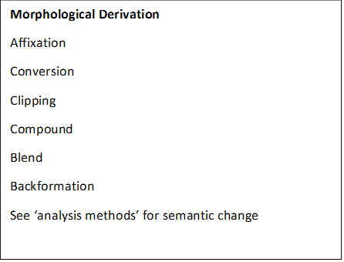
Change Methods

Slide 19
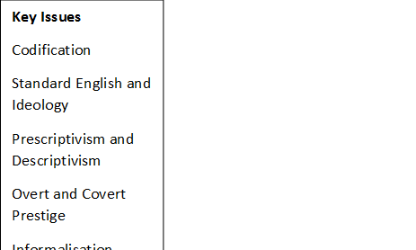
Change Knowledge

Slide 20
GOOD LUCK!!

