Slide 1
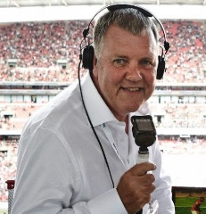
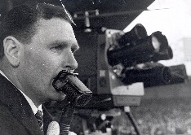
How has the language used in football commentary has evolved over the years
Hypothesis
I expect there to be a clear difference in how the commentators from the two eras speak
I expect there to be more pauses in the 1960s transcripts compared to the present day ones
Findings
RP vs Estuary English
From this we saw a transition away from Received pronunciation in the 1966 transcripts to use of Estuary English used in the present day transcripts
This is said to be the new RP according to David Rose Warne
It is also said that it will replace RP in formal situations
Gender theory
From the present day transcripts we also saw that the commentators were going against the theory of Deborah Tannen
This being because Tannen argued see the world as a competitive space and see communication and speech as a way of building status
Compared to how women see communication as a way in which to offer or seek support
Although we saw that Glenn Hoddle offer support to Clive Tlydesley
This did not occur in the 1966 transcripts between Wally Barnes and Kenneth Wolstenholme
Suggests the roles of men are changing but has been only started to change fairly recently
Discourse Structure
From the 1966 transcripts we saw the omission of the analysis section instead there was an instant replay of the goal and a gap of twenty six seconds between commentary
This compared to the present day transcript which had an analysis part
This shows how the expectation of the viewer has changed and now they expect the commentators to analyse the goal
Methodology
Choose two football matches one from present day and one from the 1966 World cup final
The two teams are England and West Germany
Transcribe two matches from each era
Make each section three minutes long
Transcript one was from the last three minutes of the 1966 game
Transcript two was from the mid way point of the second half in the 2016 game
Transcript three was from the mid way point of the second half in the 1966 game
Transcript four was from the end of the second half from the 2016 game
Future Directions
If I were to do this again there are certain things that I would do differently
I would make gender a more significant part of the investigation
Change it from different eras to instead doing a women’s football match and compare it to a male equivalent to see if the language used my commentators alters in anyway
Or even one match with all male commentators and one with female commentator as well
See if language used by males changes when speaking to a women compared to speaking to a man
Whether females language is different to that of a man
References
Linguistics of Football by Eva Lavric 2008
Rosewarne, David, 1984 “Estuary English” Times Educational Suplement, 19th October 1984
The language of Sport emagazine issue 2 November 1998
http://www.allinfo.org.uk/levelup/enb2gender.htm
Spoken language Pragmatics by Regina Weinhert 2007
Language of Football Commentators: An Analysis of Live English Football Commentary and its Types by Radek Humpolik

