Slide 1
A-Level English Language Investigation
Topic Ideas

Slide 2
Language and Law (Forensic Linguistics)
Key questions:
Is the language of law accessible to the lay person?
Is the language of law just/fair?
How may the language of law be ambiguous?
Can you determine whether somebody is innocent or guilty through their language?
Who possesses power in a court setting?

Slide 3
Language of Politics
Key questions:
Is the language of politics democratic?
How can political language manipulate its citizens?
How much linguistic freedom do citizens have?
Is rhetoric or slang more effective in political speeches?
Are politicians successful in converging to the general public?

Slide 4
Language of Religion
Key questions:
Is the language of religion still applicable today?
Is our language more reflective of a secular society?
How have religions used language to increase membership?
Is the language of religion oppressive/divisive?
In what ways is the language of religion contradictory?

Slide 5
Language of Marketing
Key questions:
How do companies persuade people to purchase their products?
In what ways do companies rely on stereotypes to sell products?
How much linguistic power do international corporations have over their consumers?
How effective is the language of advertising?
How do marketing departments rely on the psychology of language to manipulate their audiences?

Slide 6
Language of the Environment (Ecolinguistics)
Key questions:
How is language used to indicate significance of climate change?
How has language changed to accommodate new environmental ideas/technologies?
In what ways does the language of the environment manipulate individuals’ emotions/moral compass?

Slide 7
Representation of Accent & Dialect
Key questions:
Why do people’s perceptions of accent differ?
Are we becoming increasingly prescriptivist or descriptivist with our attitudes towards accent and dialect?
How are characters represented in fiction through dialect?
Does accent restrict or enable social mobility?
Are there professions which favour/require a particular accent?

Slide 8
Language of Relationships
Key questions:
How does the language of dating differ to the language of friendships?
How may professional relationships blur into personal relationships?
How and why do we consciously/subconsciously converge or diverge when speaking to other people?
How might the language of relationships be both exclusive and inclusive?
How may address terms damage/improve relations between people?

Slide 9
Language of Censorship
Key questions:
Is it right that we censor language so as not to cause offence to others?
Has political correctness gone too far?
Should we learn not to take offence from taboo language?
Is the intonation more threatening than the words themselves?

Slide 10
Language and Technology
Key questions:
Is technology corrupting our language?
How may online identities differ from physical face-to-face identities in terms of language use?
How can the language of technology be exclusive/inclusive?
To what extent does the language of technology mirror spoken language?
Are emojis words?

Slide 11
Global English(es)
Key questions:
To what extent is English viewed as the lingua franca?
How does British English differ as a language from American/Australian English?
What is the difference between a language and a dialect?
To what extent is the spread of English dangerous for the survival of other languages?
To what extent has the dominance of the English language resulted in a decline of native speakers learning second languages?

Slide 12
Language in the Media
Key questions:
What are the key linguistic differences between print media and broadcast media?
Do news stories follow Labov’s narrative structure?
Are news stories inherently negative?
How do radio presenters use the English language differently to television presenters?
How has the language of BBC news presenters changed over time?

Slide 13
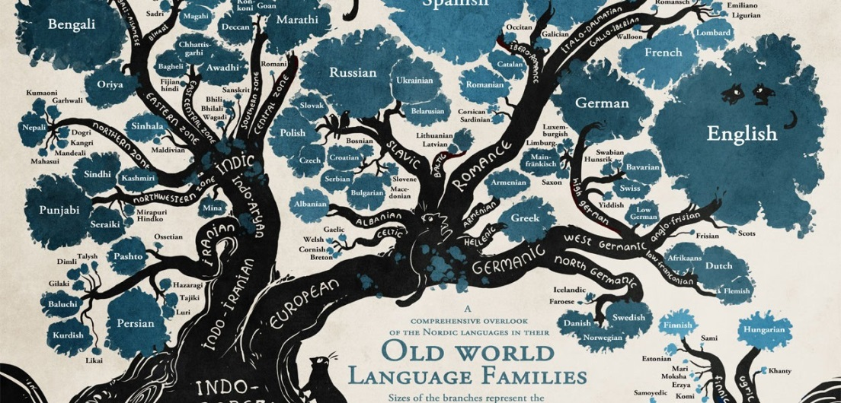
History of English
Key questions:
How has Present Day English evolved to be a global language from a collection of different languages?
To what extent is the English language a creole?
How have language attitudes of English changed over time/due to influence of other languages?
To what extent do you think Latinate lexis will drop out of English?
Does English have an unnecessary number of synonyms?

Slide 14
Language of Argument
Key questions:
What language choices induce conflict?
How is argument intentional/accidental?
How can conflict destroy/boost relationships?
How does the language of argument reflect a negotiation of power?
What are the differences of argument (if any) between same-sex and mixed-sex conversations?

Slide 15
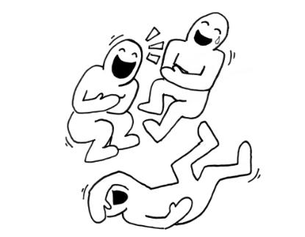
Language of Comedy
Key questions:
How does language create the emotional response of laughter?
How can the language of comedy be inclusive/exclusive?
To what extent can comedy liberate/offend?
How do comedians exert power over their audience?
To what extent has political correctness limited comic material?

Slide 16
Language Acquisition
Key questions:
Do children develop language more quickly through speaking to them as adults?
Do children from middle class backgrounds have greater vocabularies?
How do children learn second languages faster than adults?
How does a person’s idiolect develop?
To what extent does lack of communication with adults limit a child’s linguistic development?

Slide 17
Language of Teaching
Key questions:
How can language used by teachers build/weaken relationships with students?
What is the value of positive reinforcement in language?
How has the language of teaching changed over time?
How can teachers/students gain/lose power in the classroom?
How conscious are learners of the language of learning?

Slide 18
Language of Health
Key questions:
How is the language of medicine inaccessible?
How can individuals be comforted/scared by medical language?
Do you think Latinate medical terms will gradually fade from the English language to reduce translation time from doctor to patient?
How do mental health disorders affect language use?
To what extent do doctors have linguistic power over patients?

Slide 19
Language and Gender
Key questions:
Does gender theory still apply in today’s conversational contexts?
Is power only asserted through stereotypically masculine language?
Does sexual orientation influence language use?
How can the English language exclude women?
To what extent is gender neutral language influencing the way we speak?

