Slide 1
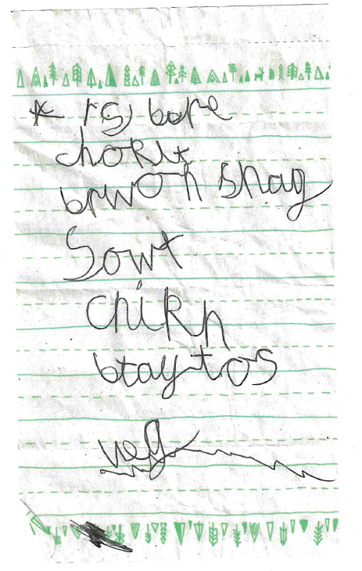
What do you think this text is? What does it say?

Slide 2
Spelling...
There are 44 phonemes in the language but only 26 letters
Try sounding out these words... How would you spell them if you spelt them the way they sound?
Graphemes - the letter combinations we use to turn the phoneme (the sound) into written words. Digraphs are two letter combinations, like ‘ph’ for the ‘f’ sound, that are used to make one sound.
What’s the problem with these words for children learning to write?
Homophones words that sound the same, but are spelt differently (and mean different things)

Slide 3
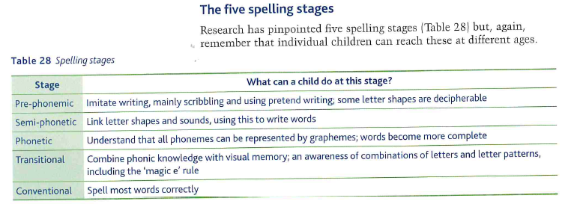

Slide 4
Designing a language investigation around some CLA data
Group 1: The Artist and Teeth Instructions are by the same child, but at a different age. Group 2 ‘The Artist’, is by a 6 year old girl, and ‘A Sunny Day’ by a 7 year old girl. Group 3: The two texts ‘A Terrible Day’ and ‘A Space Adventure’ were written by the same child. In your group, how would you design a language investigation using this data?
How would you design a language investigation using this data?
Think carefully about the linguistic frameworks you would use
Try making some notes now, using the frameworks you have chosen
How does the page of theory that I’ve given you help?
What would be the problems with this investigation structure and how would you improve it?
Field of interest/study/ concepts | Constant element | 2+ Pieces of data with minimal non-linguistic variation | Linguistic Variation that you would study | Investigation Question | Three Appropriate Methods
Technology, speech/writing, idiolect/sociolect | A 17 year old female A level student (not doing English Language) | Transcriptions of her talking to a friend and texting to the same friend | Spoken and written mode; face to face vs computer/phone mediated language | How does language vary between texting and face-to-face conversation? | Standard/non standard grammar; lexical choices; graphology and prosodics
Language of children

Slide 5
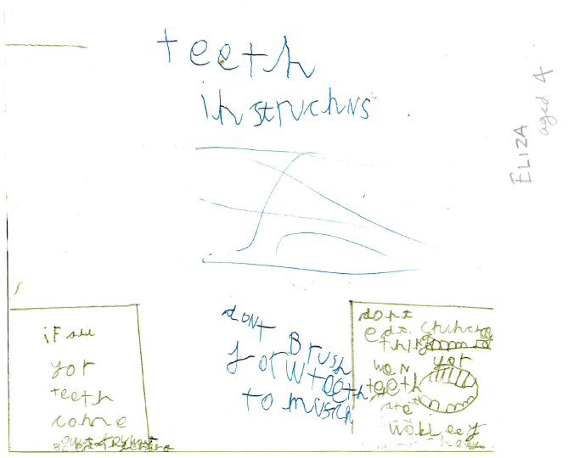
What do you think this text is? What does it say?

Slide 6
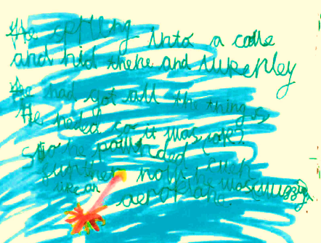
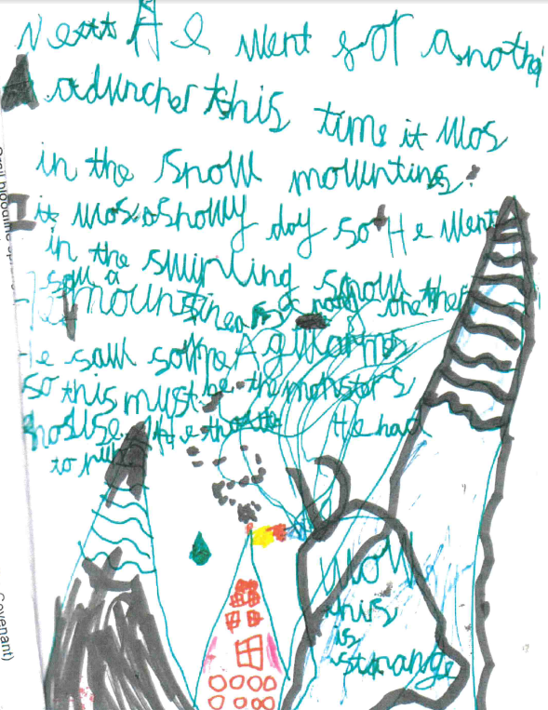
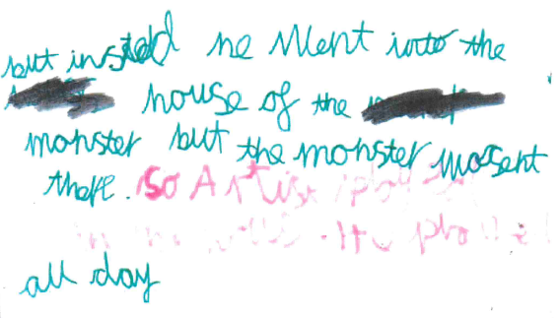

Slide 8
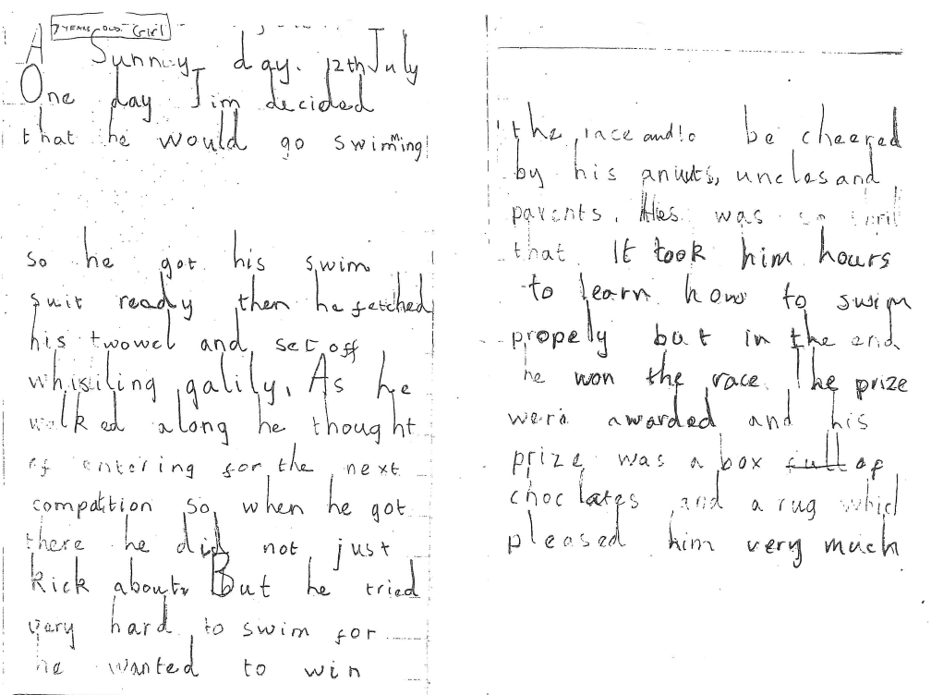

Slide 9
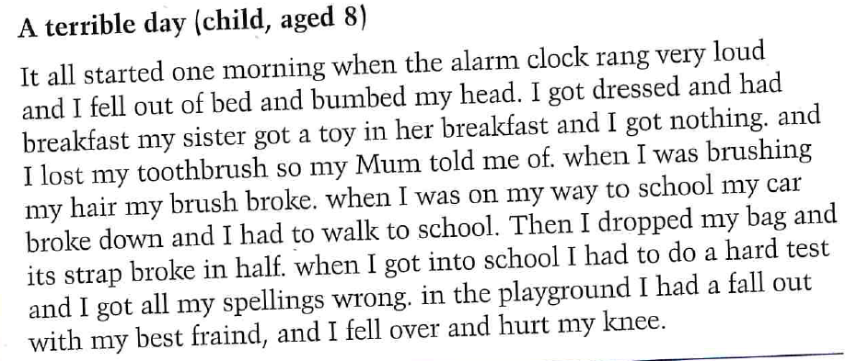
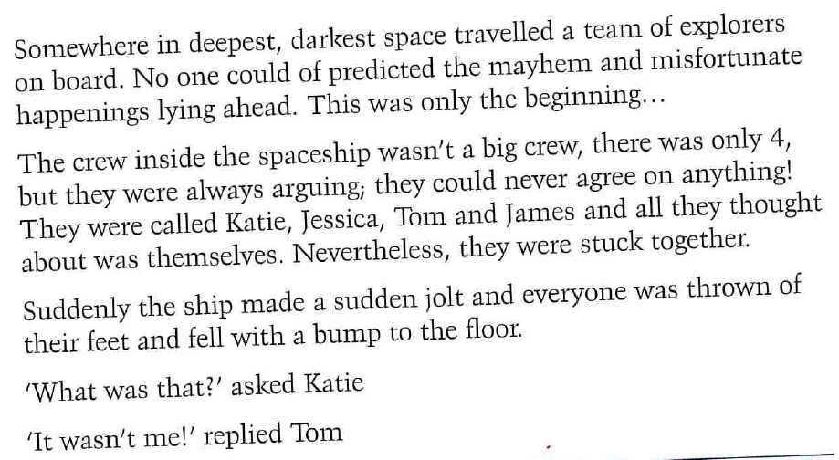
Two texts written by the same child

Slide 10
