Slide 1
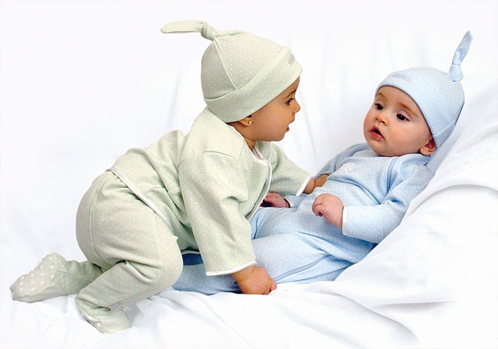
English Language
Child Language Acquisition

Slide 2
How do children learn to speak? The four main theories:
Children learn language through imitation (Behaviourism).
Children learn language through a specific type of interaction with their caretakers (CDS).
Children have an innate capacity for language (Innatism).
Children develop, linguistically, in stages which correspond to their intellectual development (Cognitivism).

Slide 3
How difficult is learning to speak?
It is ‘doubtless the greatest intellectual feat any one of us is ever required to perform’ (Bloomfield, 1933)
You have to master:
Sounds – 44 sounds
Words – over 1m
Meaning: how do you know what a ‘dog’ is?
Grammar: Struggling artists can be a nuisance vs. Marking papers can be a nuisance.

Slide 4
Behaviourism
Behaviourism, or Learning Theory, is the idea that language is learned through imitation, in the way in which all other behaviour is learned.
There are three key aspects of behaviourism; imitation, reinforcement and association.

Slide 5
CDS
CDS, or Social Interactionism, rejects innateness.
It is the theory that caretakers use a particular type of speech, almost universally, which aids a child’s understanding of language.
Features include: simplified vocabulary, repetition, short, simple grammar, commands, questions, high pitch and slow pace (Snow & Ferguson, 1977).

Slide 6
Innatism
Innatism is the idea that children acquire language naturally, via an innate capacity, which is triggered through exposure to their own language.
Chomsky proposed that humans were born with a Universal Grammar (UG), which was separate from intelligence and allowed children to be aware of the generic rules of language.

Slide 7
Cognitivism
Cognitivists argue that language is not independent from intelligence and is, in fact, dependent upon intellect.
The theory implies that a child needs to understand an entity in order to give it a name and needs to understand time to use tenses.
Language follows comprehension.

Slide 8
Behaviourism – support vs. criticism
Accent is imitated
Children aren’t rewarded
Association is complicated
Input quality is poor
Children speak to themselves and say things they’ve never heard
Children don’t learn via correction:
C: Nobody don’t like me.
M: Say ‘nobody likes me.’
C: Nobody don’t like me (above x 8).
M: Now listen carefully. Say ‘nobody likes me.’
C: Oh…nobody don’t likes me.

Slide 9
CDS – support vs. criticism
Interaction appears to help develop conversational skill and politeness
Caretaker speech is limited
It doesn’t account for children following stages of development, regardless of upbringing
Grammar is too complicated to be learnt this way.

Slide 10
Innatism – support vs. criticism
There are parts of the brain which are known to be responsible for language
It’s the only theory which accounts for similar stages of acquisition across cultures and the speed at which children learn:
Children pass through very similar stages of development:
Holophrastic – approx. 12 months
Two Word – approx. 18 months
Telegraphic – approx. 2 years
It doesn’t show appreciation for language as a social phenomenon.

Slide 11
Cognitivism – support vs. criticism
Children do learn in stages
Some milestones in language link to milestones in development
Savants do not have impaired language ability.
Children follow similar stages but are not equally intelligent.
Correlation or causation?

Slide 12
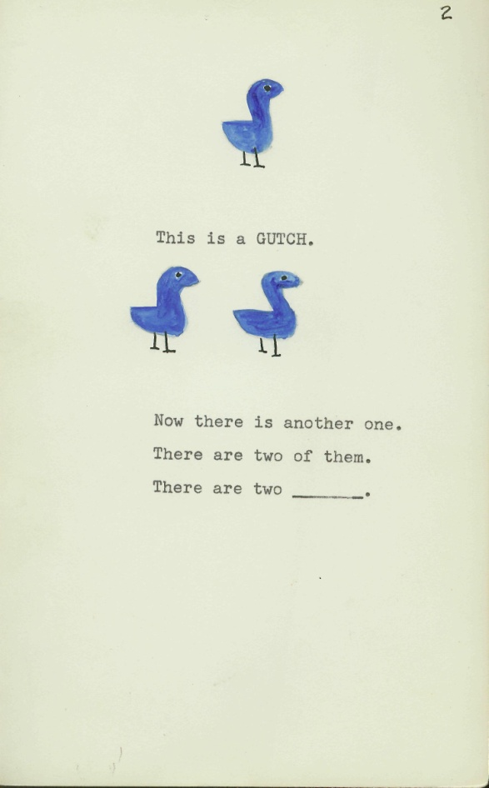
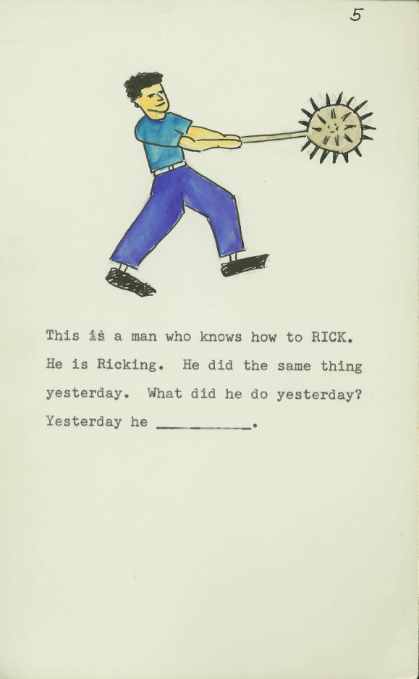
The evidence – which theories does this research support/challenge?
Notes:
Berko, 1985, 3-4 year olds – rules of language – not imitating

Slide 13
The evidence – which theories does this data support/challenge?
Child: The daddy doll’s more bigger than this one
Mother: Yes, it’s much bigger isn’t it?
Child: It’s more bigger
Child: My want to hold your hand
Child: Mummy’s got a poorly ankle. She hurt it when she felled over

Slide 14
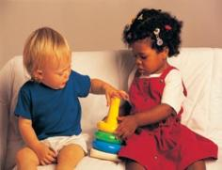
What do theories of language need to account for?
children learning language rapidly
the regularities which exist across languages
the stages that children pass through
the fact that children make mistakes
the fact that input is so limited
and that grammar and meaning are so complex.

