Slide 1
Phonetic Development

Slide 2
Early phonology
Stage One: 0-8 weeks: Basic biological noises
During the first few weeks, the child expresses itself vocally through crying. Different kinds of cry can be identified - hunger, distress or pleasure, for example. Cries are ‘reflexive’ noises. The quality of sound is similar to a ‘mouth-wide-open’ vowel such as [a]. Babies from different countries make the same sound. Also, the child can vary its rhythm and pitch patterns.
Stage Two: 8-20 weeks: Cooing and laughing
The sounds are quieter, lower pitched, more musical. At the beginning of this period, each segment of cooing is quite short (about 1\2 second). It consists of a short vowel-like sound usually preceded by a consonant-like sound. It is quite nasal in quality. Sounds are made like ‘coo’, ‘goo’ and the reduplicated ‘ga-ga.’ There is more lip movement at this stage. By now sounds are being formed in the VELAR region of the mouth (‘ga-ga’, ‘coo’) and the child is becoming increasingly aware of what its mouth and vocal chords can do.

Slide 3
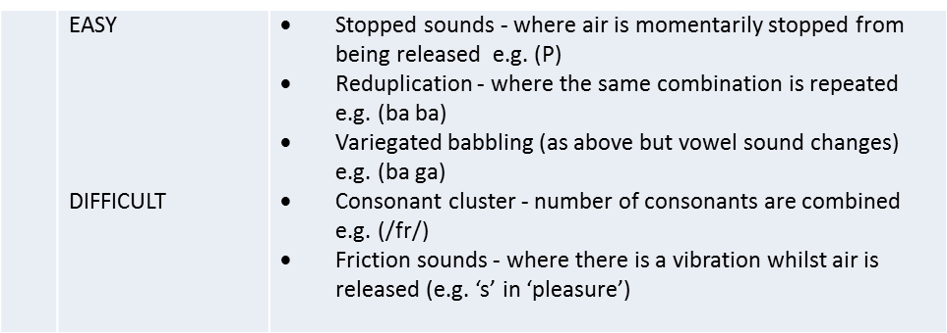
Stage Three: 20-30 weeks: vocal play
Cooing sounds die down. Single vowel-like or consonant-like sounds are repeated over and over again. Several sounds are made at front of mouth [mmmm] and [nnnn] or friction sounds such as [ffff]. Consonant-vowel (CVCV) sequences are more noticeable e.g. ‘Mama’, ‘dadadada’. There is greater range of consonant-vowel sound and the nasal aspects of ‘m’ and ‘n’ are developing. Uvular sounds made by the back of the tongue and labial sounds formed at the lips are giving the baby a vocal work-out. The child practises the fricative sounds of ‘f’, ‘z’ and ‘s’
Stage Four: 25-50 weeks: babbling
Ababababab\dadadada - this is reduplicative babbling and there are variegated sequences - adu, mabu. More complex friction sounds are present - ‘s’ and ‘sh’. Cluster consonants are avoided - early speech prefers consonants to occur before vowels - ‘ta’ rather than ‘at’. Surveys suggest still no differences in babbling between different races. The child is trying out sounds in a random manner at this stage.
Babbling continues up to 18 months and often alongside ‘real’ speech.

Slide 4
Phonemic Expansion & Contraction During the babbling phase. The number of different phonemes produced by the child increases initially. This is known as PHONEMIC EXPANSION. However, by the age of 10 months, the number of phonemes reduces (PHONEMIC CONTRACTION) and the range of sounds made by the child shrinks, becoming increasingly restricted to those of the child’s mother tongue.
Stage Five: 9 - 18 months: melodic utterance
Melody, rhythm and tone develop. Children from different language backgrounds now sound increasingly different from each other. In the transition from pre-language to language, children produce many ‘proto-words’ where the sounds are clear but the meaning is not.

Slide 5
FAVACDURDS

