Slide 1
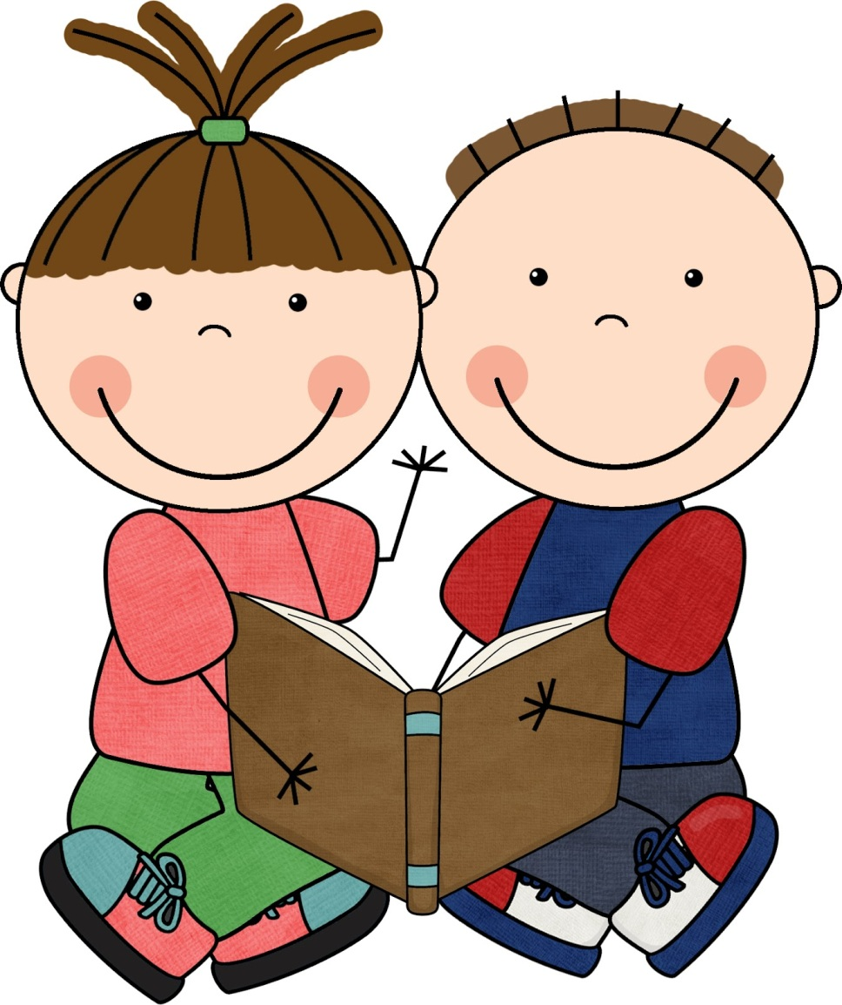
Child Language
Reading Schemes

Slide 2
What are they?
Reading schemes are created to assist children in their development.
Biff and Chip are part of the Oxford Reading Tree scheme.
Such schemes have levels of difficulty to help children to acquire, develop and extend their knowledge of lexis, semantics and grammar through the use of familiar characters and simple narratives.
They may also link to culture, politeness, equality and behaviour.

Slide 3
Typical Features
Lexical repetition
Syntactical repetition (SVO, one clause?)
Simple verbs (rather than verb phrases)
One sentence per line/page
Anaphoric referencing
Limited use of modifiers
Text-image cohesion
They may also:
Interact with the reader
Use phonological devices
Present simple dialogue
Vary sentence moods

Slide 4
Analyse them
Take one book between three of you, read it to each other and then analyse your text, considering the features mentioned.
Read your book to the class, in level order, and explain the features you noticed.

Slide 5
Now create some
Now you know how reading levels work, join up with another group of three and complete the book you’re given by adding text and images.
If you have time, read and present these.

