Slide 1
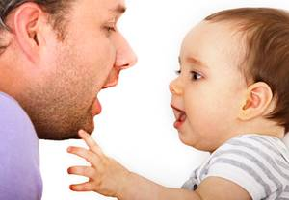
Child Language Acquisition
Language Acquisition Debates

Slide 2
AS Revision Quiz
A lot of your AS knowledge you will need to draw on for the Child Language Acquisition unit.
A child will need to learn the following to develop speech. Define each one:
Phoneme
Phonetics
Lexis
Semantics
Syntax
Morphology
Phonology
Discourse
Pragmatics

Slide 3
How difficult is it learning to speak?
It is ‘doubtless the greatest intellectual feat any one of us is ever required to perform’ (Bloomfield, 1933)
You have to master:
Sounds – 44 sounds
Words – over 1m
Meaning: how do you know what a ‘dog’ is?
Grammar: Struggling artists can be a nuisance vs. Marking papers can be a nuisance.

Slide 4
Where does language come from?
4 Approaches:
Nativist – humans have an inbuilt capacity to acquire language
Behaviourist – language is acquired through imitation and reinforcement
Social Interactionist – child language is developed through interaction with adults
Cognitive – language acquisition is part of a wider development of understanding that develops
Discuss in your groups which one you agree with at this point and vote

Slide 5
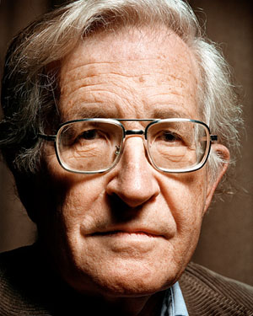
1) Nativist – inbuilt capacity to acquire language
Noam Chomsky
Children:
experience the same stages of development and at the same pace
resist correction
create forms of language that adults don’t use (overgeneralisations)
make their own rules for language use that seem to understand that all languages have grammatical rules
produce correct language when surrounded by poor adult-speech

Slide 6
The Wug Test – Jean Berko-Gleason
https://www.youtube.com/watch?v=MgB2iMuEZAA

Slide 7
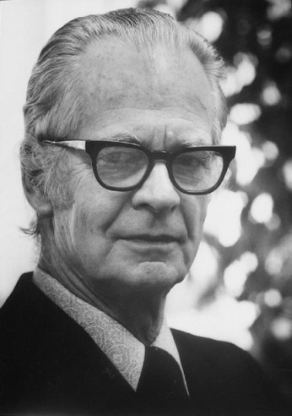
2) Behaviourist – acquired through imitation + reinforcement
B.F. Skinner
Children:
imitate accent and dialect
learn politeness and pragmatic aspects of language
repeat language they have heard around them and incorporate it into theirs – lexical knowledge must be gained from being told the right labels

Slide 8
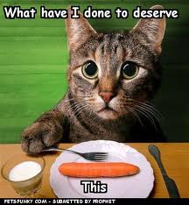
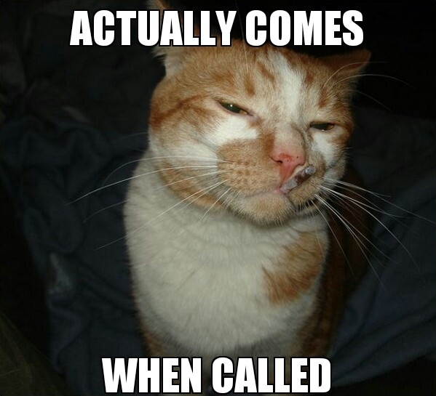
Remember a time when you have been:
3. Praised
1. Told off
2. Punished
Did it change your behaviour in any way?
4. Rewarded

Slide 9
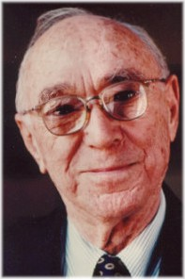
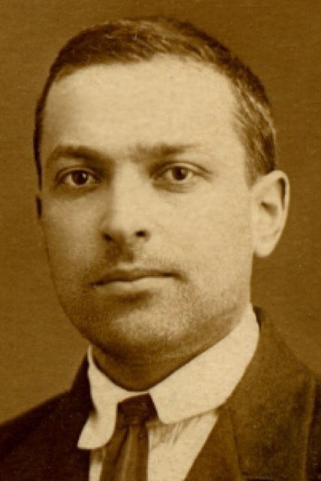
3) Social Interactionist – children interact with adults
Jerome Bruner
Lev Vygotsky
Routine/rituals seem to teach children about spoken discourse strategies such as turn-taking
Pragmatic development suggests that children do learn politeness and verbally accept behaviour
Role-play and pretend play suggest that more interaction with carers can affect vocabulary

Slide 10
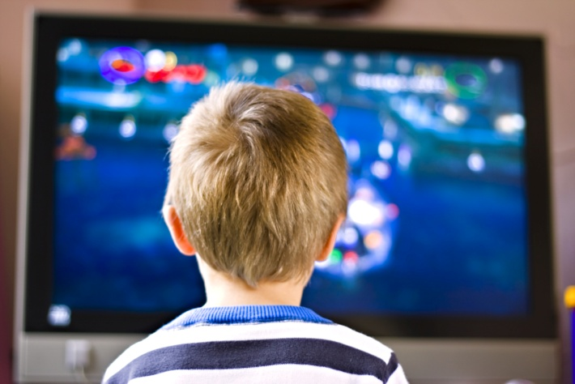
Case Study of ‘Vincent’:
Source: Jean Aitchison (1996: 53)
Vincent, a hearing child born to deaf parents, learned to communicate with sign language. He used to sit in front of the TV and watch the pictures with fascination but did not pay attention to the sounds. He did not speak until he went to school.

Slide 11
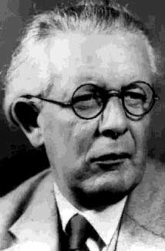
4) Cognitive – part of wider development of understanding
Jean Piaget
Lev Vygotsky
Children:
can‘t grasp aspects of language until they are ready; stages of development support this
produce utterances which increase in complexity as they work towards mastering a rule

Slide 12
Bellugi’s Stages for Negation & Pronoun Formation

