Slide 1
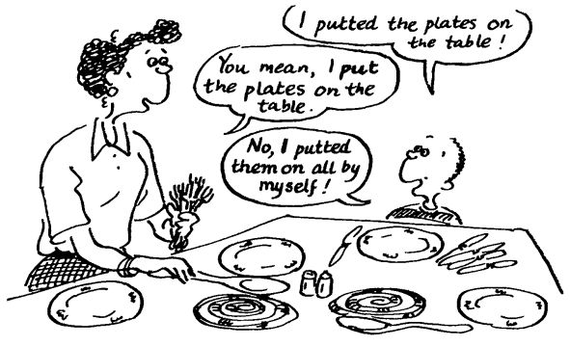
Child Language Acquisition
Criticism of Approaches

Slide 2
Nativist Approach
Children:
stop overgeneralising and learn to use language correctly, as with irregular verbs
need input to give them more skills than grammar e.g. pragmatic understanding
children who have been deprived of social contact can’t achieve complete communicative competence

Slide 3
Study of Genie
Girl deprived of social contact until she was 13 and then unable to learn speech beyond a very basic level (i.e. feral child)
Supports the critical period hypothesis where language needs to be acquired within a certain time frame
How does this challenge Chomsky’s theory?

Slide 4
Behaviourist Theory
Children:
do more than just imitate language and can form sentences that they have never heard of before
hear ungrammatical spoken language around them but can still learn correct language
do not seem to respond to correction
aren‘t negatively reinforced for language use
aren‘t always corrected by parents for incorrect grammar
corrections might slow down development
imitate but don’t necessarily understand meanings

Slide 5
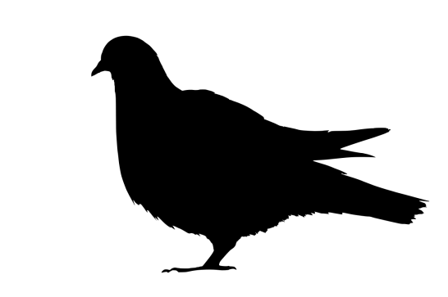
Other Limitations of Behaviourism
‘fis’ phenomenon suggests that children can hear and understand the correct pronunciation but simply can’t produce it themselves at that stage
Research was conducted on rats, dogs and pigeons, not on humans

Slide 6
Social Interactionist Theory
Children from cultures that do not promote interaction with children (e.g. Samoa) can still become articulate and fluent language users without adult imput

Slide 7
Cognitive Theory
Children:
with cognitive difficulties can still manage to use language beyond their understanding
acquire language without having an understanding of it, especially in the early stages of development
‘fis’ phenomenon suggests children’s cognitive understanding can be present but their physical development still impacts their ability to use language

Slide 8
Which theory do you align yourself the most with?
Using the transcript provided, write a couple of paragraphs in support or critiquing one or more of the child language acquisition theories focussing closely on the data.

