Slide 1
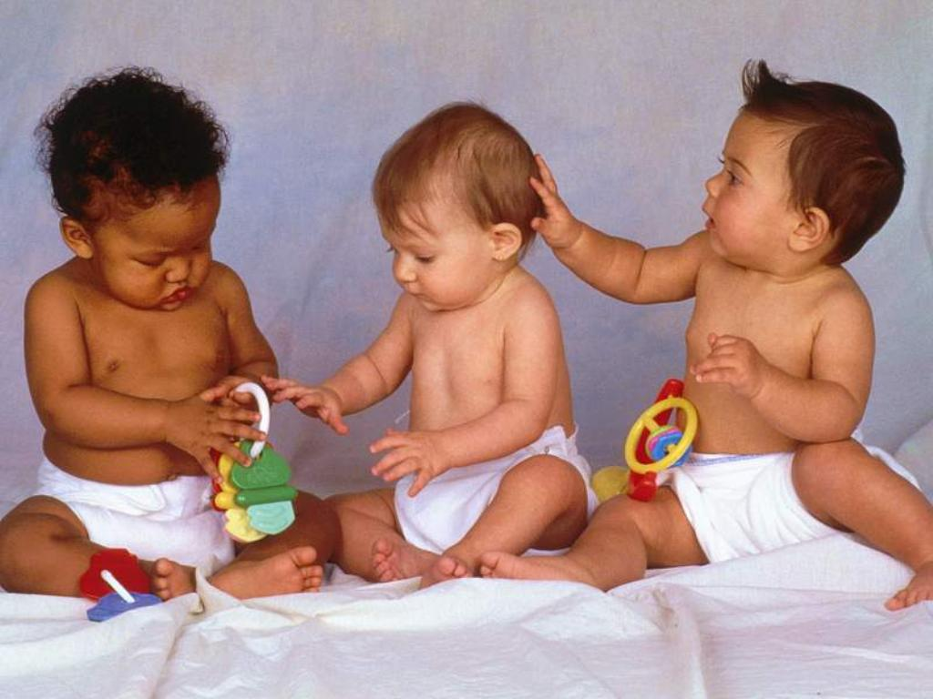
Child Language Acquisition
Developing Phonology

Slide 2
Some Key Terms:
Phonemic expansion: the variety of sounds a child can produce increases
Phonemic contraction: the sounds a child can make are reduced so that they can only make the sounds of their own language
Reduplicated monosyllable: the repetition of a sound such as ‘ba ba’
Consonant clusters: groups of consonants such as ‘str’ or ‘gl’ that demand more muscular control than single consonants or vowels so tend to appear later in the baby’s utterances

Slide 3
Pre-Verbal Stages: place in the correct order
Proto-words
Babbling
Cooing
Vegetative

Slide 4
Pre-Verbal Stages:
Vegetative – sounds of discomfort or reflexive actions e.g. crying, coughing, burping, sucking (0 – 4 months)
Cooing – comfort sounds, vocal play e.g. grunts and sighs become vowel-like coos, laughter starts, hard consonants and vowels produced, pitch (squeals, growls) and loudness (yells) practised (4 – 7 months)
Babbling – extended sounds resembling syllable-like sequences, repeated patterns e.g. reduplicated sounds (‘ba-ba’) and non-reduplicated (variegated) such as ‘agu’ (6 – 9 months)
Proto-words – word-like vocalisations accompanied by paralinguistic features (e.g. pointing) to aid communication (9 – 12 months)

Slide 5
Early Phonological Errors:
Deletion – omitting the final consonant in words e.g. do(g), cu(p)
Substitution – substituting one sound for another (especially the ‘harder’ sounds that develop later, such as /∫/) e.g. ‘pip’ for ‘ship’
Addition – adding an extra vowel sound to the ends of words, creating a CVCV pattern e.g. doggie
Assimilation – changing one consonant or vowel for another (as in the early plosive sounds /d/ and /b/) e.g. ‘gog’ for ‘dog’
Reduplication – repeating a whole syllable e.g. dada, mama
Consonant cluster reductions – consonant clusters can be difficult to articulate, so children reduce them to smaller units e.g. ‘pider’ for ‘spider’
Deletion of unstressed syllables – omitting the opening syllable in polysyllabic words e.g. ‘nana’ for ‘banana’

