Slide 1
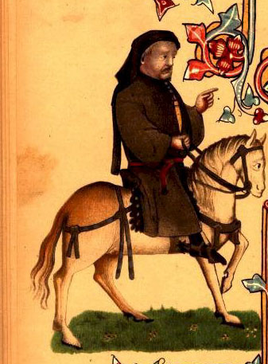
Middle English
Emergence of Standard English: 1350 – 1500
https://www.youtube.com/watch?v=3lGJntNFFqo
Notes:
https://www.youtube.com/watch?v=3lGJntNFFqo

Slide 2
Hundred Years’ War (1337 – 1453)
Dynastic conflict between the French and the English crown
Nationalistic sentiment after the war led to resentment towards France with French no longer a realistic language choice for the English nobility
French was only used by the educated in high society as a matter of culture and fashion rather than economic or political necessity

Slide 3
Peasants’ Revolt (1381)
Labour shortages gave the peasants a stronger bargaining position
Increased geographical mobility
Rise of commoners to positions of leadership and authority in public service e.g. Henry VII filled his offices increasingly with the growing middle class
Social upheaval was part of the rise of capitalism

Slide 4
War of the Roses (1455 – 1485)
House of York vs. House of Lancaster
House of York – supported by commercial classes in London
House of Lancaster – supported religious/language change but introduced the poll tax!
Solution: Henry VII (a Lancastrian and a Tudor) creating centralisation of power. Standard begun to emerge in the early 14th C.

Slide 5
Lollardy
Challenged the role of Latin in the Medieval Church due to the language being accessible to only the few a means of control over the many
Major part of the movement was John Wycliffe’s translation of the Bible into English (1382). Resisted by the authorities but indicated presence of growing reading public

Slide 6
Blankety Blank does Middle English:
Get into pairs and grab a mini whiteboard!

Slide 7
Fill in the blanks:
1423
Parliament used French until about _______ for petitions. From on English and French were used and only in English after .
The turning point seemed to be during the reign of due to victory over the French at Agincourt.
English was used officially by the royal bureaucracy after .
The earliest known will in English comes in the year .
London brewers began using it in .
Latin remained the language of .
1485
1489
Henry V
1420
1383
1422
record

Slide 8
Try and work out what the following means:
Dixitque Deus fiat lux et facta est lux (Latin)
And God seide, Be maad liζt and madd is liζt (Early Wycliffe)
And God seide, Liζt be maad and liζt was maad (Later Wycliffe)
And God said, Let there be light and there was light (King James Version)

Slide 9
New Standard
Beginning of the 13th C people from all over England were moving to London and bringing their widely divergent dialects with them > centre of government & administration, trade & commerce
London was the biggest city in England with 70,000 people
The second biggest city was with
The third biggest city was with .
Norwich
12,000
York
10,000

Slide 10
Drive to Standardisation
Levelling – London vernacular was no longer a Southern variety but more a Midlands one laced with Northern features
Chancery English – written language promoted by government administration. Contributed greatly by Caxton’s printing press in .
Teaching in English was introduced in the mid 14th C and was the rule by .
English was used in the law courts of London in .
1476
1385
1356

Slide 11
Impact of the Great Vowel Shift
Attributable to greater social mobility
Partially due to migration
Also due to upper classes emphasising variants of vowels to maintain the distinction from the lower orders most effectively
Wave theory: As particular speakers and speech communities gained in power and prestige, the language variants they used were adopted in neighbouring areas.

Slide 12
Borrowings:
From Flemish, Dutch and Low German
However, extraordinarily large number of French and Latin borrowings had a major effect on structure of English vocabulary
Native words were replaced by loan words but very often the old words continued to exist beside the new ones

Slide 13
Borrowing Activity
Group these words into triplets (Germanic-French-Latin synonyms)
Rise Ask Flame Conflagration
Time Sacred Mount Interrogate
Fire Epoch Age Consecrated
Ascent Question Holy

Slide 14
By the end of the Middle English Period:
16.5%
28.3%
27%
28.24%

