Slide 1
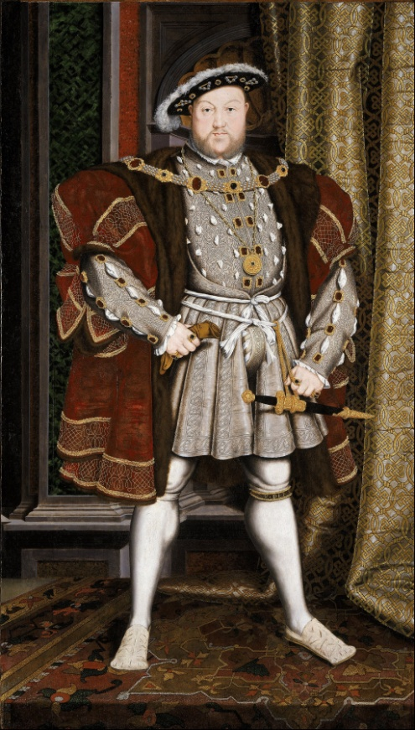
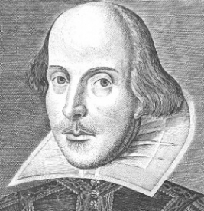
Early Modern English
1500 – 1700

Slide 2
Economic & Demographic developments:
Growth of a national market
Mercantilism (competition between countries)
Production of wool was major industry overtaken by grain in terms of profitability
Land enclosures carried out – privatisation of the commons (more beneficial for the better of). Contributed to social unrest of the period with depopulation of villages > urbanisation

Slide 3
Reformation & Renaissance
King replaced Pope as Head of the Church
Radical religious movements:
Puritanism reflected growing concerns of the middle class
Quakerism reflected concerns of the lower classes
Renewed interest in classical learning (Renaissance); science became more empirical; beginning of a literary boom (Shakespeare, Marlowe, Milton).
Literacy started to spread and significance of the press grew.

Slide 4
Political unrest & Restoration
Tudor dynasty united England (and Wales) and ended English territorial ambitions in France.
Key conflicts based on religion included:
English Civil War (1641-49)
Commonwealth (1649-53)
Protectorate (1653-59)
Royalists (aristocracy) who wanted to maintain feudal order vs. Parliamentarians (middle class) who wanted to secure more democratic control through Parliament.
Consequences of the Commonwealth and Protectorate included promoting godliness:
Closing theatres
Laws against adultery, blasphemy, religious education
Continuing weakening power of the monarch
Restoration ended antipathy toward foreign ideas – French ideas and social ideals as well as French borrowings were once again en vogue

Slide 5
standardisation
Written English lost almost all of its regional features
Reinforced by the introduction of printing
The ‘Standard’ was a Southern variety rather than Northern or Western found among the well-bred and well-educated in London.
Ruled out speakers of regional dialects who were viewed as vulgar, effeminate or affected
Prescriptivism took on greater force after 1660 due to the Restoration period

Slide 6
Latin
Maintained as the language of record, but also scholarship. English was not considered to have the fixity of morphological and syntactic form ‘that was desirable for a language meant to convey scientific and scholarly thought’ (Soderlind 1998).
Experienced a revival in English Renaissance
Latin used pervasively in the domain of law

Slide 7
Grammatical change
More rigid word order
Inflections weakened
‘Do’-periphrasis (auxiliary verb)
Basic shift from the traditional gender system to one based on the feature (human). Lead to loss of old masculine-feminine-neuter distinction
New neuter possessive form its
Demonstrative pronouns also included yonder (distant from speaker and hearer)

Slide 8
Lexical Change
You started to replace thou as a singular form
Growth of compounds
Plural alternation of <f> with <v> generally accepted e.g. wife, wives
Hierarchical address terms: Lord/Lady (nobility), Sir/Dame (gentry), Mr/Mrs (working professionals), Goodman/Goodwife (yeomen), no title (craftsmen/labourers)

Slide 9
ORTHOGRAPHICAL change
Orthography underwent a high degree of regulation in the hands of the printers
Fair amount of toleration towards alternative spellings
From the mid 17th C to the mid 18th C, capitalisation of the most prominent words (especially nouns) was widely practised
Respect for learning and a recognition of the etymologies of numerous words > spellings become more Latin-like e.g. dette became debt (Latin – debitus)
Contractions reached their peak in the early 18th C e.g. &, tho, punishmnt
Use of phonetic spellings e.g. don’t (markers of style)
Retention of older spellings e.g. diner for dinner

Slide 10
Great Vowel Shift
Commenced in the Middle English period (1350 – 1500)
Highlighted the mismatch between spelling and pronunciation. English spelling was essentially fixed by the early 16th C and represents the stage of pronunciation reached at or before that time
High vowels became diphthongised e.g. time
/ti:mə/ became /təIm/
Migrants moved to London due to its increasing opportunities and accommodated to London speech by differentiating their vowels
Upper classes wanted to distance themselves from the lower classes by differentiating their vowels

Slide 11
Borrowing
Many of the new borrowings were tied to specific fields. Individuals from these fields wanted a simple and clear style and there was seldom a native equivalent (science):
Science (commensurable)
Medicine (sporadic)
Religion (latitudinarian)
Majority of Latin loan words were general e.g. immaturity, invitation, relaxation, parental
Backlash against the large number of borrowings in the late 16th C and early 17th C pejoratively termed inkhorn terms > regarded as obscure, affected and pompous. Move to use Germanic words

Slide 12
Semantic change
Secure:
Original meaning: carefree, overconfident
Current meaning: fixed/fastened so as not to come loose, safe
Enthusiasm:
Original meaning: negative term for religious fantaticism
Current meaning: intense eager enjoyment/interest
Ringleader:
Original meaning: neutral leader/head
Current meaning: initiates an illicit/illegal activity

Slide 13
Literature
Shakespeare coining new words and phrases e.g. conversions such as ‘eared’, compounds such as ‘green-eyed’, blends such as ‘glisters’ (glistens + glitters)
Milton – famous poet who was a freethinker in terms of liberty reflected in his work; variant and futuristic grammatical and lexical choices

Slide 14
Time to be a Journalist
With the information about the Early Modern English period, write a newspaper article about how English has changed since the Middle English period and compare it to today.
Choose one of the newspapers below and consider your target audience:

