Slide 1
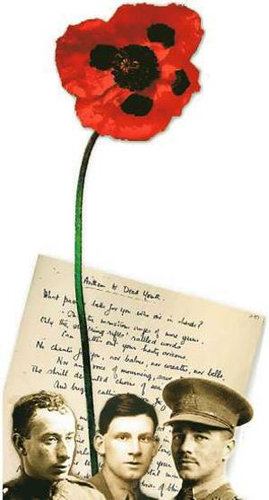
Phonology in War Poetry
Advanced Linguistics
Monday 7th November 2016

Slide 2
Why is sound such an influential sense?
Sound serves 2 basic functions for people around the world: signalling and communication.
Signalling: omni-directional – it can signal an object or event that is completely out of sight and beyond your tactile senses
Communication: humans have developed an intricate form of signalling that we call language. This enables us to communicate complex and abstract ideas as well as thoughts, feelings and specific forms of information.

Slide 3
What are the connotations of these sounds to you?
https://www.youtube.com/watch?v=yzkCplTjBN0
https://www.youtube.com/watch?v=SlZMVAydqaE
https://www.youtube.com/watch?v=nDq6TstdEi8
https://www.youtube.com/watch?v=nRwM7UEQ8Q0

Slide 4
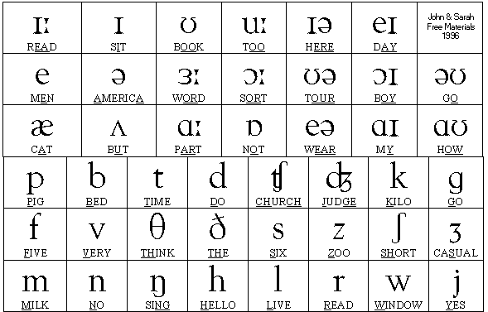
The sounds of the English language:
How many sounds do you think there are?
Think of the connotations of words such as sizzling, pop, delicious, tart, mango.

Slide 5
A brief introduction to phonology:
Consonants:
Plosives: Created when the airflow is blocked for a brief time - /p//b//d//t//k//g/
Fricatives: Created when the airflow is only partially blocked and air moves through the mouth in a steady stream - /v/ /ð/ /z/ /ʒ/ /f/ /θ/ /s/ /ʃ/ /h/
Affricatives: Created by putting plosives and fricatives together - /ʤ/ /ʧ/
Approximants: Created by a continuous, relatively unrestricted airflow - /w//r//j/
Nasals: Created by air moving through the nose - /m/ /n/ /ŋ/
Laterals: Created by placing the tongue on the ridge of the teeth and then air moving down the side of your mouth - /l/
Vowels: Vowels are sounds made without closure or audible friction
Long vowels: /ɑ:/ /i:/ /ɜ:/ /ɔ:/ /u:/
Short vowels: /I/ /ɛ/ /ə/ /i/ /ʌ/ /ʊ/ /æ/ /ɒ/
Diphthongs: A vowel in which there is a perceptible change in quality during a syllable - /eI/ /aI/ /əʊ/ /Iə/ /ɛə/ /aʊ/ /ɔI/ /ʊə/

Slide 6
Applying this knowledge to war poetry:
What words jump out at you based on their sounds?
How does the sound of the word add to its meaning/the meaning of the poem overall?
What are the connotations of certain sounds?

Slide 7
Applying this knowledge to war poetry:
Bent double, like old beggars under sacks, Knock-kneed, coughing like hags, we cursed through sludge, Till on the haunting flares we turned out backs, And towards our distant rest began to trudge. Men marched asleep. Many had lost their boots, But limped on, blood-shod. All went lame, all blind; Drunk with fatigue; deaf even to the hoots Of gas-shells dropping softly behind. Gas! GAS! Quick, boys! - An ecstasy of fumbling Fitting the clumsy helmets just in time, But someone still was yelling out and stumbling And flound'ring like a man in fire or lime.- Dim through the misty panes and thick green light, As under a green sea, I saw him drowning. In all my dreams before my helpless sight He plunges at me, guttering, choking, drowning. If in some smothering dreams, you too could pace Behind the wagon that we flung him in, And watch the white eyes writhing in his face, His hanging face, like a devil's sick of sin, If you could hear, at every jolt, the blood Come gargling from the froth-corrupted lungs Obscene as cancer, bitter as the cud Of vile, incurable sores on innocent tongues,- My friend, you would not tell with such high zest To children ardent for some desperate glory, The old Lie: Dulce et decorum est Pro patria mori.
What words jump out at you based on their sounds?
How does the sound of the word add to its meaning/the meaning of the poem overall?
What are the connotations of certain sounds?

