Slide 1
The language of marketing
With Stephanie Walshe

Slide 2
The Language of Marketing

Slide 3
What’s it all about?
Persuading people that your products or services are better than anyone else’s in a true and legal way.

Slide 4
Companies that got it wrong!
Dannon's popular Activia brand yogurt lured consumers into paying more for its purported nutritional benefits when it was actually pretty much the same as every other kind of yogurt
A class action settlement last year forced Dannon to pay up to
$45 million in damages
Source: ABC News

Slide 5
New Balance
A New Balance trainer that reportedly helped users burn calories were found out when studies did not find any boosted health benefits from wearing the shoe.
Plaintiffs are seeking $5million in compensation.
Company claims included hidden technology and calorie burning activators. Source: Reuters

Slide 6
Wrigley’s
Eclipse gum claimed that its new ingredient, magnolia bark extract, had germ-killing properties.
Consumers sued Wrigley’s in 2009 when it was proved ads were misleading.
As part of the settlement, Wrigley changed how it markets and labels its gum. It agreed to pay $6-7 million compensation. Source: Business Week

Slide 7
The one that got away!
When consumers asked what was seasoning Taco Bell's seasoned beef, the company didn't know how to respond.
It was simply using oat filler!
The franchise had been tricking its consumers into thinking its products were of a higher grade than they actually were.

Slide 8
What should Marketing be based on?
RESEARCH
Which can be qualified and quantified

Slide 9
What makes it work?
Understanding the psychology of people’s selection process combined with effective communication and experiences.

Slide 10
How is it applied?
Through selecting the most effective media for your product or service.

Slide 11
CINEMA ADVERTISING
PRESS ADVERTISING
VIDEO
WORD OF MOUTH
Brochures
Website
Forums
SEO
Networking
PODCASTS
APPS
Classified Advertising
DIRECT MARKETING
WEBINARS
Leaflet Drops
Recommendations
Mail Outs
POSTERS
COLD CALLING
Experiential
TV
Blogging

Slide 12
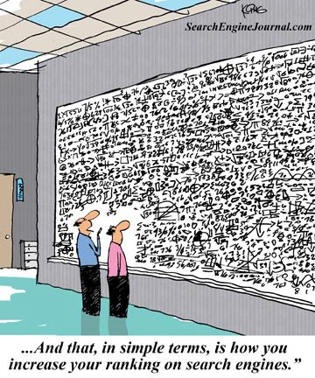

Slide 13
Marketing is a MASSIVE subject
It’s a bridge between CREATIVITY and SALES

Slide 14
Marketing has its own BUZZWORDS!
● CONTENT SHOCK
● HOLISTIC
● DATA-DRIVEN CONTENT
● NATIVE ADVERTISING
● CONTENT DISCOVERY PLATFORMS
● PROMOTED POST
● INFLUENCER MARKETING
● STORY TELLING
● PERSONALISED CONTENT
● CONTENT PERFORMANCE
● SNACKABLE CONTENT
● STORYSCAPING
● SNAP
● CONVERSATION MARKETING, etc, etc.
Used in meetings, brain storming sessions or marketing articles

Slide 15
And Acronyms & Abbreviations
Because the language of marketing is so vast, marketers use abbreviations all the time
Here are just a few:
● FMCG ● CTA ● SLA
● SEO ● CTR ● SM
● SWOT ● DM ● SMM
● AIDA ● GA ● UV
● CMS ● KPI ● WOM
● COS ● PPC ● BOGOF
● CPA ● PR ● CS
● CPC ● PV ● FP
● CPL ● QR Code ● QC
● CR ● RT ● BANT

Slide 16
What is your Start Point?
RESEARCH

Slide 17
SWOT Analysis
● Strengths
● Weaknesses
● Opportunities
● Threats

Slide 18
Strengths
What do you do well?
What unique resources can you draw on?
What do others see as your strengths?

Slide 19
Weaknesses
What could you improve?
Where do you have fewer resources than others?
What are others likely to see as weaknesses?

Slide 20
Opportunities
What opportunities are open to you?
What trends could you take advantage of?
How can you turn your strengths into opportunities?

Slide 21
Threats
What threats could harm you?
What is your competition doing?
What threats do your weaknesses expose you to?

Slide 22
What the Language of Marketing isn’t about!

Slide 23
What the Language of Marketing is about!
● It needs to be persuasive
● It needs to be ethical
● It needs to be original
● It needs to tap into emotions
● It needs to give the right impression
● It needs to be supported by good research
● It needs to be easily understood
● It needs to perform

Slide 24
Personal SWOT Analysis
Q. What’s the point?
A. Helps to develop your career
Q. What can I gain from doing this?
A. Illumination
Q. Why is it important?
A. It helps you focus on your strengths, minimise your weaknesses and take the greatest possible advantage of the opportunities open to you.

Slide 25
THANK YOU!
Godalming Sixth Form College

Slide 26
And remember…
A little humour goes a long way!

