Slide 1
Animal Communication
Advanced Linguistics

Slide 2
Some definitions:
Communication: the act of conveying intended meanings from one entity or group to another through the use of mutually understood signs and semiotic rules.
Language: the method of human communication, either spoken or written, consisting of the use of words in a structured and conventional way.

Slide 3
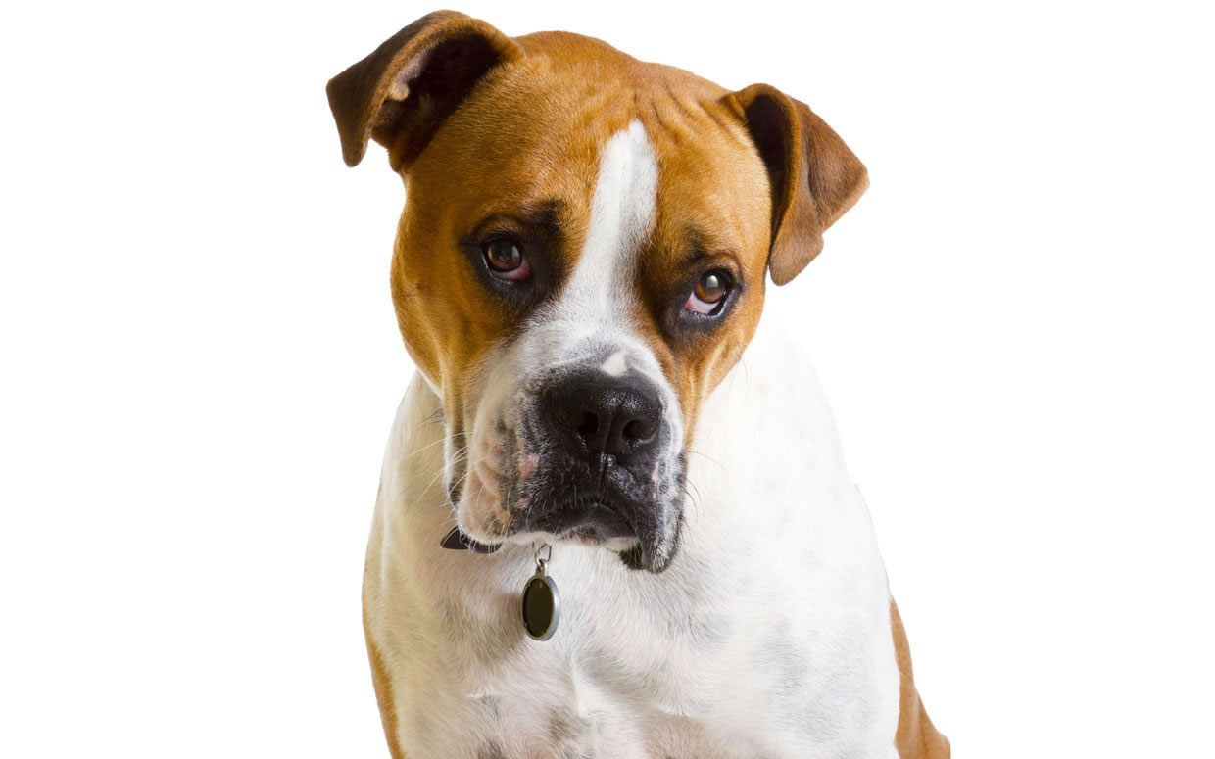
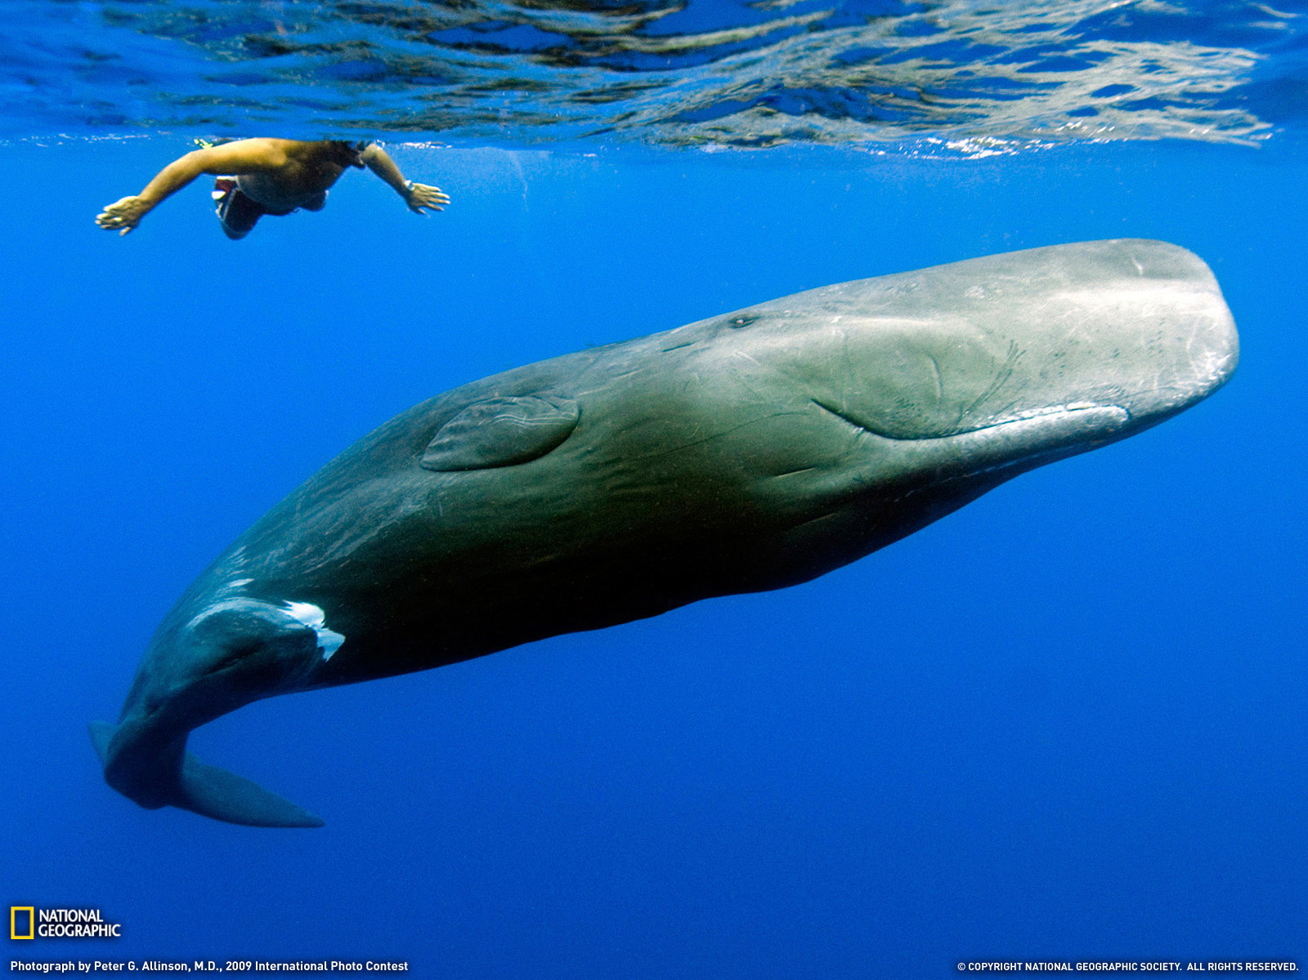
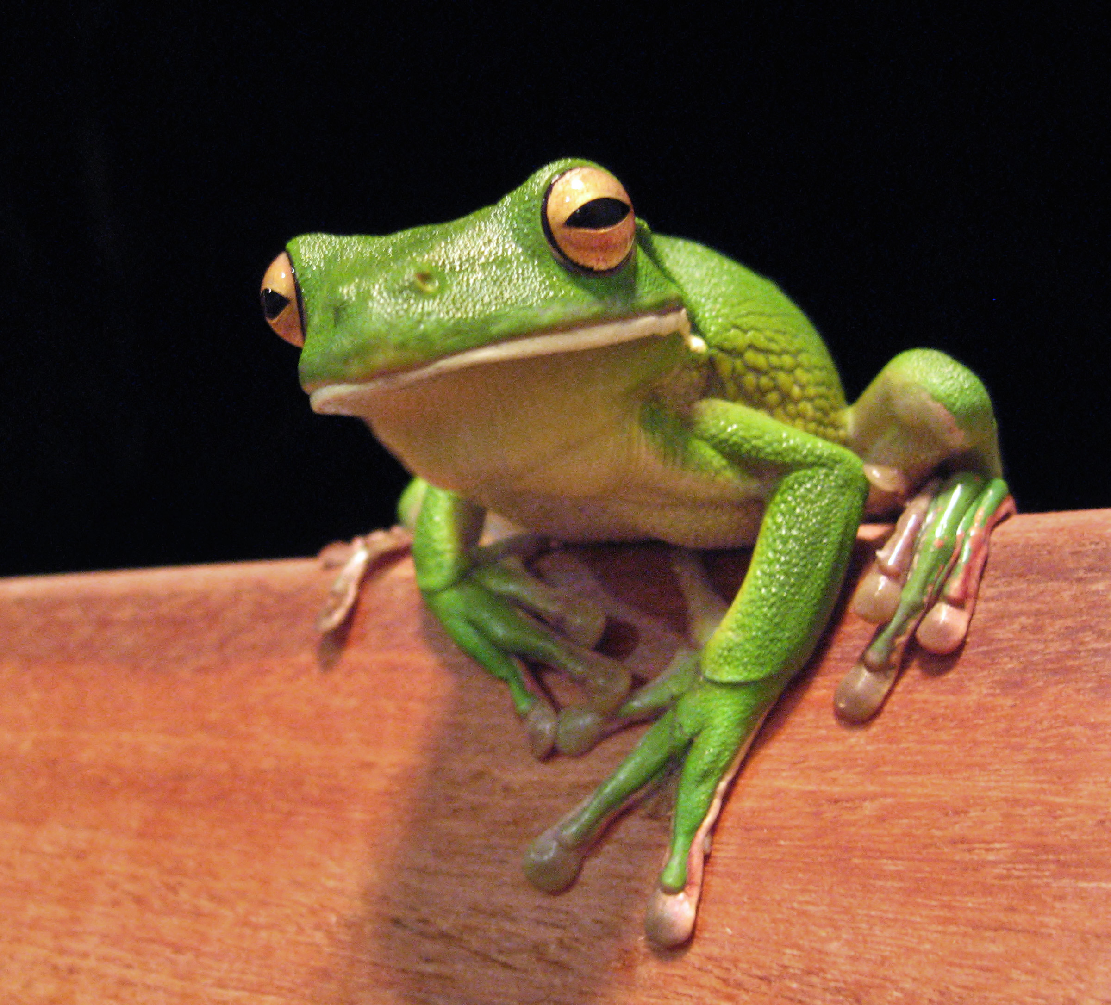
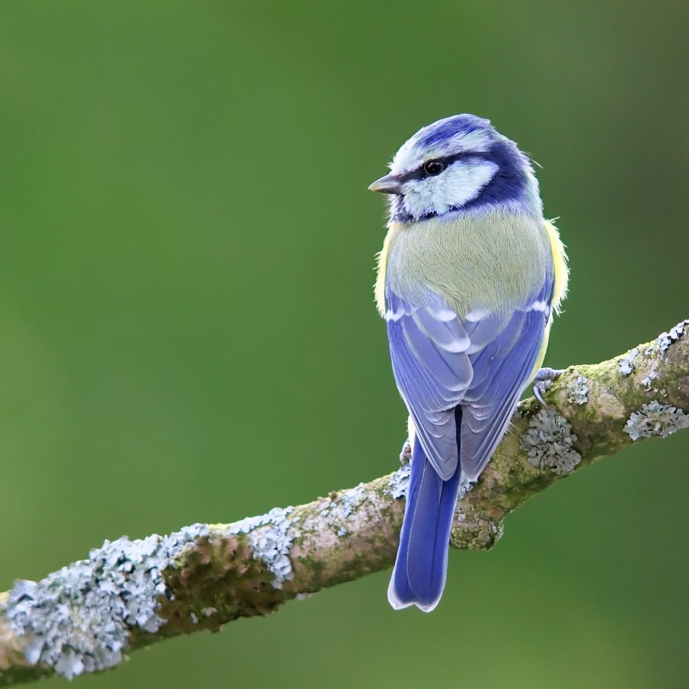
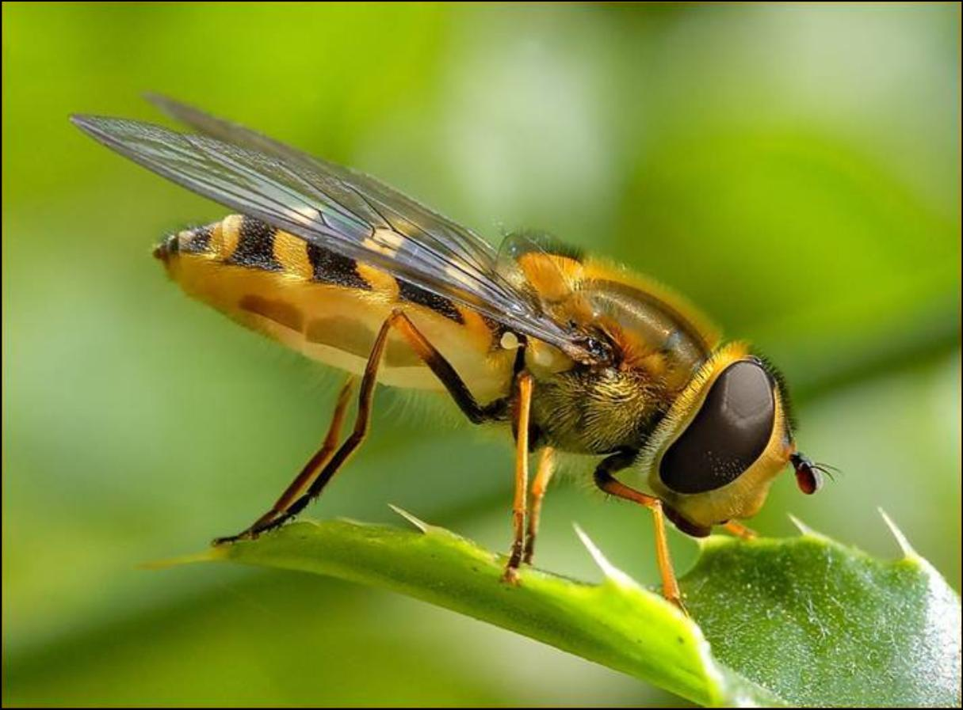
Pick an animal below and provide an example of how it communicates:
Dog
Whale
Frog
Bird
Bee

Slide 4
Categorising Animal Communication:

Slide 5
Features of Animal Communication:
Rely on verbal and non-verbal forms of communication
Non-vocal auditory outbursts e.g. the slap of a dolphin’s tail on the water
Bioluminescence (using their sense of sight to navigate)
Scent marking
Chemical or tactile cues
Visual signals
Postural gestures

Slide 6
Do species have certain dialects?
Dialect: a non-standard variety of a language, including lexis and grammar, particular to a region
A study on whales: blue whales produce different patterns of pulses, tones and pitches depending on where they’re from.
Some bird species have also been found to possess different dialects. In certain cases, birds who live on the border between territories code switch accommodating to the variety of that language community.

Slide 7
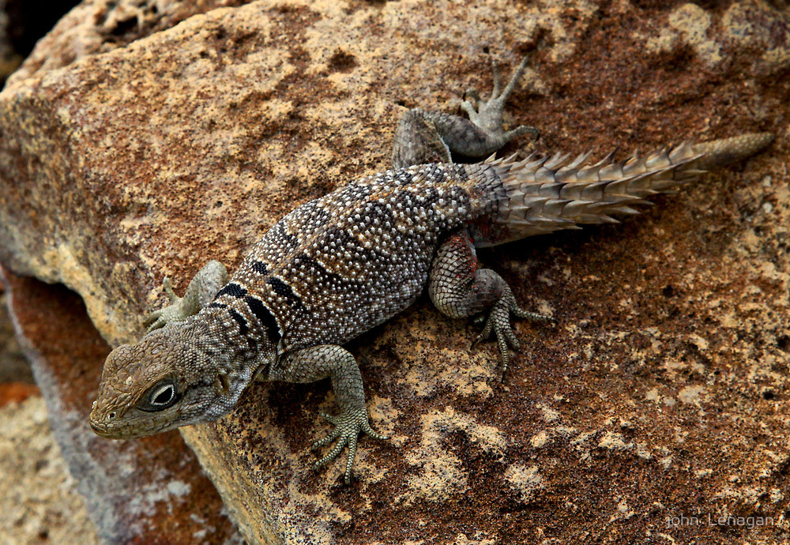
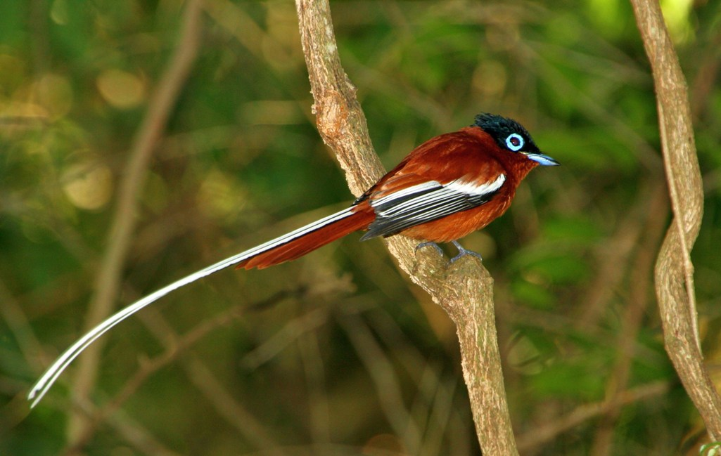
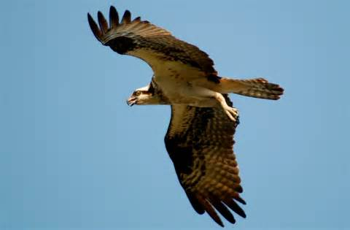
What about communication between species?
Communication between species can play important roles as well. One study suggested that the reason Madagascan spiny-tailed iguanas have well-developed ears (despite the fact that they don’t communicate vocally) is so that they can hear the warning calls of the Madagascan paradise flycatcher when a common predator (raptors) is about to strike.

Slide 8
How do we communicate with animals?
High frequency lexis
Monosyllabic
Rising intonation (tone signals pragmatic meaning)
Falling intonation (demonstrates assertiveness/dominance)
Extended vowel sounds (breaking up morphology of lexis)
Tag questions (one-directional language)
Repetition
Holophrases (one word that has pragmatic meaning)
More concrete nouns compared to abstract nouns

Slide 9
Are humans interfering with animal communication?
Yes
Increased shipping traffic over the last century has dramatically affected the transfer of whale song around the ocean basin.
Some species of bird have had to modify their singing styles, producing songs that are louder and shriller, in order to be heard above the urban clamour. Female birds find these modified singing styles decidedly less alluring.

