Slide 1
Rendering accents and dialects in literature: why and how ?

Slide 2
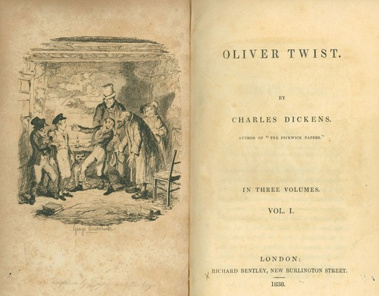
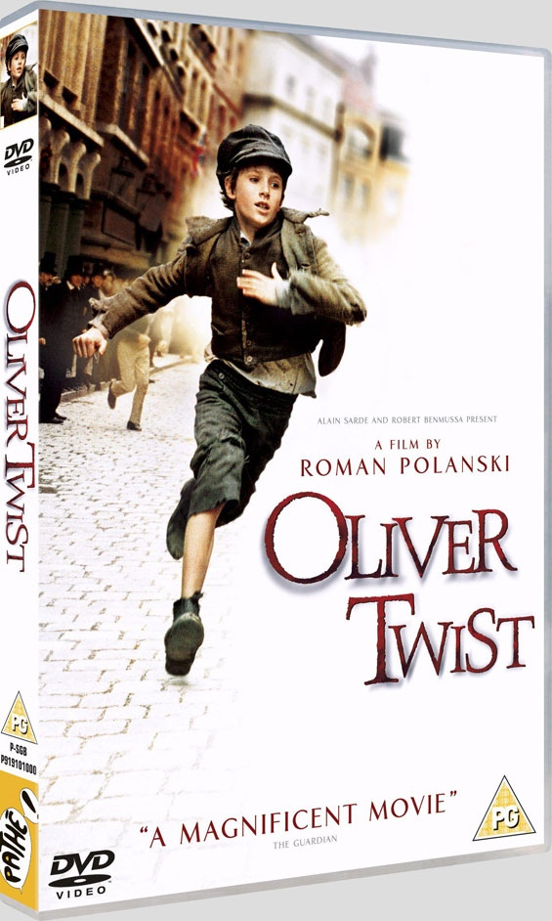
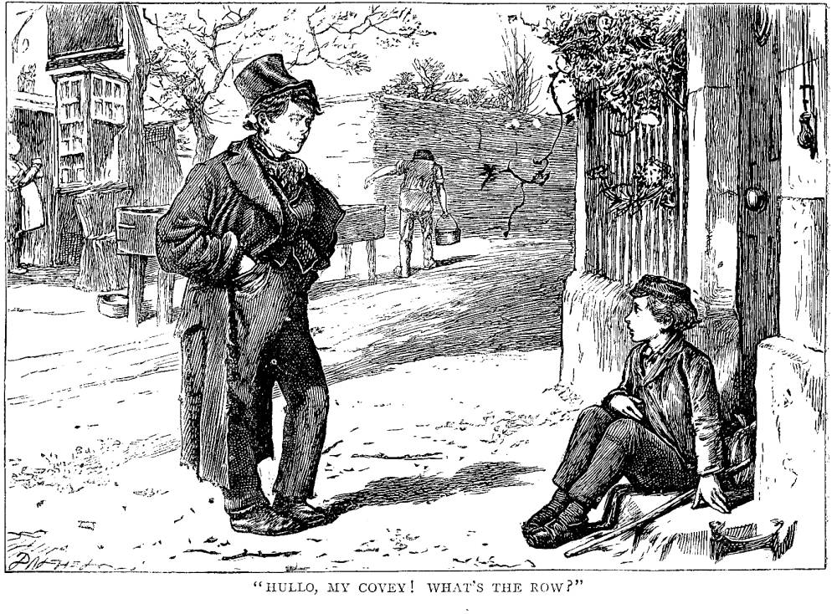
Oliver Twist, by Charles Dickens, published1837-39
Cockney accent and dialect in Victorian England
https://www.youtube.com/watch?v=yPGRUrvuNGk

Slide 3
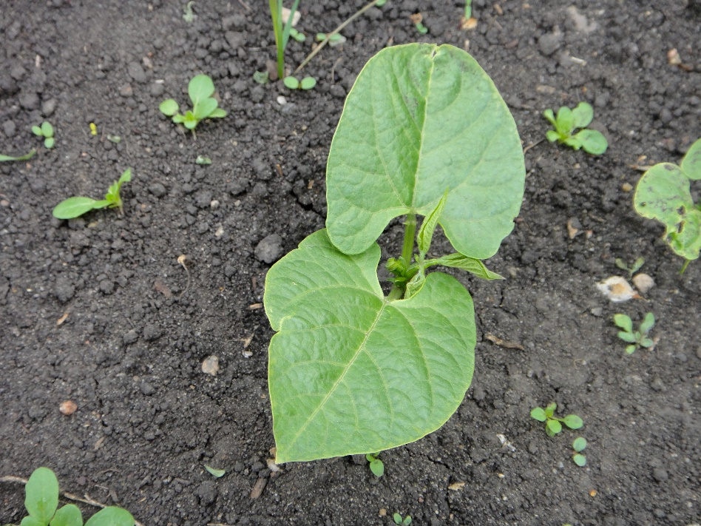
What dialect lexemes and phrases can you see?
Creating an ‘eye-dialect’ in literature: how?

Slide 4
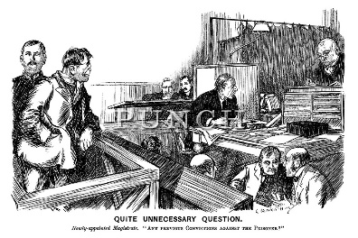
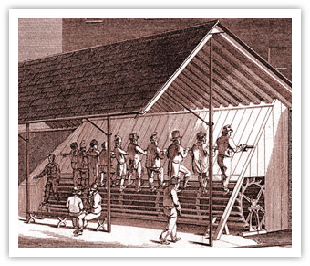
Beak, or Beck, is an old word, of Dutch origin, for anyone in authority (masters are still ‘beaks’ at some public schools).
In 1818, the “tread-wheel” was introduced to prisons. Prisoners would step on the spokes of a large paddle wheel, turning the gears to pump water or crush grain, leading to the term “tread-mill”. In eight-hour shifts, prisoners would often climb the equivalent of 7,200 feet. The exertion often led to injury and illness and was used to tame more defiant inmates.

Slide 5
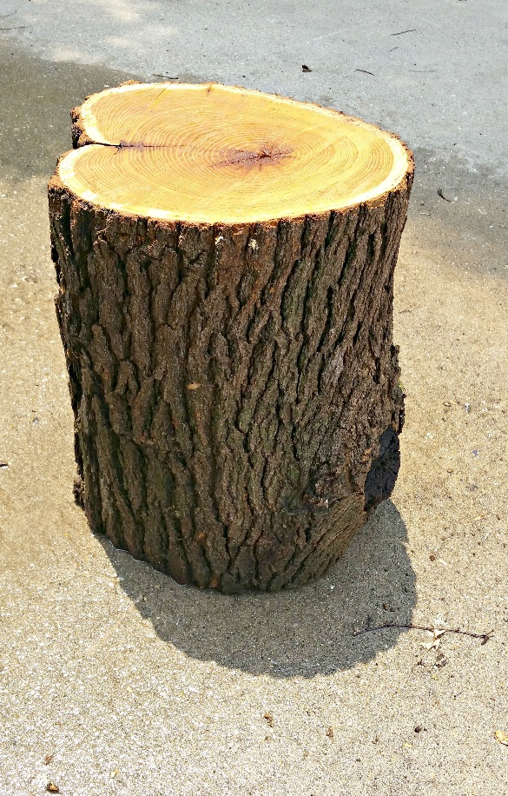
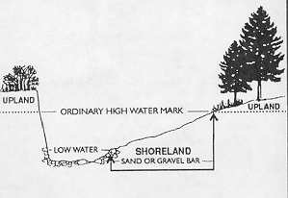
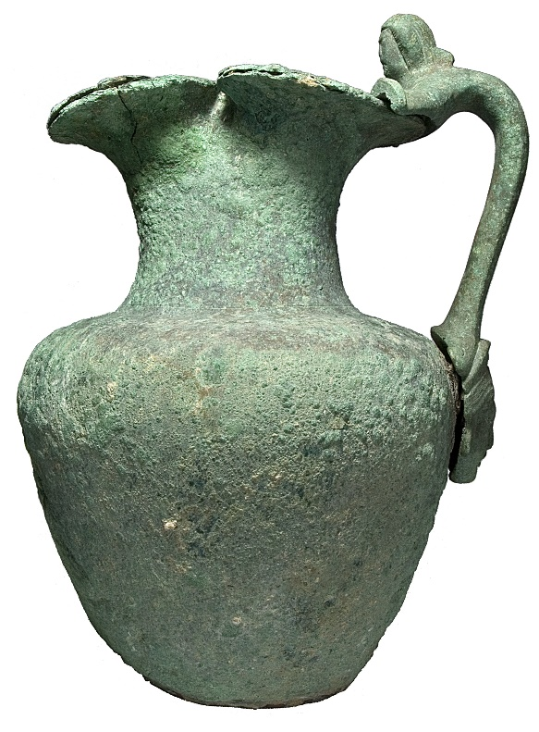
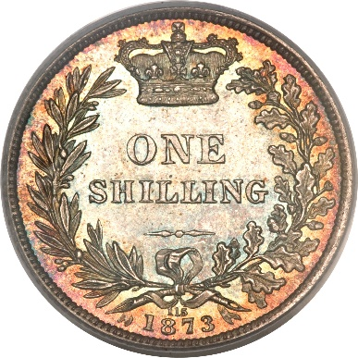
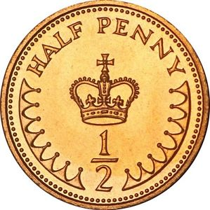
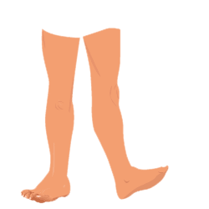
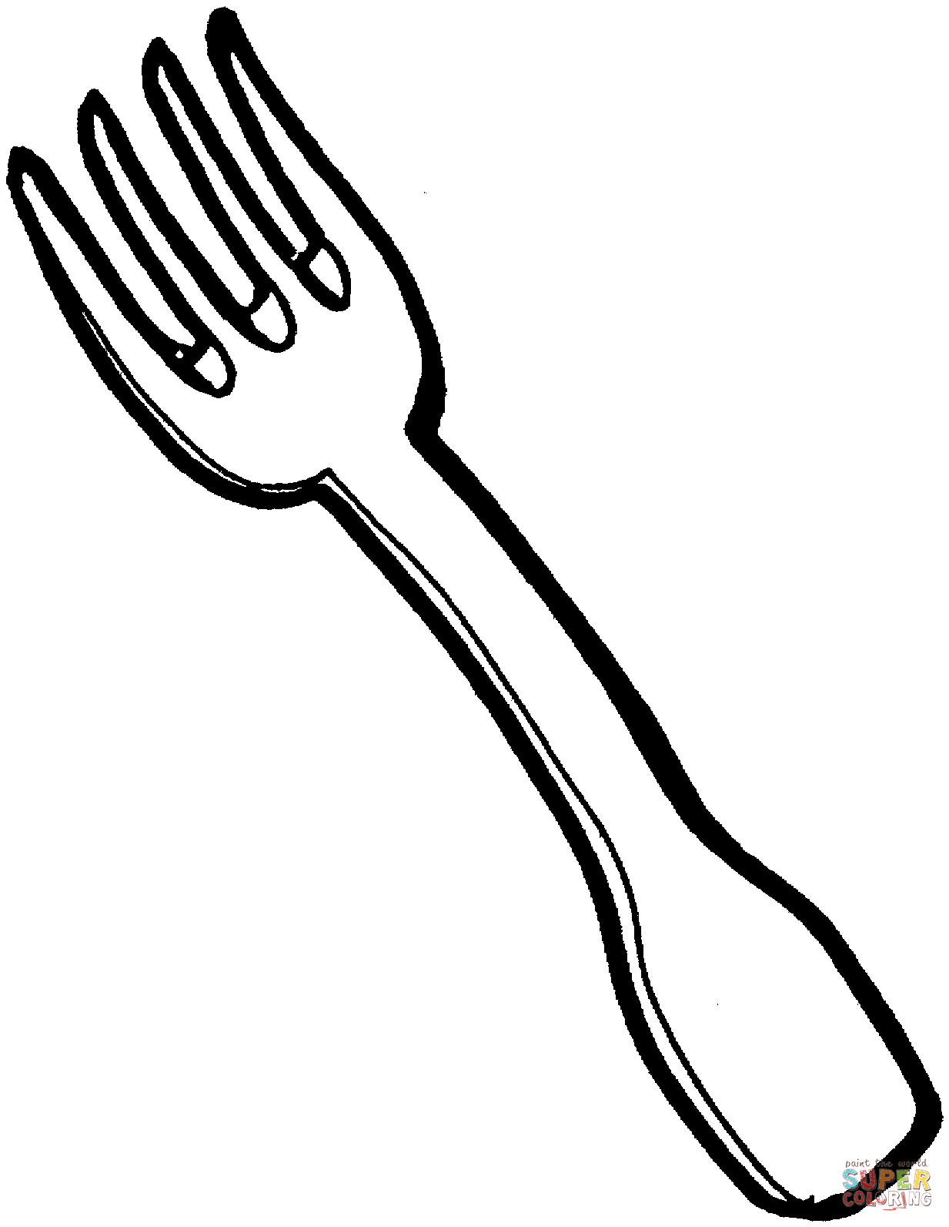
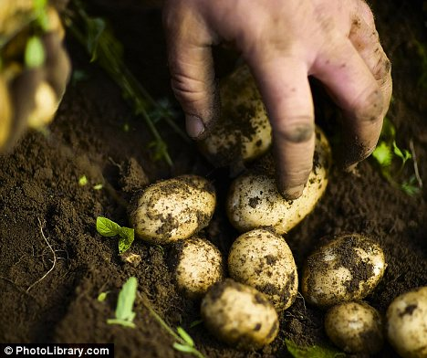
Stone Jug - the Greek word (kordmos) means either an earthen jar or a prison
‘to stump up’ - derives from horse trading or other dealing where money was put onto a wooden post (stump) to display good faith in a deal
the origin of the word grub is 14th Century Old English (grybban) meaning to dig

Slide 6
What non-standard pronunciation can you see, conveying an accent?
“sivin”
“com-pan-i-on”
“madgst’rate”
“forerd”
“a going up”
“nivir”
“acos”
HOW?
Modified spelling
Contractions
‘a’-prefix

Slide 7
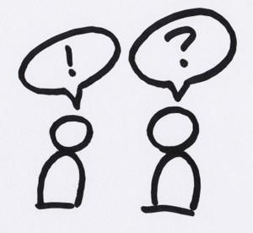
Creating an ‘eye-dialect’ in literature: why?
Authenticity
Creation of perspective
(Moral?) characterisation
Empowerment of groups

Slide 8
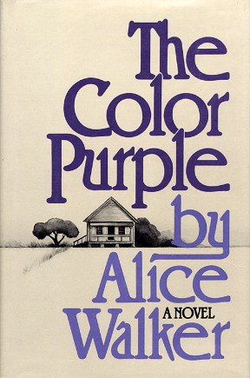
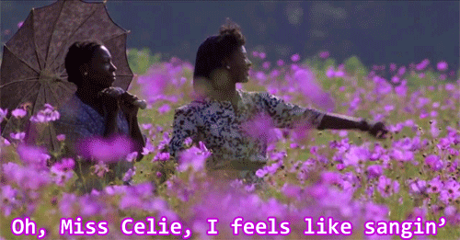
The Color Purple, by Alice Walker, published1982
Southern black vernacular in 1920s-30s America
https://www.youtube.com/watch?v=SH4PhFHyC5s&index=5&list=PL30DD527C1D9BC176

Slide 9
Rendering accents and dialects in literature: how and why?
Dialect lexemes
Modified spelling
Contractions
Authenticity
Creation of perspective
Empowerment of groups

