Slide 1
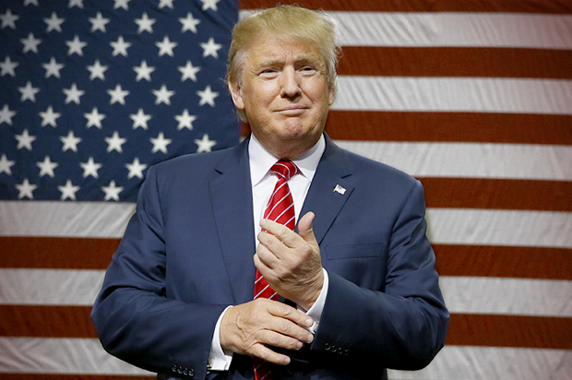
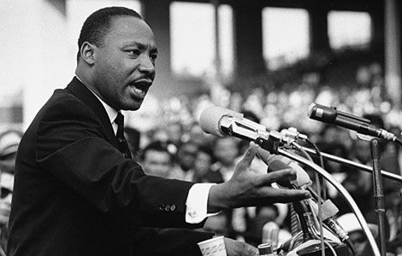
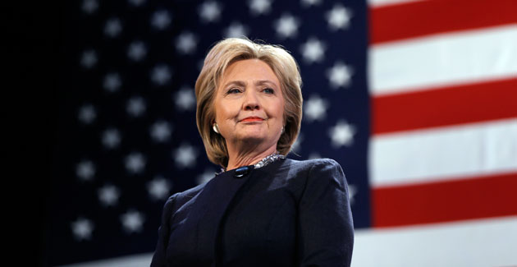
Language and Politics
Advanced Linguistics
Monday 9th January 2017

Slide 2
Functions of Political Language
Informative (Referential)
Persuasive
Rhetorical

Slide 3
Features of Political Language
Manner is usually formal
Formulaic utterances e.g. God bless America
Informal language is used in order to change tone markedly for effect

Slide 4
Lexis
Subject specific lexis
Abstract nouns
Address terms for politicians by their role title e.g. President
Key consideration of pragmatics linking to positive/negative connotations, euphemisms/dysphemisms

Slide 5
Grammar
Use of pronouns is significant
Framing of questions
Frequent use of ‘wh-’ interrogative words
Modal auxiliaries e.g. will

Slide 6
Functions of Poetic/Rhetorical Metaphor:
Affords us imaginative pleasure
Makes the abstract concrete, appeals to more our senses
Adds emotional intensity and conveys attitudes
Can imply meanings without stating them explicitly
Can help us to understand complex or abstract areas of reality

Slide 7
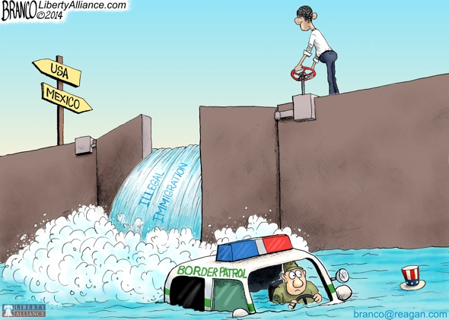
Flood of Immigrants

Slide 8
Conceptual Metaphors
Based on correlations between complex, abstract areas of experience and more familiar, concrete, physical ones
E.g. Argument is war
‘He attacked every weak point in my argument’
‘I’ve never won an argument with him’
‘Her criticisms were right on target’

Slide 9
Conceptual Metaphor: Crime
Which of the following do you find more influential?
Crime is a [wild beast preying on/virus infecting] the city of Addison. The crime rate in the once peaceful city has steadily [attacked/infiltrated] the community. These days, it seems crime is [lurking in/plaguing] every neighbourhood.

Slide 10
Rhetorical Devices: Speeches
Anaphora – repeat a word or phrase in successive phrases e.g. I have a dream
Antiphrasis – uses a word with opposite meaning e.g. The Chihuahua was named Goliath
Antithesis – makes a connection between 2 things e.g. That’s one small step for a man, one giant leap for mankind’
Enumeratio – listing e.g. firstly, secondly / Renovation included a spa, tennis court, pool and language.
Epizeuxis – repeating one word for emphasis e.g. fun, fun, fun!
Hyperbole – an exaggeration e.g. I have done this a thousand times
Litotes – makes an understatement e.g. The terms are not disagreeable to me
Oxymoron – a two-word paradox e.g. beautiful nightmare
Parallelism – uses words or phrases with similar structure e.g. I went to the store, parked the car and bought a pizza.

