Slide 1
Language of Romantic Relationships
How do we speak differently to people on dates?
A:
Enjoys long romantic walks, to cook dinner and have cosy nights in watching films.
B:
Enjoys eating in the top restaurants in London, buying trendy clothes and enjoys a good party.
C:
Enjoys music and is a budding musician, has strong moral values and has a passion caring for animals.

Slide 2
Language of dating
Consider the following 3 contexts. How would you approach someone that you found attractive and what language would you use to communicate with them?
Context 1: At a coffee shop in a queue
Context 2: Having matched with somebody on Tinder
Context 3: In a professional work environment

Slide 3
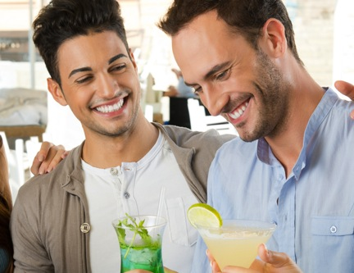
Language of Dating
How would your language change based on how well you already know them?
Friend
Acquaintance through a mutual friend
Stranger

Slide 4
Politeness Theory
The expectations of a successful date are that you will follow Politeness Theory (Brown & Levinson, 1987). A lot of first dates will use negative politeness, some positive politeness and off-record strategies. Rarely will there be bald-on-record unless both people are very extrovert and sense a similar sense of humour therefore not causing damage to relationships.
Try and write an extract of a successful date using these strategies.
Notes:
https://www.youtube.com/watch?v=E6KLsUX6qeM (25:20)

Slide 5
Address Terms
Often, in relationships, people refer to their partners using endearing address terms which may follow societal conventions e.g. darling or babe or may be a term that is known only between the two individuals e.g. spud
What conventional address terms do you know? Are there any unique ones that you have heard couples say?

Slide 6
Expectations of Language Use
What do you think are the expectations of language use in a relationship apart from address terms? Think about the following media:
Texting
Phone calls
Emails
Working together
In front of their children
Birthday cards
Instant messaging

Slide 7
Language of Break Up
What is distinctive about the language of break up? Choose one of the following phrases and decode it to its exact meaning:
1. Conscious uncoupling
2. Give each other some space
3. Take a break
4. Mutual decision
5. You’re too good for me
6. I need to focus on my career
7. I love you but I’m not IN love with you
8. We’re at different points in our lives
9. Let’s stay friends
10. It’s not you, it’s me

Slide 8
Language of Break Up
Why is it challenging to communicate the language of breaking up with your partner?
Link your ideas to Brown & Levinson’s Politeness Theory and think about the effects of each strategy.
Think about the synonyms for ‘break up’. What are the connotations?

