Slide 1
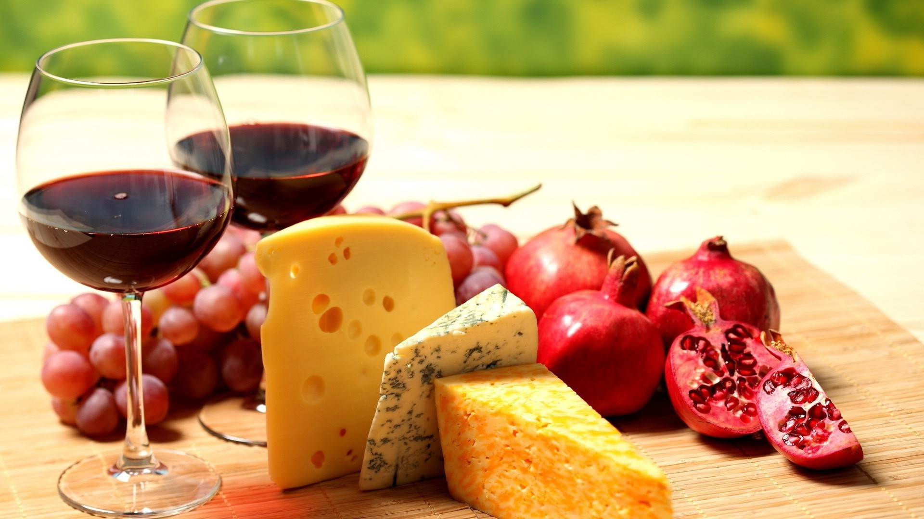
Language of Food & Drink
Advanced Linguistics

Slide 2
Sparkling Wine
All the floral, fruity charms of Prosecco with the edge of salinity you get from Picpoul de Pinet – it’s delicious with oysters and shellfish. Judges at a recent competition said it had a ‘lovely clean nose with lots of apple and sherbet’ and went on to say; ‘The mousse is excellent and those sherbet notes really come to the fore. Super fresh…it would make a cracking aperitif wine.’ And who are we to disagree?

Slide 3
Starters: Tuna Carpaccio
Sliced, lightly seared raw Yellowfin Tuna with Sauce Vierge and Black Olives

Slide 4
Mains: Cassoulet de Toulouse
Traditional Tarbais Bean Stew with Confit Duck Wing, smoked Toulouse Sausage and Bacon Lardons, topped with melted Garlic Butter and Sourdough Croutons

Slide 5
Desserts: Tarte Fine aux Pommes
Crisp Puff Pastry Tart with finely layered Apples and Vanilla Ice-Cream

Slide 6
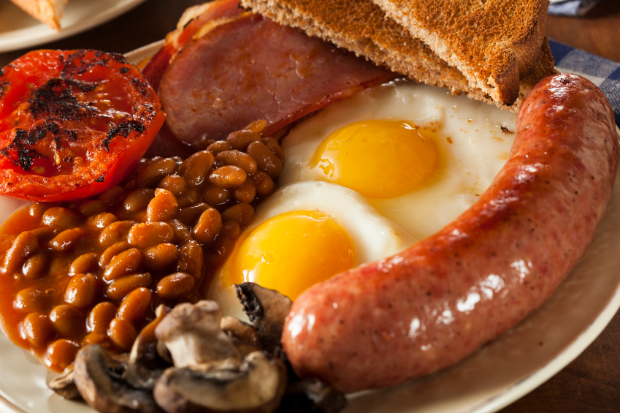
Fry Up vs. Traditional English Breakfast

Slide 7
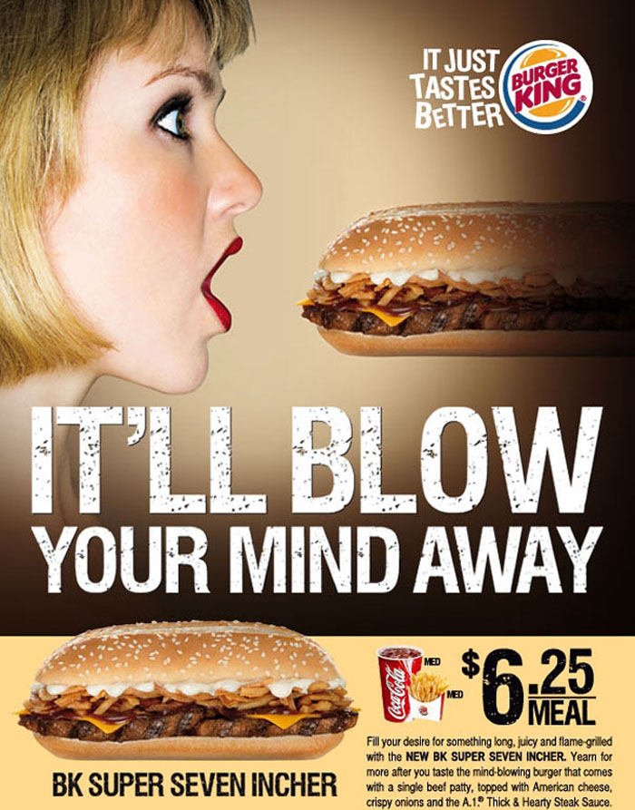
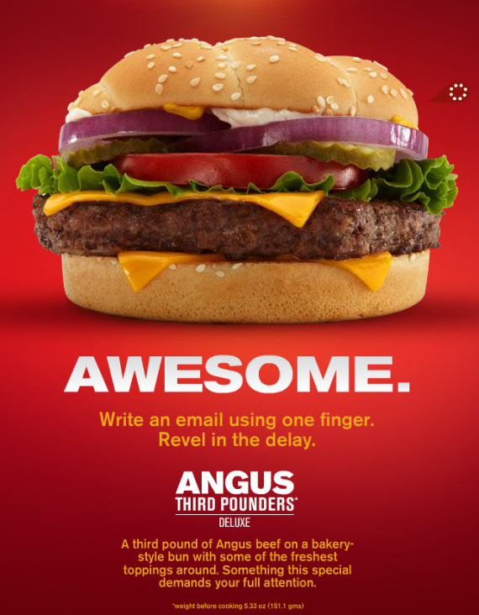
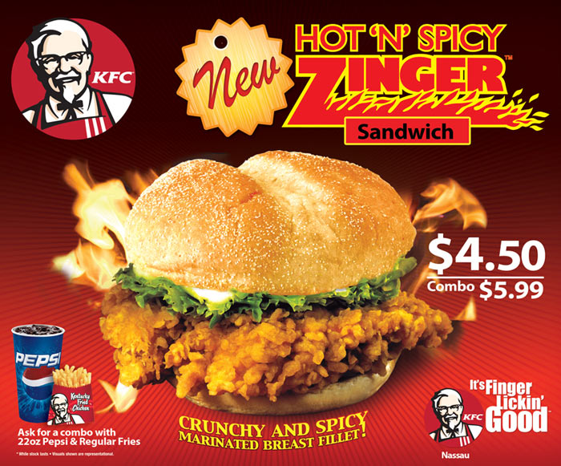
Language of Fast Food:

Slide 8
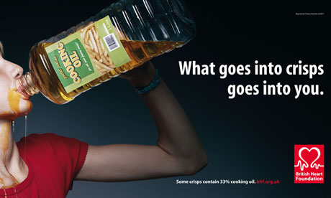
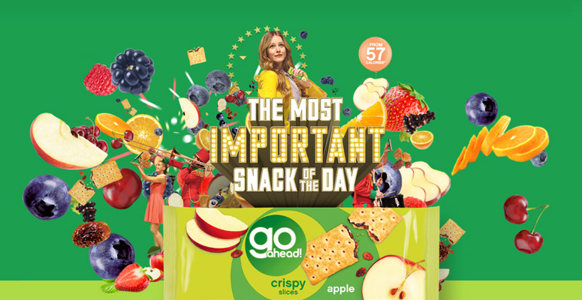
Healthy Eating: Attack vs. Defend

Slide 9
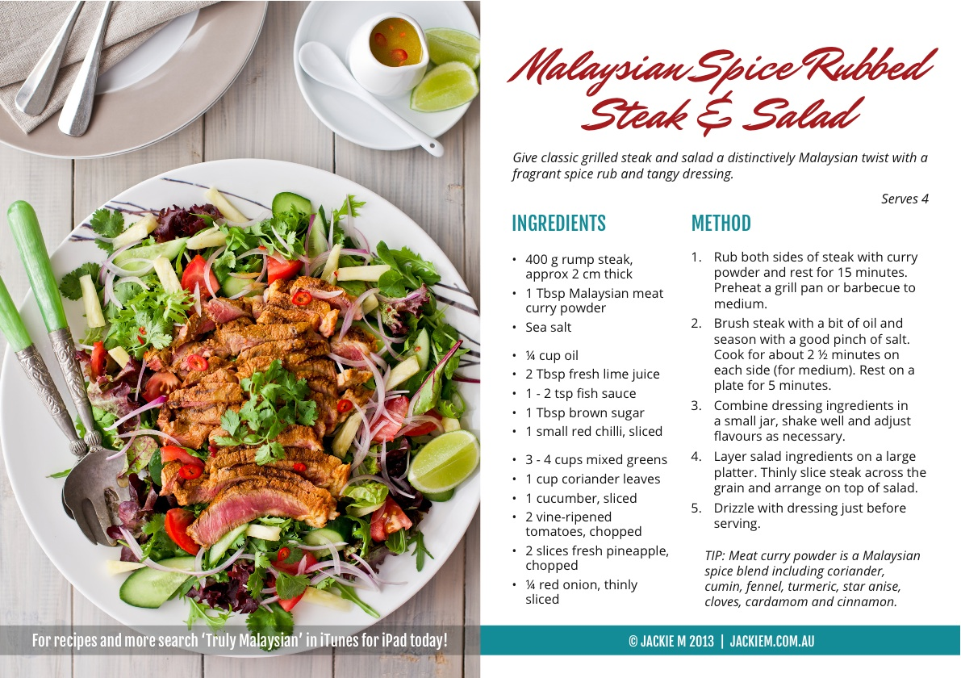
Language of Recipes:

