Slide 1
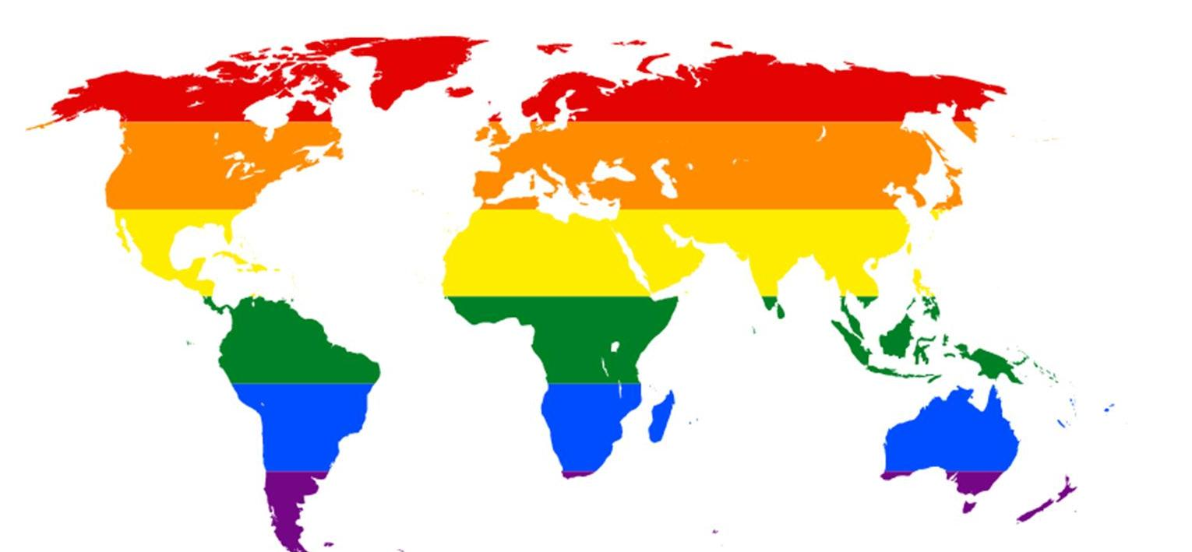
LGBT+ Linguistics
Advanced Linguistics

Slide 2
LGBT+ - What does is stand for?
LGBT+ stands for:
Lesbian
Gay
Bi(sexual)
Trans(gender)
+ - Anyone who identifies outside of the LGBT acronym e.g. agender, asexual, intersex

Slide 3
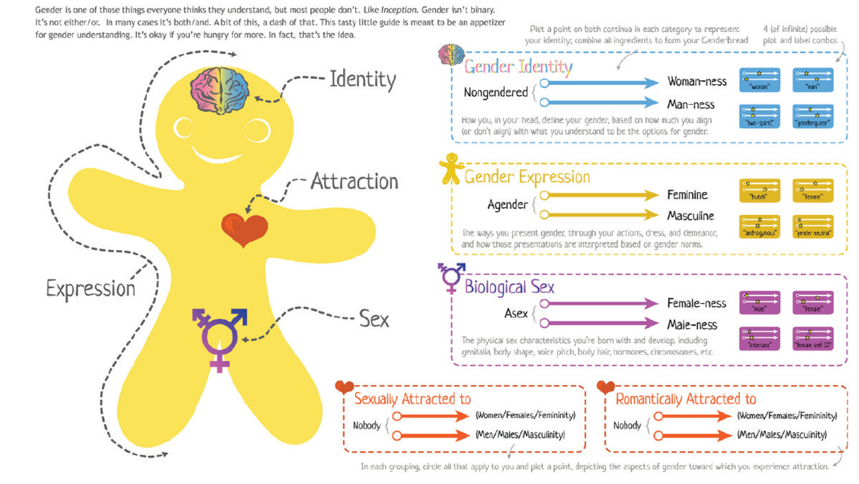
The Genderbread Person

Slide 4
Understanding Gender Identity
Man
Woman
Cisgender: An individual whose gender identity matches their sex assigned at birth.
Transgender: An individual whose gender identity differs from their sex assigned at birth:-
–FtM: Males who were assigned female at birth
–MtF: Females who were assigned male at birth
–Genderqueer: A person who does not identify as either of the gender binaries (male or female) any or all of the time.
Non-Binary:
Agender: An individual who neither identifies as male nor female.
Bi/Tri/Pangender: An individual who considers themself to have two or more genders
Genderfluid: An individual who moves between genders or with a fluctuating gender identity.
Two-Spirit: A term traditionally used by Native American people to recognize individuals who possess qualities or fulfil roles of different genders.

Slide 5
Understanding Gender Expression
Feminine
Masculine
Androgynous: An appearance and/or identification that is neither male nor female, presenting a gender that is either mixed or neutral.

Slide 6
Understanding Biological Sex
Male
Female
Intersex: A term used to describe a person whose sex chromosomes, genitalia and/or secondary sex characteristics are determined to be neither exclusively male nor female.

Slide 7
Understanding Sexual Orientation
Heterosexual: An individual who experiences sexual attraction to a person of the opposite gender.
Homosexual: An individual who experiences sexual attraction to a person of the same gender.
Bisexual: An individual who experiences sexual attraction to people of two genders.
Polysexual: An individual who experiences sexual attraction to people of many genders.
Pansexual: An individual who experiences sexual attraction to people of any gender.
Asexual: An individual who does not experience sexual attraction to people of any gender.
Skoliosexual: An individual who experiences sexual attraction to people of non-binary gender.
Androsexual: An individual who experiences sexual attraction to masculinity.
Gynosexual: An individual who experiences sexual attraction to femininity.
Demisexual: An individual who experiences sexual attraction only once a strong emotional connection is formed.

Slide 8
Understanding Romantic Attraction
Heteroromantic: An individual who experiences romantic attraction to a person of the opposite gender.
Homoromantic: An individual who experiences romantic attraction to a person of the same gender.
Biromantic: An individual who experiences romantic attraction to people of two genders.
Polyromantic: An individual who experiences romantic attraction to people of many genders.
Panromantic: An individual who experiences romantic attraction to people of any gender.
Aromantic: An individual who does not experience romantic attraction to people of any gender.
Skolioromantic: An individual who experiences romantic attraction to people of non-binary gender.
Androromantic: An individual who experiences romantic attraction to masculinity.
Gynoromantic: An individual who experiences romantic attraction to femininity.
Demiromantic: An individual who experiences romantic attraction only once a strong emotional connection is formed.

Slide 9
Can you apply these labels to yourself?
Genderbread Person outline:
gender identity
gender expression
biological sex
sexual orientation
romantic attraction
Why do we need labels?
Can we have a separate speech community based on our labels?

Slide 10
J.L. Austin (1976)
Language is performative; a shared way of speaking can be used to create a single, cohesive identity that in turn organises political struggle. Sexuality is one form of social identity, discursively constructed and represented
Gay men and lesbians may, through the use of language, form speech communities. A speech community is a community that shares linguistic traits and tends to have community boundaries that coincide with social units. Membership in speech communities is often assumed based on stereotypes about the community as defined by non-linguistic factors. Speakers may resist culturally dominant language and oppose cultural authority by maintaining their own varieties of speech. Language use can also mimic culturally dominant forms or stereotypes.

Slide 11
Code Switching
Changing speech styles, or code switching, can indicate which identity individuals want to put forward as primary at a given time. Choices of language use among gay men depend on the audience and context, and shift depending on situational needs such as the need to demonstrate or conceal gay identity in a particular environment.
“Exploratory switching” can be used to determine whether an interlocutor shares the speaker's identity. E.g. a gay man might use certain key words and mannerisms generally known by the community as a test to see whether they are recognized by the interlocutor. This allows the gay man to establish solidarity with a community member previously unknown to him without having to disclose his orientation to a heterosexual and potentially hostile person.

Slide 12
Polari
A secret language used by homosexual men (particularly in the 1960s) with certain terminology used to refer to things/people:
Polari Term | Meaning
Betty bracelet | Policewoman
Camp | Effeminate
Cottage | Public Toilet
Mince | A camp walk
Naff | Awful (Not Available For Fucking)
Slap | Make-Up

Slide 13
What do you think these Polari terms mean?
Chicken
Fruit
Glossies
Hoofer
Lallies
Trade
Willets

Slide 14
Kulick’s Argument
The search for a link between sexual identity categories and language is misplaced, since studies have failed to show that the language gay men and lesbians use is unique.

Slide 15
Gay Men & Female Stereotypes (1970s):
Robin Lakoff – gay men deliberately imitate women’s speech features including:
Increased use of superlatives
Emphatic adjectives e.g. divine
Inflected intonation
Lisping
David Crystal – gay male speech is effeminate (simpering voice) with a wider pitch-range than heterosexual men, more frequent use of complex tones (e.g. fall-rise/rise-fall) and switching to a falsetto register

Slide 16
Key Questions:
Why has there been so much talk of gay men in relation to other LGBT+ identities?
Do you think that lesbians, bisexual and trans* people have (stereotypical) speech communities?
Do you completely refute the claim that LGBT+ people would have a speech community? How can you compare to other minorities?
Do you think that gay men used to have a speech community but that this has been eroded due to liberalism in society allowing more than the stereotype?

