Slide 1
Origins of English
Advanced Linguistics

Slide 2
When did English become English?
What languages have contributed to the formation of English?
When did English become ‘English’?

Slide 3
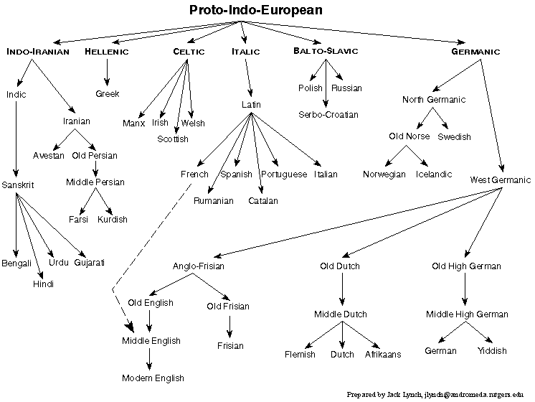
What is a proto-language?
The assumed first language that people spoke from which we now have 5,000 – 7,000 languages across the world.

Slide 4
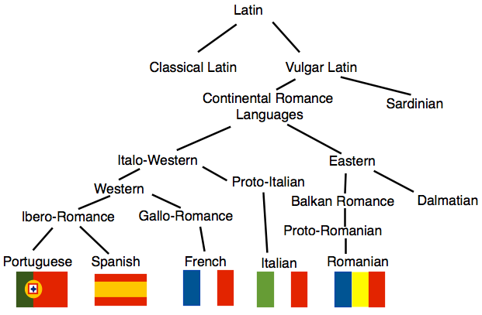
Language Families influencing English:
Romance language family
Indo-European language family

Slide 5
When do varieties become languages?
Mutual intelligibility
Power (political)
In prehistoric times, migrations of people often led to the loss of contact and to divergence. Therefore, language growth occurred.

Slide 6
What about borrowing?
Certain languages have renewed contact, however, through:
Trade
Military conquest
Shared cultural practices
Technical diffusion
Are languages dying in an increasingly globalised word? Is this a bad thing?

Slide 7
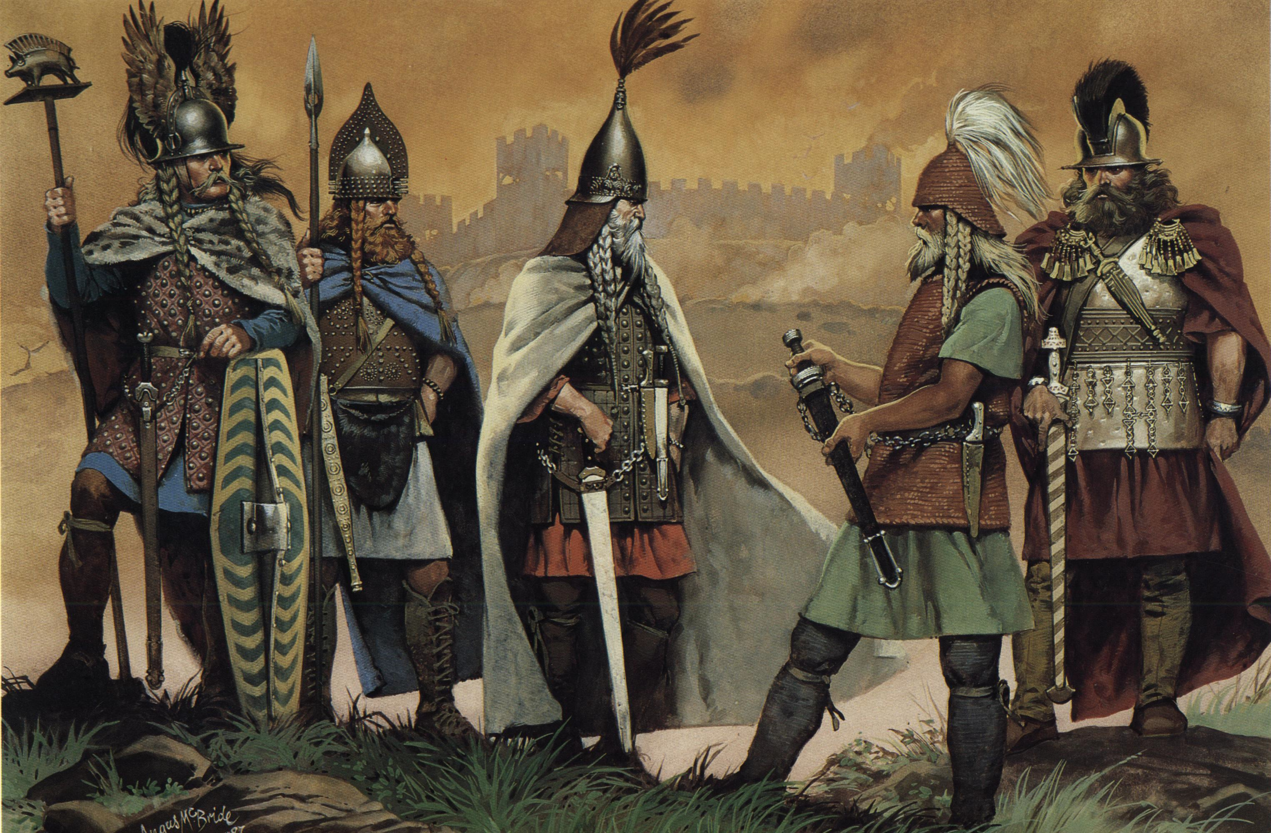
Role of the Celts:
Evidence to suggest that they settled in Britain as early as 2000 BC.
2 Celtic language groups:
Goidelic-Celtic: Irish, Scottish Gaelic
Brythonic-Celtic: Welsh, Cornish
Most Celtic words left in the English language (of which there are only around 200) are largely place names e.g. Exeter derived from Brythonic iska (water, fish) and leith (damp, wet), Thames (dark river)

Slide 8
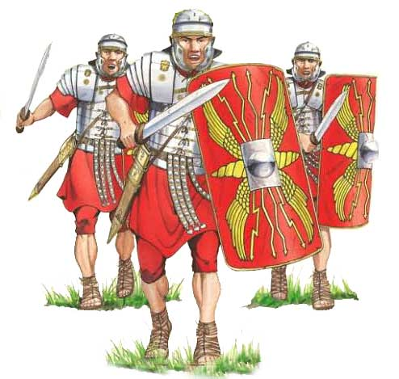
Role of the Romans: 55 Bc – 450 AD
Julius Caesar landed in Britain in 55/54 BC – aim to bind Britain tightly to the political and economic influence of Rome.
43 – 410 AD: Roman cities grew up across Britain (apart from the far West and the North (most densely in the South East).
Roman influence on economy – supplier of metal (iron/tin) to the Continent, founded Londinium (London), building of houses with central heating, running water, tiled mosaic floors, introduction of money
Roman influence on culture – dress, ornaments, utensils, pottery, glassware, public baths, theatres, temples.

Slide 9
Role of the Angles, Saxons, Jutes & Frisians: 500 - 700
Saxons concentrated on the south coast (Sussex, Wessex) and north of the Thames (Middlesex, Essex)
Angles found on the east coast and in the Midlands up to Northumbria/southern Scotland by 600
Jutes settled in Kent, parts of Hampshire and Isle of Wight
Frisians were not associated with any particular place
All were speakers of North Sea Germanic; Frisian is still spoken in parts of The Netherlands and Germany. A loose structure of kingdoms came into existence in the 6th century: Northumbria, Mercia, East Anglia, Kent, Essex, Sussex and Wessex.

Slide 10
How easy is it to create a completely new language?
Try to create your own without drawing on language systems you know.
If you’re finding this impossible, which languages are you drawing upon to create your ‘new language’?
Explain the process of creating your new language. Where did you start? What were the most important first words?

