Slide 1
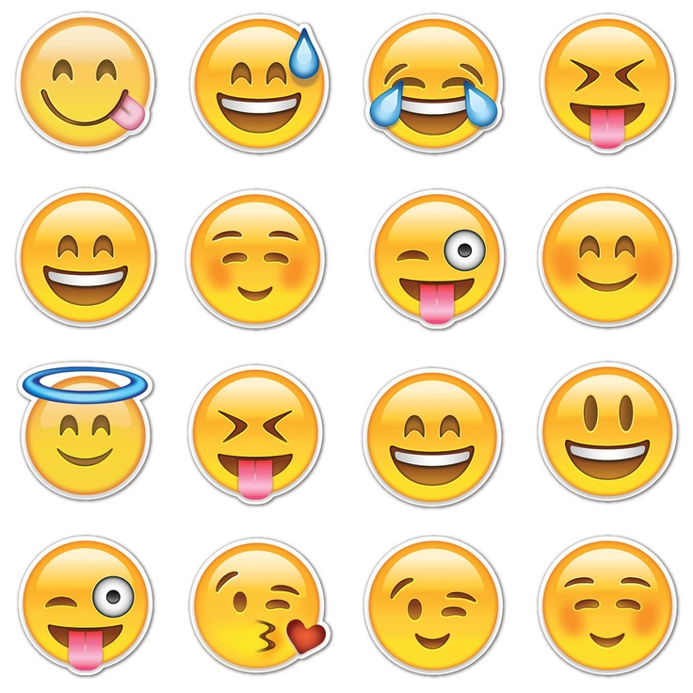
Language of Emojis
Choose an emoji face and provide 3 alternative meanings for it.
Advanced Linguistics

Slide 2
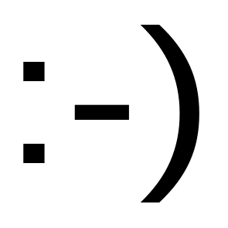
Emoticons
Definition: a pictorial representation of a facial expression using punctuation marks, numbers and letters to express a person’s feelings or mood
Etymology: blend of ‘emotion’ and ‘icon’
History: traced back to 1635 by a Slovak notary on his own town’s municipal financial records. Used first on the internet in 1982 in Pennsylvania, USA.

Slide 3
Emojis
Definition: ideograms (graphic symbol) and smileys (stylised representation of humanoid face) used in electronic messages and web pages
Etymology: stems from Japanese meaning pictogram (e = picture, moji = character)
History: originating on Japanese mobile phones in the late 1990s exacerbated by their international inclusion in iPhones followed by Android

Slide 4
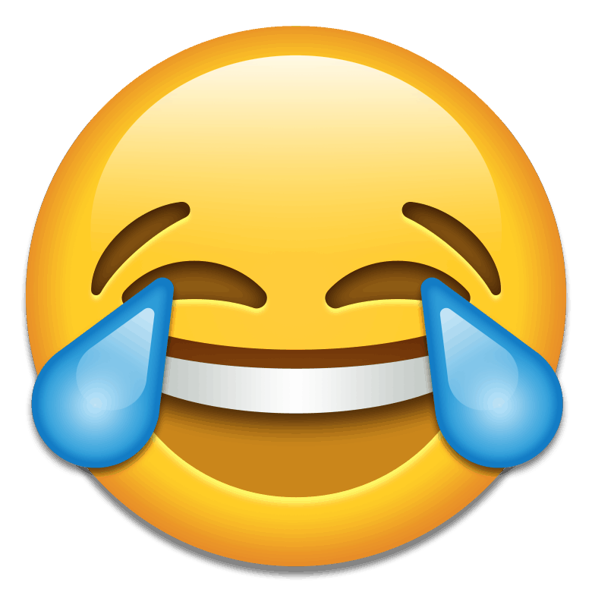
Cultural influence
Oxford Dictionaries named ‘Face with Tears of Joy’ emoji as its 2015 Word of the Year after recognising the impact of the word emoji on popular culture (reflecting ethos, mood and preoccupations of 2015). Do you agree that this emoji should have won word of the year?
Do you think emojis are a separate language or complement the English language? Task: Text your friend a question and your friend has to reply with at least 6 emojis for us to translate into English.
Do you think emojis are a force for good in enabling cross-cultural/linguistic communication or do you think it makes individuals using them lazier?
What attitudes do people have of emoji users? Are there certain types of emojis which are a no-go?
Notes:
http://blog.oxforddictionaries.com/2015/11/word-of-the-year-2015-emoji/

Slide 5
What is the future of emojis?
Are emojis required in order to express pragmatic understanding or can this be delivered through other forms?
To what extent are mobile phone companies restricting/expanding our vocabularies?
Task: Try to create a completely new emoji with a related meaning.

