Slide 1
Language of Different Occupations
Advanced Linguistics

Slide 2
Surfers:
‘excited’ – freaking, amped, buzzing, stoked, psyched, frothing
‘dream wave’ – gnarly, beast, choka, kick-ass, rad, harsh, smoking
Surfer types:
‘brah’ or ‘dude’ – a fellow surfer
‘barney’ or ‘kook’ – a complete beginner
‘gremmie/grommet/grom’ – a young and very inexperienced surfer
‘frube’ – a surfer who doesn’t catch a wave for the whole time they are in the water
‘paddle-puss’ – someone who stays in the whitewater close to the beach
‘Hellman’ – an extreme surfer of the big waves
‘shubie’ – someone who buys all the surf gear, including a board, but never actually goes in the water
‘blow-in’ – a non-local who moves in on other surfers’ territory
‘cluck’ – someone who is totally afraid of the waves
‘hotdogger’ – a cool and expert surfer
‘Melvin’ – a surfer whose shorts have ridden up the bottom very noticeably
‘waxhead’ – a real surfing enthusiast

Slide 3
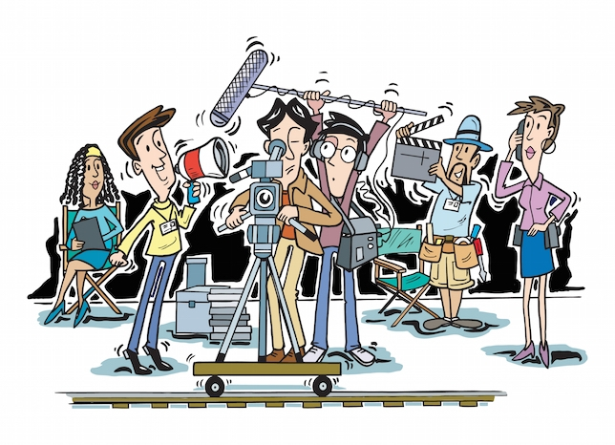
Film/TV Crew:
‘D-girls’ – ‘development girls’, an insulting title used for both men and women in the lower ranks of a film company or crew’
‘blow job’ – cleaning the camera lens with a blow of compressed air
‘four banger’ – a trailer with 4 dressing rooms (U.S.)
‘blondes, brunettes, brutes’ – different types of set lamps
‘bunny’ – the script from the rhyming slang: bunny (rabbit) + pork = talk
‘see you on the green’ – said by one actor to another before meeting on stage/set

Slide 4
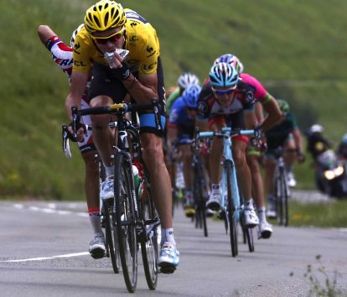
Cyclists:
‘weekend warriors’ or ‘Fred and Doris’ – cycling newbies, often identifiable by their blinking lights and abundance of water bottles, even if they are only out for 5K.
‘lube in a tube’ – lubricant to help the bike run smoothly
‘bonk’ – as with running, this is hitting the wall of cycling – a state of utter exhaustion.
‘brain bucket’ – a helmet
‘spuds’ – Shimano-branded cleated shoes, also known as SPDs.

Slide 5
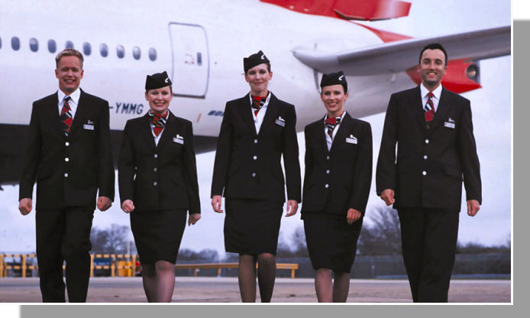
Cabin Crew:
‘flying mattresses/tarts with carts/sky hostesses’
‘slam-clicker’
‘coach roach’
‘crop-dusting’
‘mango’

