Slide 1
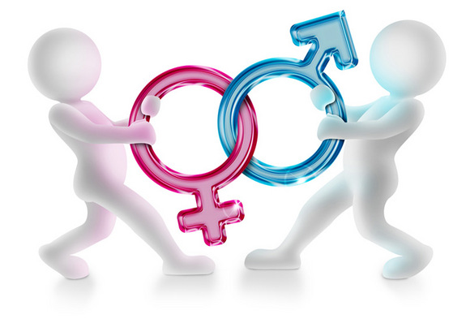
Language in the Media
An Introduction to Gender and Stereotypes

Slide 2
What is gender?
Gender: either of the two sexes (male and female), especially when considered with reference to social and cultural differences rather than biological ones. The term is also used more broadly to denote a range of identities that do not correspond to established ideas of male and female
Gender

Slide 3
What are gender stereotypes?
Stereotype - a widely held but fixed and oversimplified image or idea of a particular type of person or thing

Slide 4
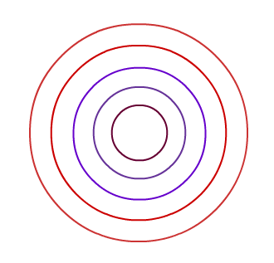
Degrees of Association: Lexical/Semantic Fields associated with Gender

Slide 5
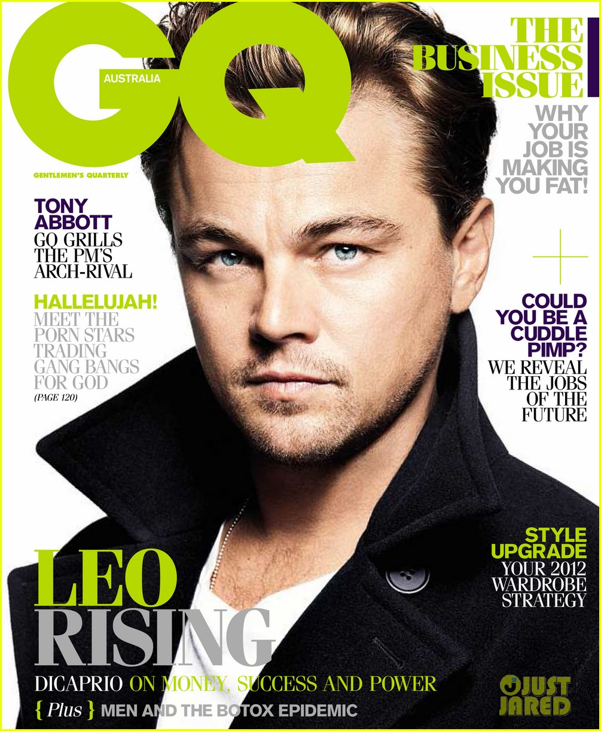
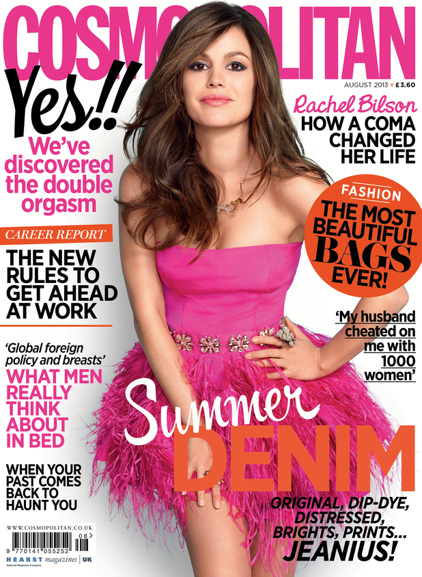
Men’s & Women’s Magazines

Slide 6
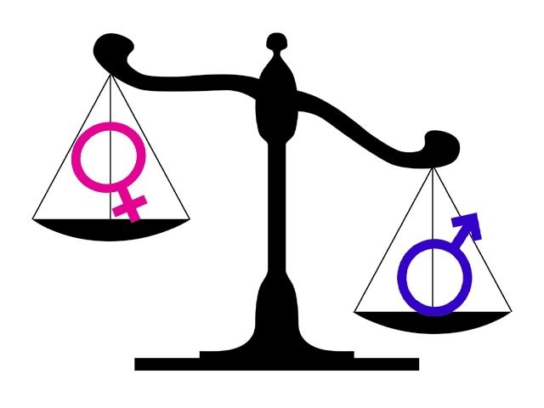
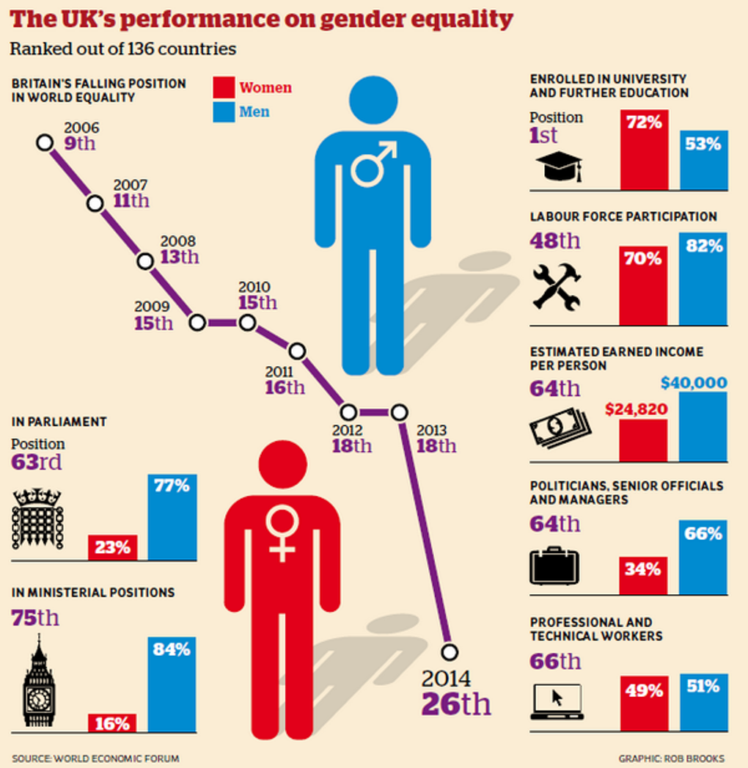
A few facts on gender inequality…
https://www.youtube.com/watch?v=IG5LyMYsvTs

Slide 7
Unmarked vs. Marked Forms
The unmarked form is considered the norm and is nearly always the male term e.g. actor.
The marked form is different to the norm and is nearly always the female term e.g. actress

Slide 8
Masculine Generic
The use of the generic masculine pronoun has been used to refer to all genders for centuries. This is especially the case in law where he/his/him/man refer to all genders. This is slowly being challenged by feminists with the use of the feminine generic (she/her/woman) or by gender neutral generic with the singular use of they/their/them.

Slide 9
Semantic Derogation
Negative connotations associated with overt marking of the female form (different to the male norm). Examples include master vs. mistress, bachelor vs. spinster, etc. Theorists who have studied semantic derogation include Schulz (1975), Cameron (1990) and Mills (1995). This is an example of lexical asymmetry.
Mills (1995): many of the female equivalents are marked as indicative of sexual promiscuity (‘courtesan’ and ‘adventuress’). Other pairs such as ‘lord’ and ‘lady’ have experienced dramatic shifts: whilst ‘lord’ still suggests high status, ‘lady’ is more widely used undergoing semantic deterioration shown in its use in terms such as ‘dinner lady’ but never ‘dinner lord’.
Consequently, through political correctness there has been a move towards gender-neutral terms such as headteacher to replace headmaster or headmistress.

Slide 10
Order of Precedence
In line with patriarchal patterns, in most circumstances the man/male comes before the woman/female. This can be found through the pairings man and woman, husband and wife, boys and girls. This is particularly the case when addressing a heterosexual married couple (Mr and Mrs J. Holmes) with the initial referring to the male’s first name.
In some cases, however, there is a rule of courtesy. When addressing a group of people, often the addresser will begin with Ladies and gentleman. Similarly in the family unit, children will often utter a reversed order of precedence when referring to their parents, Mum and Dad. This is mainly due to the mother usually being the primary care giver.

