Slide 1
Lexis and Semantics
Revisited

Slide 2
What is lexis?

Slide 3
What is lexis? Lexis = Form of Words
Etymology
Register
High and low frequency
Collocation
Morphology
Word Classes

Slide 4
What is Semantics?

Slide 5
What is Semantics? Semantics = meaning of words
Semantic fields
Figurative language
Connotations
Polysemy
Synonyms and antonyms
Hypernyms and hyponyms

Slide 6
Lexical cohesion
Lexical cohesion links words through meaning and association rather than grammatical structure
Repetition
Using the same word more than once can link separate sentences e.g. All we could see was rain. Anything would be better than rain.
Ideas can be linked by using synonyms rather than exactly the same word.
For example – He wandered slowly towards the building then ambled down the corridor before loitering outside the door.

Slide 7
Lexical Cohesion Cont...
Words that commonly appear together in lexical units are called collocations
All native speakers of English understand its collocations easily but non-native speakers might find them a bit bizarre. They are related by association rather than through any grammatically based rule.
Some words produce predictable collocations e.g. neat and tidy is never rearranged to tidy and neat
Collocations become well known phrases that are seen as normal and acceptable
They aren’t usually linked together by meaning only by familiar association
Collocations are cohesive because they’re recognisable patterns to the reader. If a word is paired with one that is doesn’t collocate with then the cohesion and fluency is lost

Slide 8
Grammatical cohesion
Reference
This involves third person pronouns (he, she, it they) and demonstrative pronouns (this, that)
An anaphoric reference refers back to something that has already been mentioned e.g. My grandmother went to university. She wanted to be a teacher. The word ‘she’ is cohesive as it links back to the ‘grandmother’.
Cataphoric references is when a forward reference is made to something that will be mentioned in the future (following sentences)
An exophoric reference is one made to something outside of the text. It refers to something in the immediate, present context of the utterance e.g. that tree over there

Slide 9
Grammatical cohesion cont...
Identification
This is when determiners such as the, this and that are used to show that a noun has already been mentioned e.g. A large lorry blocked the road. The lorry had broken down.
Ellipsis
When words are left out of a sentence
Its still cohesive if the earlier part of the text enables the reader to supply the missing information
Conjunctions
Conjunctions are linking words such as and, but, also and because. They can be used to link together parts of the text to show a relationship between the two
Adverbs
These connect clauses by referencing space and time e.g. we’re leaving for London tomorrow, before the traffic gets bad

Slide 10
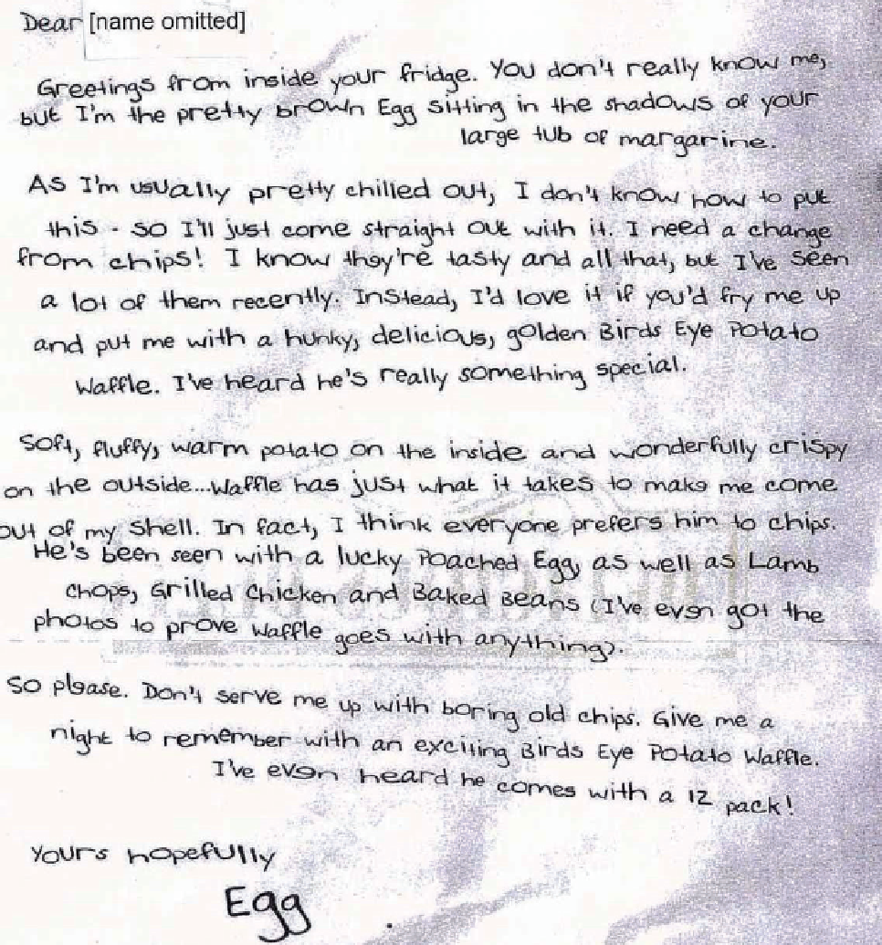
Find cohesion in this text...
Lexical or g

