Slide 1
End of Term
As we don't know what next...

Slide 2
What do you make of this sentence?
Woman without her man is nothing

Slide 3
How about now?
Woman: without her, man is nothing!

Slide 4
Punctuate this, twice (once as a love letter, once as a rejection letter)
Dear Jack I want a man who knows what love is all about you are generous kind thoughtful people who are not like you admit to being useless and inferior you have ruined me for other men I yearn for you I have no feelings whatsoever when we’re apart I can be forever happy will you let me be yours Jill

Slide 5
Love Letter
Dear Jack, I want a man who knows what love is all about. You are generous, kind, thoughtful. People who are not like you admit to being useless and inferior. You have ruined me for other men. I yearn for you. I have no feelings whatsoever when we’re apart. I can be forever happy. Will you let me be yours? Jill

Slide 6
Rejection letter
Dear Jack, I want a man who knows what love is. All about you are generous, kind, thoughtful people who are not like you. Admit to being useless and inferior. You have ruined me. For other men I yearn! For you I have no feelings whatsoever. When we’re apart I can be forever happy. Will you let me be? Yours, Jill

Slide 7
What about punctuating this to make it make sense?
James although the teacher had had had had had had had had had had had favour with the teacher.

Slide 8
The answer...
James, although the teacher had had 'had had', had had 'had'. 'Had had' had had favour with the teacher.

Slide 9
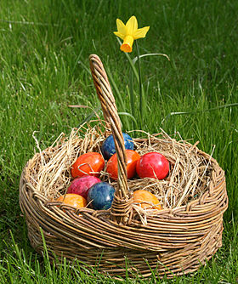
Easter
At this time of uncertainty:
Look after yourselves
Take time to do other things
Stay in touch with each other
Volunteer/work
Spend time with your family
Avoid the news (apart from on exams, maybe...)
And do some gentle revision...

