Slide 1
Grammar
Language Under the Microscope

Slide 2
Eight word classes

Slide 3
Noun types and examples

Slide 4
Verb types and examples

Slide 5
Adjective types and examples
Activity
Pick out the head noun in these examples. How is it premodified and/or postmodified?
The big, beautiful bus.
a black dog with a brown collar
the prime minister, Gordon Brown
the man who thought his wife was a hat
castles in the air
[An immaculate three-bedroom terraced property with full gas-fired central heating] is on [the market] through [this estate agency]. The ground floor accommodation briefly comprises a charming bay-windowed lounge, containing a superb late Victorian slate feature fireplace with a living flame gas fire; a separate dining-room with fitted radiation gas fire; a well-fitted offshot kitchen containing high-quality fitted hygena units, Worcester Heatslave gas-fired combination boiler and plumbing for an automatic washer.

Slide 6
Adverb types and examples
McEnroe scowls angrily at the umpire. He certainly didn’t like that call. Still, he’s keeping his temper today, and that’s the main thing. He serves again now, ferociously – into the net. Connors bounces up and down a couple of times and swipes an imaginary ball into the sky. Second service. A better serve this time, makes Connors leap sideways, but he sends a marvellous return across the court and McEnroe can’t reach it. Connors handled that very coolly and with real power.

Slide 7
And the rest...
Activity
Replace nouns with pronouns as appropriate in the following sentences:
Ruth smiled so I smiled back at Ruth.
A man burst in. The man was very angry.
Paul took Rover and Rex for a walk. Once in the park, Paul let Rover and Rex off Rover and Rex's leads.
She took the box and opened the box

Slide 8
1a
What features could you look for?

Slide 9
Syntax – what are the sentence types?

Slide 10
Rhetoric – what schemes do you remember?

Slide 11
Clauses – what do you remember?
Say why you think the passive voice might have been chosen for each of the following sentences ...
Their house was broken into last night, but nothing was taken.
He was treated for laryngitis.
The solutions were mixed in the test-tube.
Mobile phones must be turned off at all times. ... and why the active voice might have been chosen for these:
That afternoon, Sarah made Mummy a lovely birthday-card.
Bush has kept the forces in Iraq for far too long.
You have got to put more effort into your work.
The cat sat on the mat.

Slide 12
1b
Recap features to look for...

Slide 13
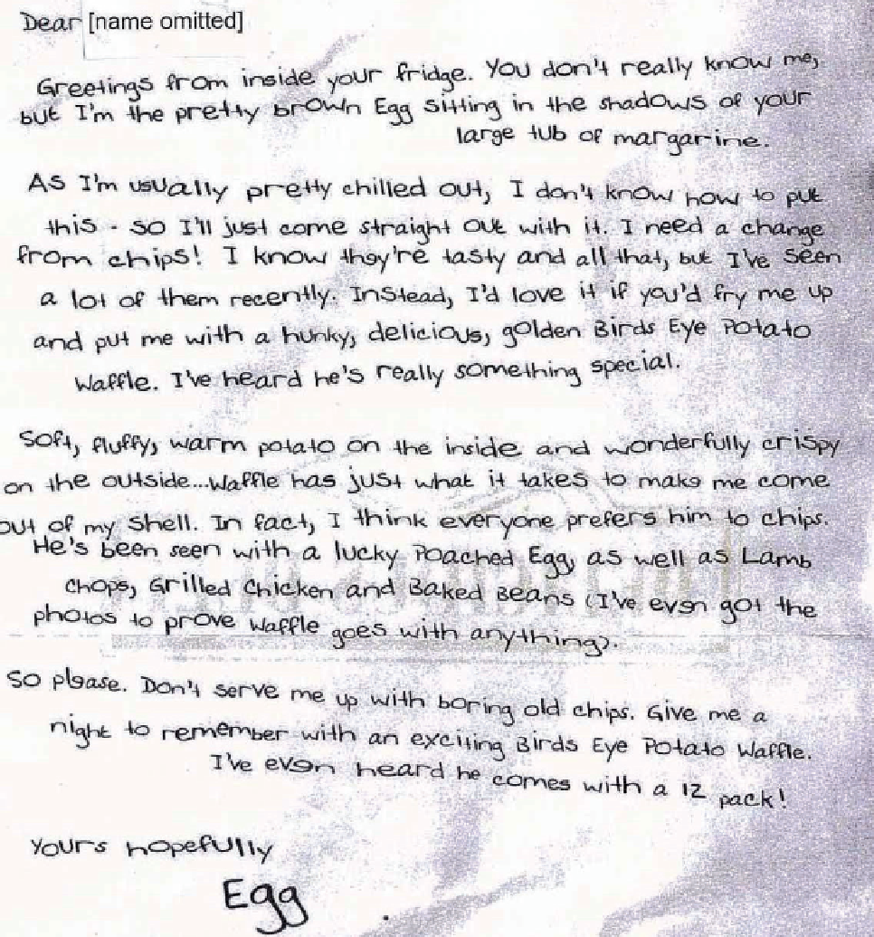
Plan and write up answers on this text...
3 points for 1a, 3 for 1b...

Slide 14
What's interesting for 1b?
Some minor and simple sentences – Ben, Lilly, Luke
Some compound and complex sentences – Ellen, Elliyah, Amelia
Imperatives at the end – Oscar, Jacob
Exclamatives – Kira, Phoebe
'You' to 'I' and then to 'he' in the subject position – Becky, Luke
Write a perfect point on why the producer used it and what effect it has on the audience. Be precise and weigh up the effect of context.
Compare against your partners.
Highlight the best one...

Slide 15
Try the same with the 'nit-free comb' text
Just do 1b...

