Slide 1
AS Speaking exam
2017

Slide 2
2 AS French themes and sub-themes
1. Aspects of French-speaking society: current trends
• The changing nature of family
• The 'cyber-society'
• The place of voluntary work
2. Artistic culture in the French-speaking world
• A culture proud of its heritage
• Contemporary francophone music
• Cinema: the 7th art form

Slide 3
Theme 1:Aspects of French-speaking society: current trends
• La famille en voie de changement
• Grands-parents, parents et enfants – soucis et problèmes
• Monoparentalité, homoparentalité, familles recomposées
• La vie de couple – nouvelles tendances
• La « cyber-société »
• Qui sont les cybernautes?
• Comment la technologie facilite la vie quotidienne ?
• Quels dangers la « cyber-société » pose-t-elle ?
• Le rôle du bénévolat
• Qui sont et que font les bénévolés?
• Le bénévolat – quelle valeur pour ceux qui sont aidés ?
• Le bénévolat – quelle valeur pour ceux qui aident ?

Slide 4
Theme 2: Artistic culture in the French-speaking world
• Une culture fière de son patrimoine culturel
• Le patrimoine sur le plan national, régional at local
• Comment le patrimoine reflète la culture
• Le patrimoine et le tourisme
• La musique francophone contemporaine
• La diversité de la musique francophone contemporaine
• Qui écoute et apprécie cette musique ?
• Comment sauvegarder cette musique ?
• Cinéma – le septième art
• Pourquoi le septième art ?
• Le cinéma – une passion nationale ?
• Evolution du cinéma – les grandes lignes

Slide 5
AS Paper 3: Speaking - 60 marks
• 12-14 minutes plus 15 minutes preparation.
Two stimulus cards 6-7 minutes each.
Preparation time in a separate room.
You make notes during the preparation period.
You will be given two pairs of stimulus cards and you must choose one from each pair, on different sub-themes.
• You must ask one question to the examiner, based on each
stimulus card discussed. It should demonstrate understanding of the card.

Slide 6
2 AS French themes and sub-themes
1. Aspects of French-speaking society: current trends
• The changing nature of family
• The 'cyber-society'
• The place of voluntary work
2. Artistic culture in the French-speaking world
• A culture proud of its heritage
• Contemporary francophone music
• Cinema: the 7th art form
2 cards from one sub-theme – you choose 1
2 cards from 2 sub-themes of the other theme - you choose 1

Slide 7
Theme 1:Aspects of French-speaking society: current trends
2 cards from one sub-theme – you choose 1
La famille en voie de changement
• Grands-parents, parents et enfants – soucis et problèmes
• Monoparentalité, homoparentalité, familles recomposées
• La vie de couple – nouvelles tendances
La « cyber-société »
• Qui sont les cybernautes?
• Comment la technologie facilite la vie quotidienne ?
• Quels dangers la « cyber-société » pose-t-elle ?
Le rôle du bénévolat
• Qui sont et que font les bénévolés?
• Le bénévolat – quelle valeur pour ceux qui sont aidés ?
• Le bénévolat – quelle valeur pour ceux qui aident ?

Slide 8
Theme 2: Artistic culture in the French-speaking world
2 cards from 2 sub-themes of the other theme
• Une culture fière de son patrimoine culturel
• Le patrimoine sur le plan national, régional at local
• Comment le patrimoine reflète la culture
• Le patrimoine et le tourisme
• La musique francophone contemporaine
• La diversité de la musique francophone contemporaine
• Qui écoute et apprécie cette musique ?
• Comment sauvegarder cette musique ?
• Cinéma – le septième art
• Pourquoi le septième art ?
• Le cinéma – une passion nationale ?
• Evolution du cinéma – les grandes lignes

Slide 9
Part 1 Discussion of first sub-theme
The discussion of this second sub-theme must last 6-7 minutes.
You may refer during the discussion to any notes made during the preparation period.
The examiner will ask you the printed questions which appear on the cards which you have selected.
The examiner will ask follow-up questions between the printed questions.

Slide 10
A question
You are advised on the front of the card to consider during your preparation time a question which arises from the material and to ask the examiner this question at an appropriate point during the discussion.
If you do not ask a question, the examiner will invite you to do so before the end of the discussion.
To meet the requirement to ask a question, you must seek information or opinion.
The examiner will give a brief response to the student’s question so as not to have a significant effect on the time available for you to demonstrate your knowledge and skills.
The examiner will then ask further questions relating to the sub-theme.

Slide 11
Part 2 Discussion of second sub-theme
Same again for your next card.

Slide 16
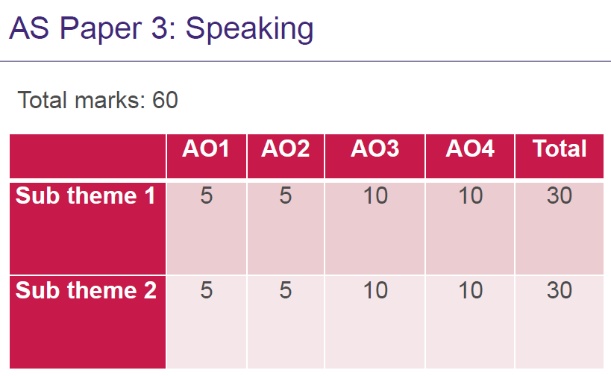

Slide 17
Errors?
Minor errors include:
incorrect genders and consequential errors of agreement
Serious errors include:
incorrect verb forms especially irregular forms
incorrect use of pronouns
missing or incorrect agreements of adjectives or past participles
Complex language includes:
use of pronouns of all types
tenses that support conceptual complexity (as in si sentences)
connectives supporting a range of subordinate clauses including those requiring subjunctive
constructions with verbs and verbs followed by infinitive with correct preposition
use of present and past participles.

Slide 18
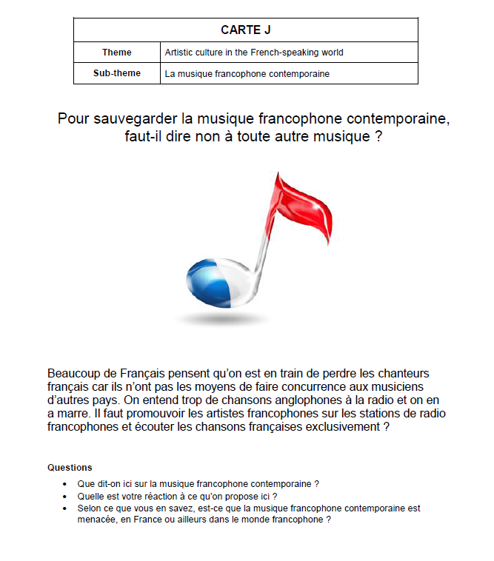

Slide 21
Your question?

Slide 22
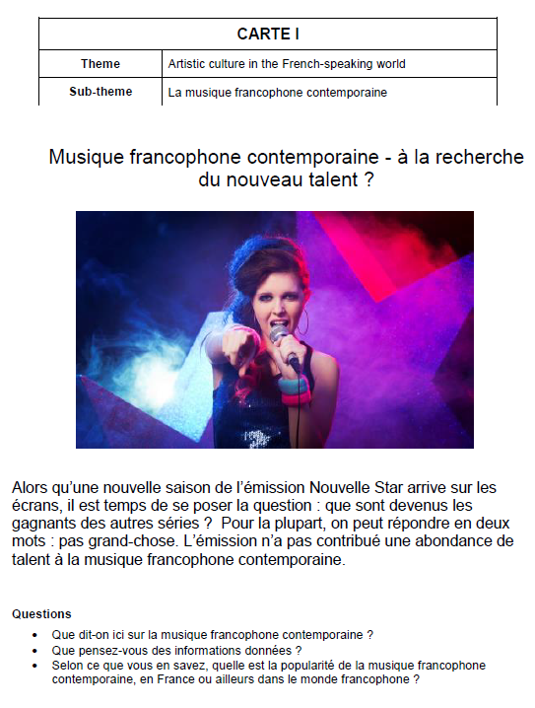

Slide 25
Your question?

